Slide 1
“impractical things endure and retain their vitality
for thousands of years,
whereas necessary, practical things survive only briefly”
Kasimir Malevich, manifesto of Suprematism
Serguei Brazovskii
CNRS & University Paris-Sud, Orsay, France
Physics of cooperative electronic states
in low-dimensional systems.

Slide 2
Lecture 1. Low dimensional electronic systems: organic crystals, chain- and layered compounds, interfaces, conducting polymers.
Symmetry broken ground states: charge- spin- and bond density waves; Wigner crystal; charge ordering; electronic ferroelectricity; Mott, Peierls and excitonic insulators.
Lecture 2. Excitations and carriers in correlated electronic systems: excitons, polarons, solitons, phasons.
Lecture 3. Electronic ferroelectricity: from realities of organic conductors to perspectives of conjugated polymers.
The related physics of solitons and domain walls.
Lecture 4. Theory elements for correlated electronic systems in one and two dimensions.
Lecture 5. Dynamical phase transitions in cooperative electronic systems induced by fast optical pumping or voltage pulses.
Lecture 6. Story of field-induced rising of the superconductivity or distraction of the insulating state. Transformations of collective electronic states under the electric field or the current.

Slide 3
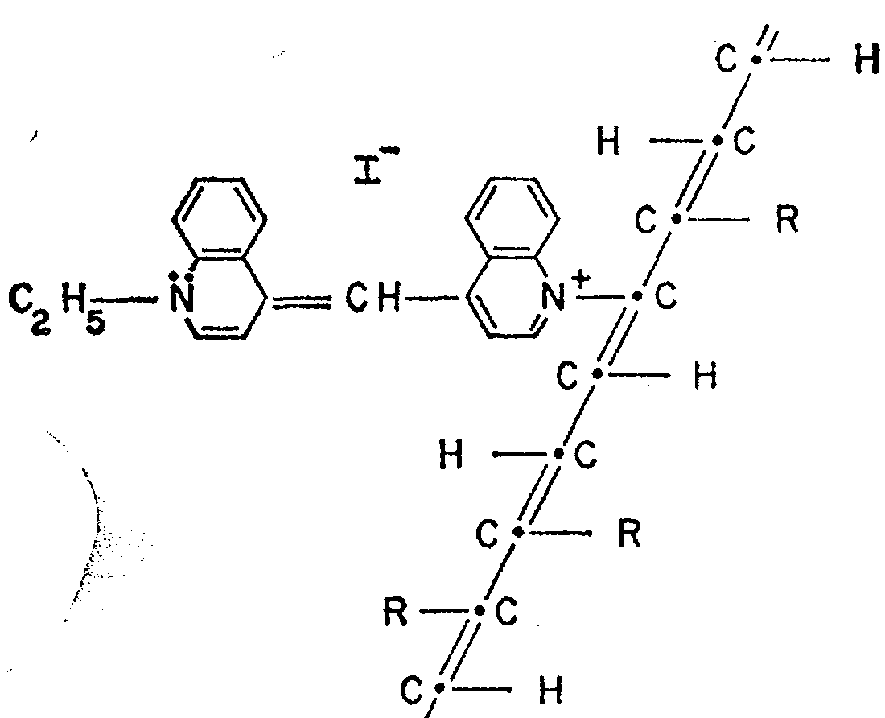
« In the beginning was the Word, …
and without him was not anything made that was made »
Physical Review 1964 & Scientific American 1965
W.A. Little , Stanford University
Possibility of a synthesizing an organic superconductor.
Superconductivity at room temperature.
It has not yet been achieved, but … it is possible to synthesize organic materials that … conduct electricity without resistance.
Little drawing: conjugated polymer -
the polyene backbone with ligands R
Superconductivity: Tc ~ ħω_{ph} exp(-1/λ)
λ –coupling of electrons to vibrations
with a frequency ω_{ph}~1/ M^{1/2}

Slide 4
New directions of material science initiated by the quest for HTSC:
Inorganic world of d-electrons
Inorganic chains/planes like MX3/MX2
(M=Nb, Ta, Ti, Mo; X=S, Se, Te),
Pt chain compounds, surface structures of adsorbed atoms
The carbon world of pi-conjugated systems:
Organic conducting crystals
Molecular crystals with a charge transfer
Conjugated polymers
Graphite (intercolated)
Fullerenes (pen&Sun born), nano-tubes, graphene
New states or their new realizations found in search for HTSC:
conductors, superconductors, magnetics, ferroelectrics,
charge ordered states, charge/spin density waves and their special versions in high magnetic fields,
optically and electronically active polymers

Slide 5
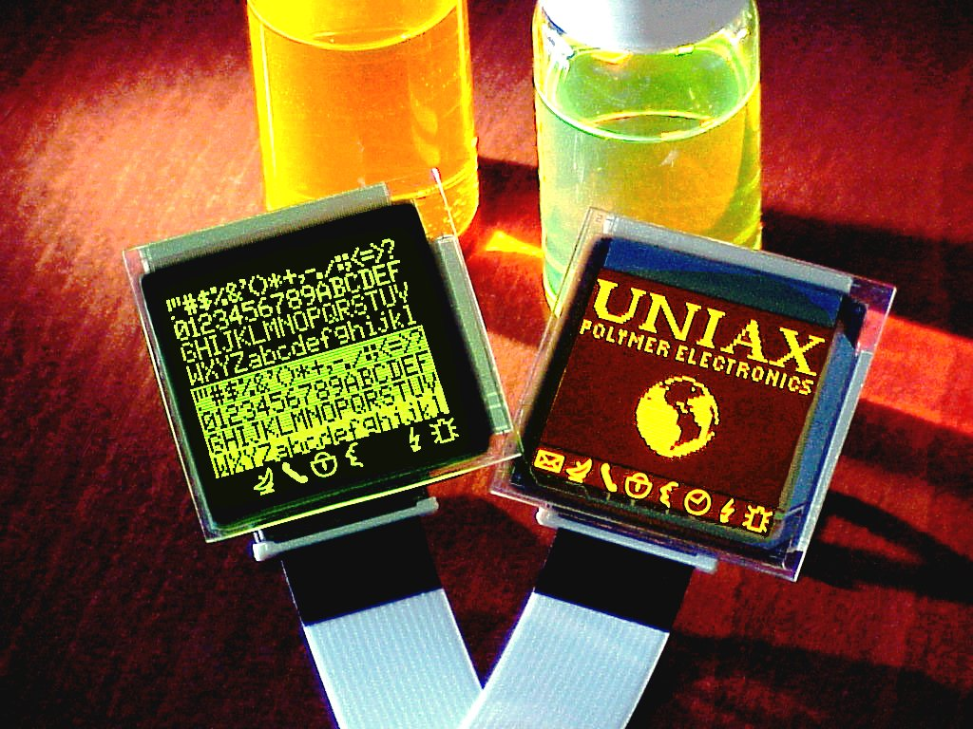
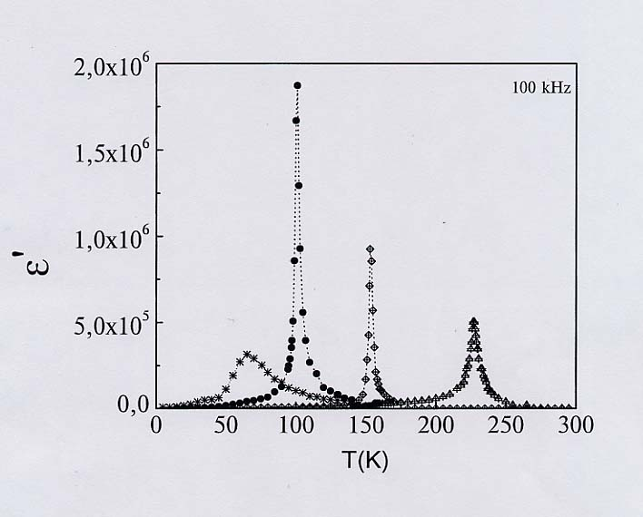
Ready or promising for applications:
Polymers for Light Emitting
or Harvesting Organic Ferroelectrics
AsF₆
SbF₆
ReO₄
PF₆
New targets: Optical, Voltage, and STM switching
in layered electronic crystals (TaS2)
Ljubljana-Slovenia, POSTECH, U. of Tokyo

Slide 6
Synthetic metals first contributors
Organic Crystals
Superconductivity
D. Jérome,
K. Bechgaard.
(quasi 1D)
E. Yagubskii et al,
T. Ishiguro,
H. Saito,
K. Murata et al
(quasi-2D)
Inorganic chain
Quasi 1D – 2D
Charge and Spin
density waves
T. Sambongi,
R.Comes,
P. Monceau
Conducting polymers
Quasi 1D
A. J. Heeger,
A. MacDiarmid
H. Shirakawa,
Y.W. Park,
R. Friend
Fullerenes
1985
Smalley, Curl
& Kroto
Nanotubes
big bang since 1993
Sumio Iijima,
D.S. Bethune

Slide 7
All Dimensionalities from Carbon
0D quantum dots – C₆₀
1D quantum wires – carbon nanotubes
1D polymeric chains
2D layer - graphene
2D layered material - graphite
3D wide gap semicond. - diamond
Notes:
Four perfect crystalline forms of carbon: diamond, graphite, C₆₀, and a short length
of a (10,10) fullerene nanotube showing the hemi-C₂₄₀ end cap.

Slide 8
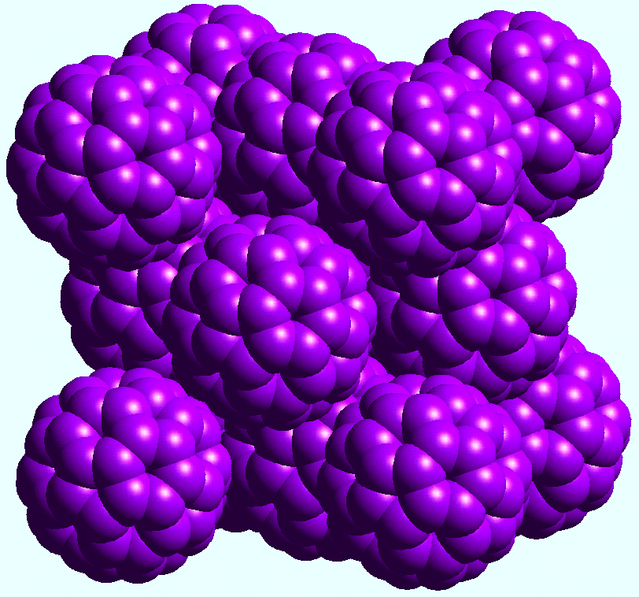
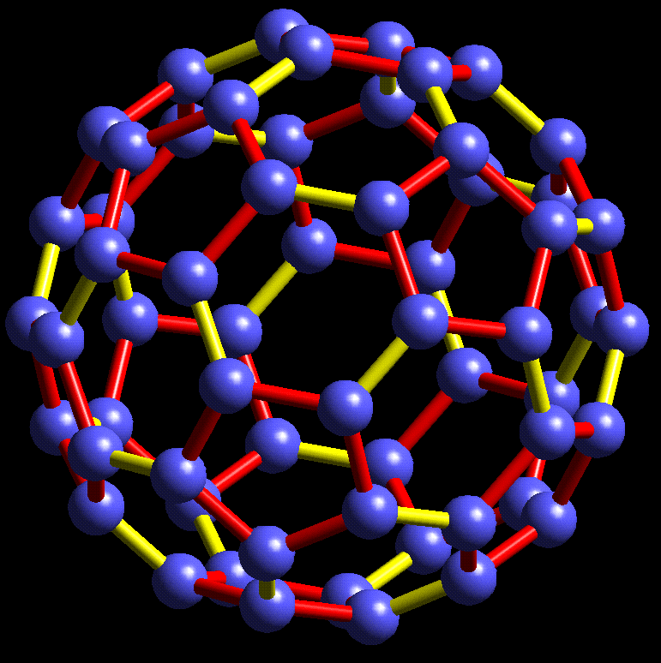
Zero dimensional:
Fullerene (C₆₀) –socker ball
  Cage diameter - 0.71 nm
  Optical gap – 1.9 V
Crystalline undoped Fullerene
fcc structure

Slide 9
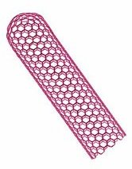
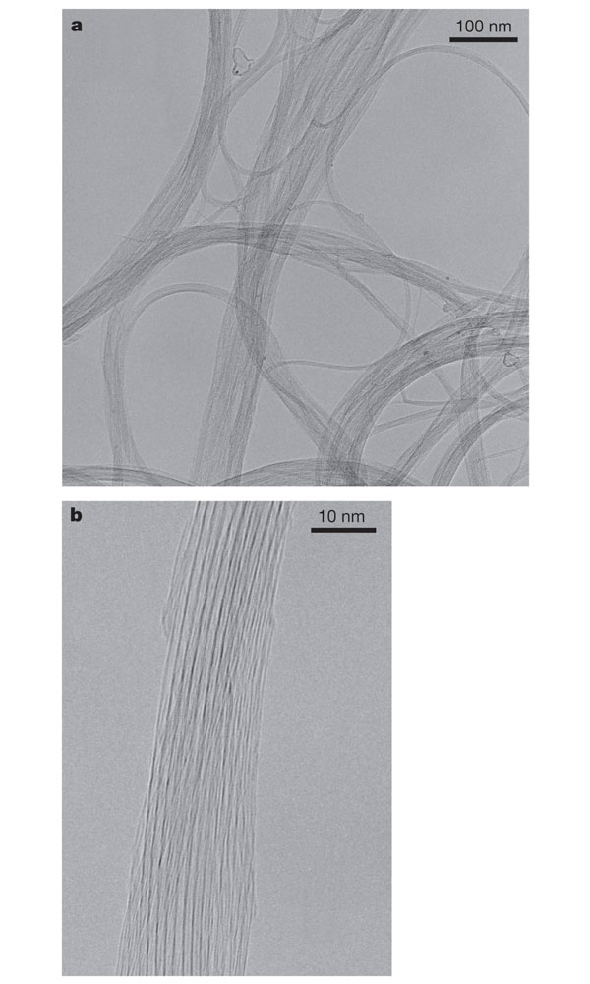
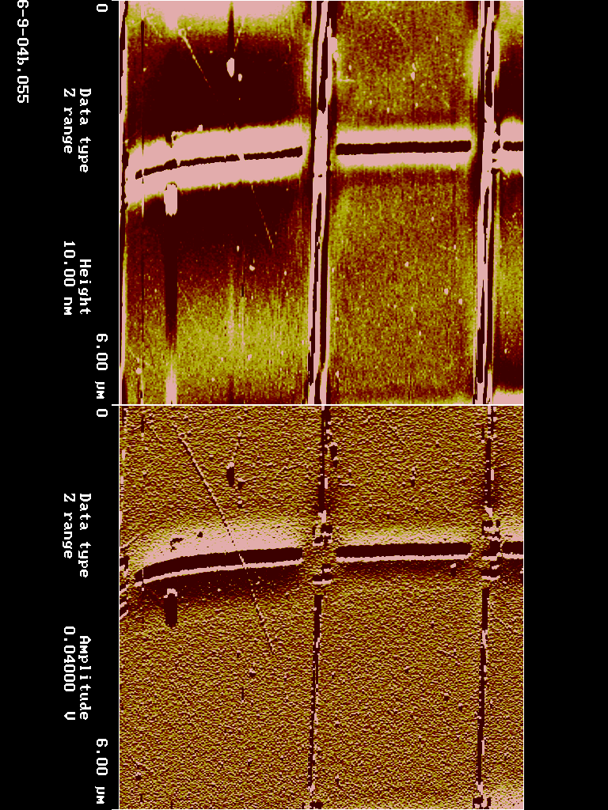
One dimensional:
Carbon nanotubes (CNT)
Carbyne –
linear polymer chain of C atoms
Young modulus
Diamond 1.22×10³ Gpa
CNT 10³ GPa
Carbyne 5×10⁴GPa
(40 times of diamond)
Multi-wall 1991
Single-wall 1993
CNT can be a very good conductor,
thin (1nm) and resistant
1nm
AFM image

Slide 10
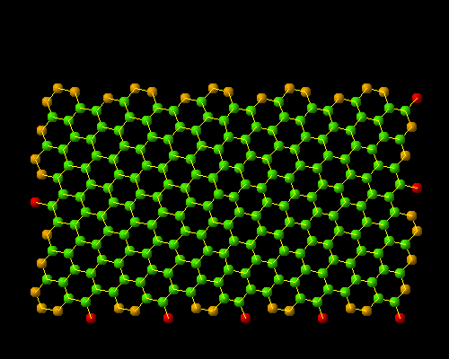
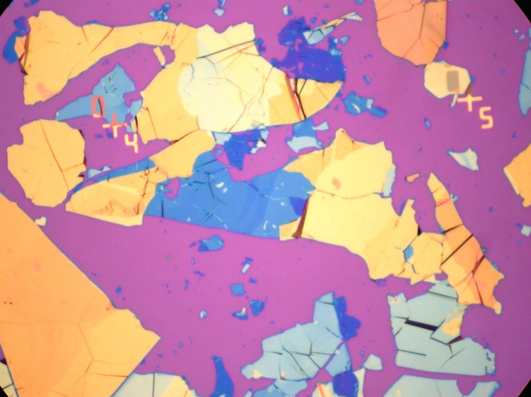
Two dimensional - graphene
Basic block – benzene ring

Slide 11
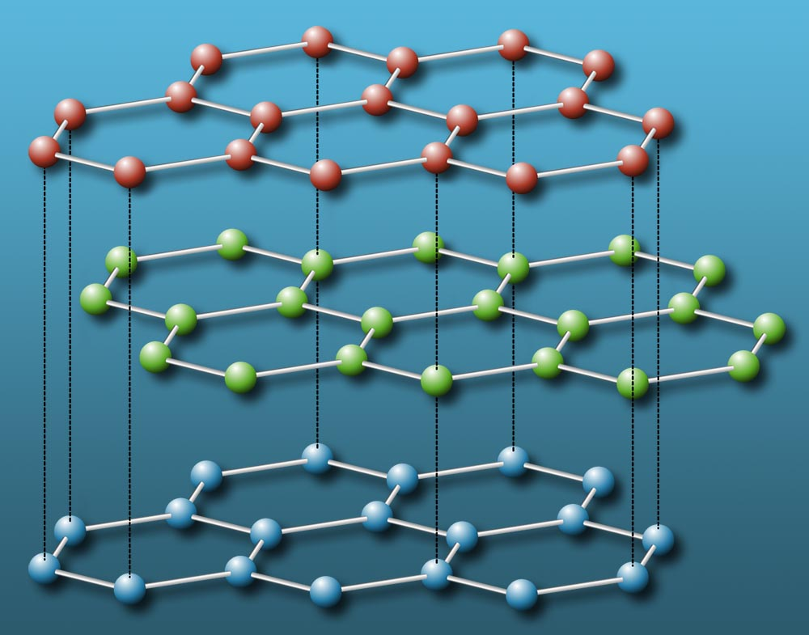
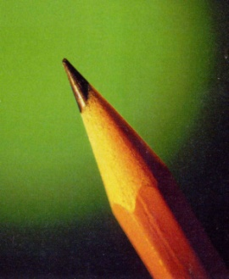
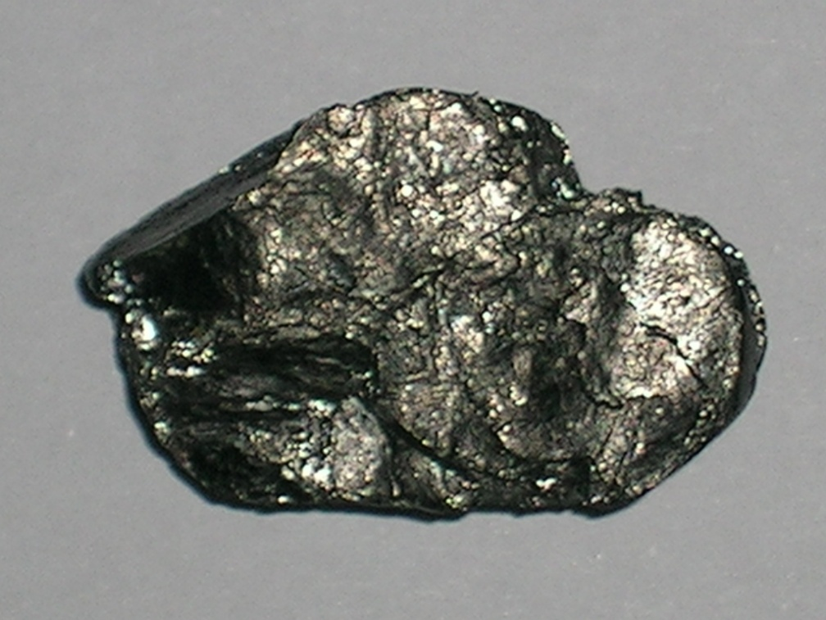
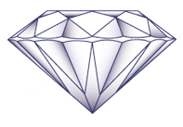
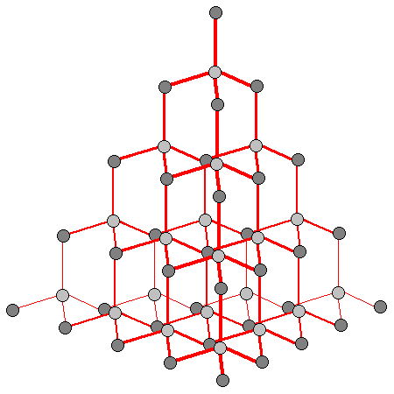
Layered = quasi-2D graphite:
Pristine semi-metal;
Reversible intercalation: electrode in Lithium-ion bataries
Intercolated conductor, up to superconductivity as C₆S
3D form: the diamond

Slide 12
Q. Where such versiality comes from?
A. Hybridization of the orbitals.
Q. Why do we need the hybridization?
A. It diminishes the kinetic energy (ΔxΔp~)
Q. What does it mean the hybridization?
A. See next slides.

Slide 13
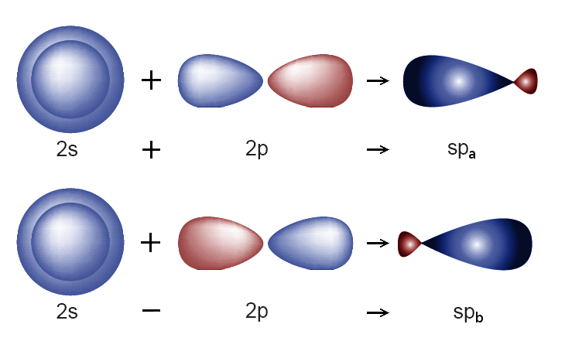
Carbon: Hybridized Orbitals
There are four valence electrons.
In the ground state valence is 2 (rem. CO).
But electron can easy come from 2s² to 2p², now the valence is 4 (rem. CO₂).
2p²
2s²
1s²
The 2s and 2p wave functions can mix forming hybridized orbitals.

Slide 14
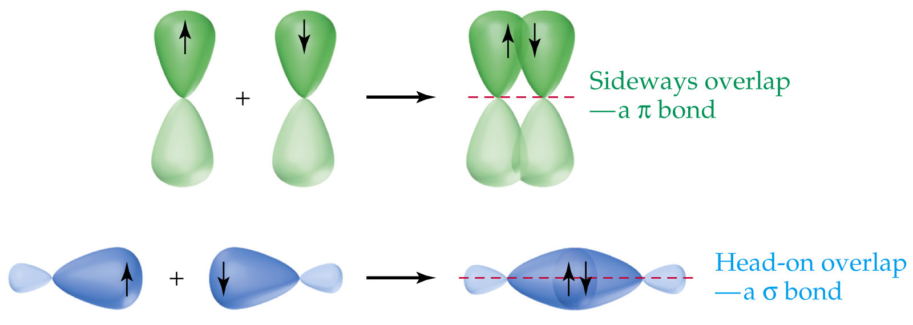
π and σ bonds
Two side-to-side 2p orbitals form a π bond.
Two co-axial 2p orbitals form the σ bond.

Slide 15
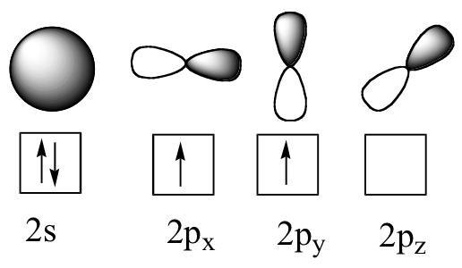
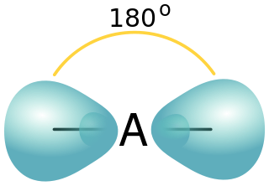
Three possible types of mixing
I. SP hybridization
Carbyne – linear polymer

Slide 16
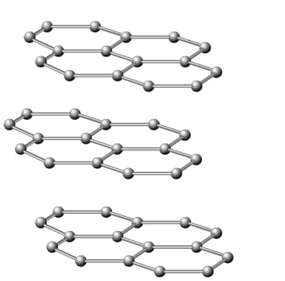
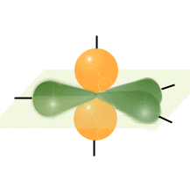
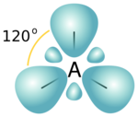
II. SP2 hybridization
Graphite
SP2

Slide 17
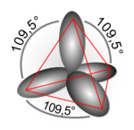
III. SP3 hybridization
Diamond

Slide 18
Saturated polymers – traditional plastics
SP3
Polyethylene (CH₂)_{x} – saturated polymer with all saturated σ - bonds, all electrons form the chain sceleton
H
H
H
H
H
H
C
C
C
C
C
C
H
H
H
H
H
H
SP2
Conjugated polymers: linear chains, phenyl based, etc

Slide 19
Electronic structures of conjugated carbon-based systems
Core electrons lying deeply in energy.
σ electrons from the valent sp3 shell of the carbon, their orbitals are directed in the backbone plane and localized between two adjacent atoms.
π electrons, from the top sp3 shell , their orbitals are directed perpendicularly to the backbone plane, hence delocalized over an array of atoms, hence the term “π− conjugation”.

Slide 20
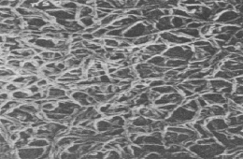
Heeger, MacDiarmid and Shirakawa
Nobel Prize in chemistry 2000
« for the discovery and development of electrically conducting polymers ».
Inside these noodles: poly-crystals of trans-(CH)_{x}
Made conducting under a heavy doping (Y.W. Park)

Slide 21
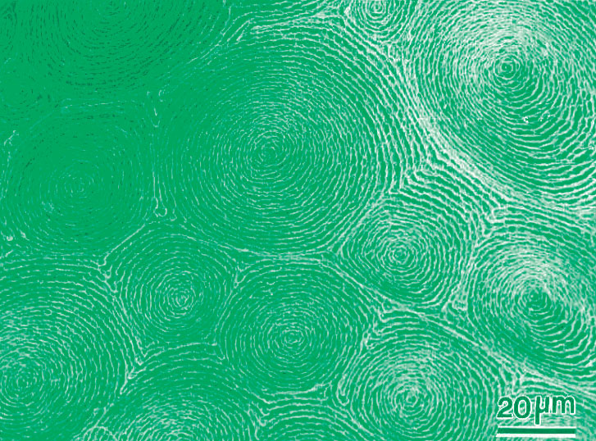
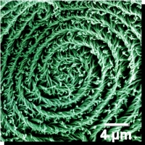
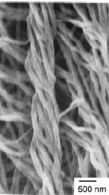
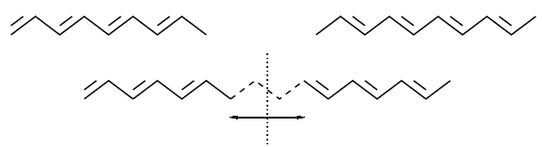
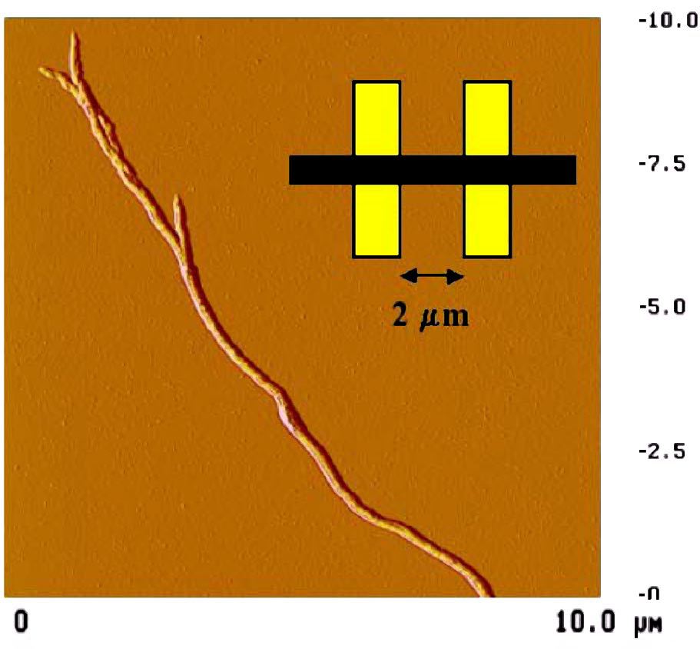
Helicoidal polyacethelene (K.Akagi, Kyoto) - multi-scale material:
cells -> spirals -> threads -> crystalline fibers -> polymer chains
-> π-electrons -> Peierls-dimerization -> solitons -> confinement

Slide 22
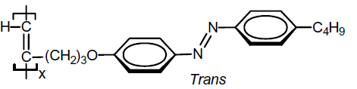
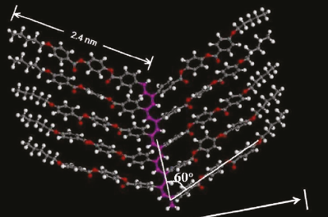
Substituted polyacetylenes - Today’s great variety:
chemistry is centered in Kyoto, Hong Kong, Beijing,
Semiconductor, excitons,
light emission, even Lasing !

Slide 23
Unique conjugated polymes: polyacetylene
Dream: the metal
Reality: narrow gap insulator
H
H
H
C
C
C
C
C
H
H
Peierls effect - one dimentional chain of equidistant atoms is unstable with respect to the dimerisation: Spontaneus symmetry braking results in the dielectric state, the gap is open
E
E
Δ∝Wexp(-1/λ)
ε_{F}
-k_{F}
k_{F}
-k_{F}
k_{F}

Slide 24
Cyclobutane C₄H₄
4 carbon atoms – 4 π-electrons
Instability
square --> rectangle
Jahn-Teller --> Peierls
Wave functions:
Ψ₁=cos 0•n=cnst
Ψ₂=cos(πn/2)
Ψ₃=sin(πn/2)
Ψ₄=cos πn=(-1)^{n}
Half filled doubly degenerate level 2,3
gain electronic energy -2Δ
loose deformation energy
Similar story in doped Fullerenes

Slide 25
Isolated benzene ring
H H
C C
H C C H
C C
H H
Degenerate level is completely filled –
no gain from reducing the hexagon symmetry.
We only loose the deformation energy
N=8 – again the instability, like for N=4:
what is next, and at large N ?

Slide 26
Peierls model - deformable lattice
Main interactions : electron – phonon coupling (electron-electron repulsions are small)
Ground state: W = W_{el} + W_{lat}
W
-Δ₀
Δ₀
symmetry Δ→-Δ
Δ

Slide 27
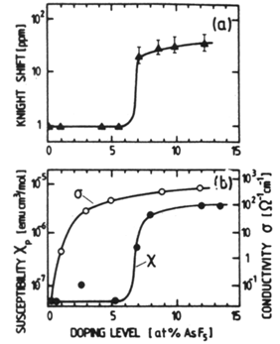
Doped polyacetylene (Y.W. Park):
Two steps to become a metal,
First hint to existence of solitons
conductivity σ and magnetic susceptibility χ
The major puzzle:
spins appear at much higher doping than the metallic conductivity:
the whole interval of conduction by spinless – unlike electrons – particles.
That and many other propertiese showing up in NMR, ESR, optics
have brought the solitons to the sight of experiments

Slide 28
Organic crystalline conductors in Japan.
Highest current activity in the world.
Wide geography: Sapporo, Tohoku, Tokyo, Okayama, Okazaki, Osaka, Kyoto, +
Tokyo area alone (and incomplete !):
NMR methods in Gakushuin (T. Takahashi) and Tokyo (K. Kanoda) Univ.,
Phase diagram experiment and theory
(U. of Tokyo – S. Kagoshima, RIKEN – H.Seo)
Ferroelectricity (U. Tokyo and RIKEN – Y.Tokura gr., Kashiwa – H. Okamoto)
Unique properties in high magnetic fields – T. Osada, ISSP, Kashiwa
Leading edge ultrafast optics – H. Okamoto - Kashiwa, S. Iwai - Tohoku
Applied R&D: R. Kato at RIKEN, Yamomoto @ Okazaki,
Y. Furukawa at Waseda U., + much more

Slide 30
The organic conductor TTF-TCNQ
k_{F}
F. Zwick et al, PRL (1998)
ARPES result: conventional Quasi-1D material with two open
Fermi surfaces originated by two stacks.
But other data: TTF at least is the strongest correlated conductor
of the whole family.

Slide 32
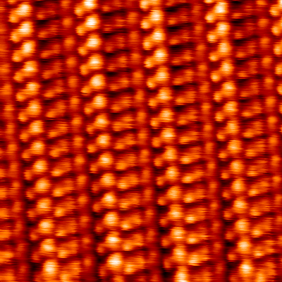
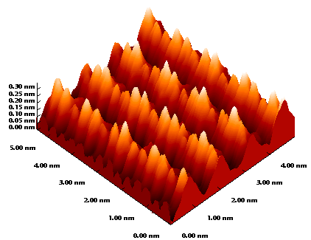
CDW at 35.6K
STM on TTF-TCNQ, Z.-Z. Wang, France
TTF⁺
TCNQ⁻
at T = 63K –
no modulation

Slide 33
S. Kagoshima
et al. (1976)
T>T_{c} – "Diffuse X-ray scattering" measures local
structural correlation without the long range order,
T<T_{c} – bright Bragg spots will appear only below T_{c}.
Lines are in the inter-chain direction:
no dependence on K - no correlation among chains.
2K_{f} appear at lower T but condense into true Braggs.
4K_{f} lines exist since the RT but never condense,
4K_{f} CDW = Wigner crystal ever coexists
with both metallic and CDW phases.
J. P. Pouget et al. (1976)

Slide 34
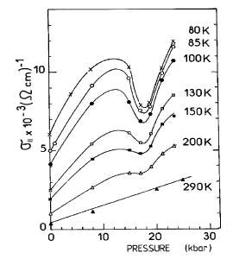
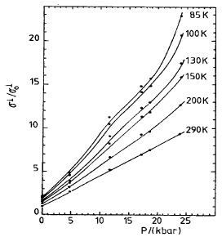
Charge Transfer Change at High Pressure D. Jerome
1:3 commensurability locking and its consequences.
Collective nature of
on-chain transport
versus
single-particle nature
of inter-chain transport
On-chain conductivity
drops at the 3:1 lock-in
Inter-chain conductivity
does not feel the lock-in

Slide 35
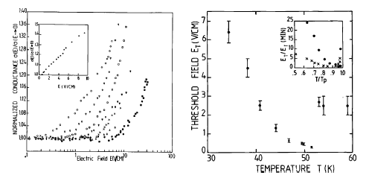
Message from/to another world: incommensurate CDWs.
Key word - sliding vs pinning.
Collective nature of the on-chain conduction in TTF-TCNQ is seen from
the nonlinear I-V which are setup below T_{c} for the 2K_{f} CDW

Slide 36
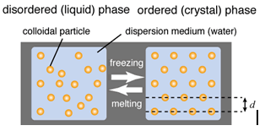
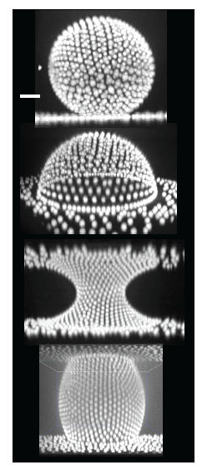
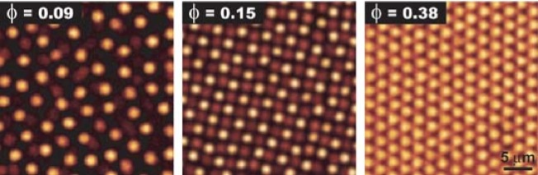

Schematic illustration of liquid and crystal states of charged colloidal dispersion.
particle charge of typically 100e to 1000e.
As the particle concentration increases, the fluid changes into a body-centered cubic crystal and eventually a face-centered cubic crystal
Microscopic realizations:
Electrons trapped near the liquid He surface,
Charge ordering in organic crystals

Slide 37
Q. Can we have the electronic crystal with one electron per unit cell?
Yes: there are the
Wigner Crystals in dilute regime of heterojunction
Charge ordering in the dense regime of organic metals
Fermi liquid : electron possess a momentum p~p_{F} , totally delocalized.
Wigner crystal: periodic arrangement of almost localized electrons.
Need Coulomb repulsion ~e²/r to dominate over the kinetic energy ~ћ²/mr², Hence r>R_{B}, electron density n<C/R_{B}^{d}
Odds against: a strongly quantum crystal
– very light electrons rather than heavy atoms
strong zero-point fluctuations around the local positions
easy melting - small C~10⁻²

Slide 38
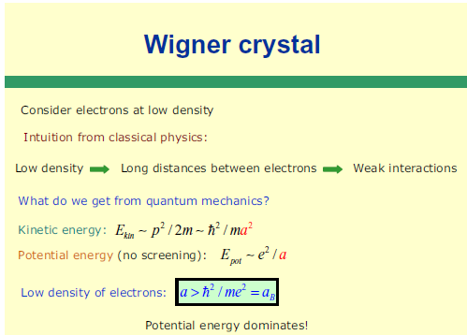

Slide 39
In D=1, Wigner crystallization is allowed even at high density
upon the metallic background – provided e²/ћv_{F}>1
It is clearly observed as the “4K_{F} anomaly”
(Pouget et al, Kagoshima)
Wigner crystal period (one electron per cell) is ½ of that for the CDW, hence the wave number is doubled.

Slide 40
Coulomb Interaction to Cause 4k_{F} CDW
2 electrons in a period
Coulomb, on-site or long-range
2k_{F} CDW
2π/4k_{F}
4k_{F} CDW
The electrons have a strong correlation in their motion
because of the repulsive Coulomb interaction.
4k_{F} CDW is the introduction to physics of strongly correlated electrons.
How common is the charge ordering – Wigner Crystal?
Can it be unlocked from the underlying lattice ?
An important issue in today's science of nano-wires.

Slide 41
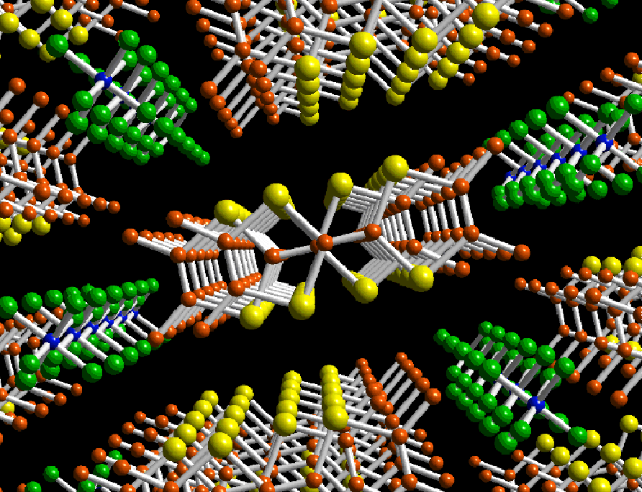
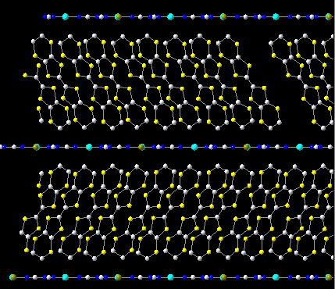
The world of π-electrons: conducting organic crystals.
Interplay of common structural instabilities (Peierls insulator)
with effects of strong Coulomb interactions (Mott insulator)
and nevertheless the superconductivity.
(TMTSF)₂PF₆
κ-(BEDT-TTF)₂Cu[N(CN)₂]Br

Slide 42
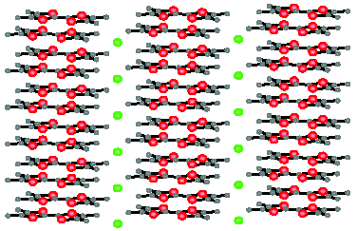
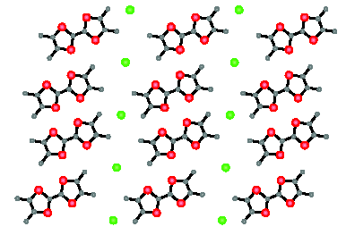
The world of organic conductors is dominated by e-e repulsion
with lattice deformations upon them
conterion
= dopant X
Molecule
TMTTF
or TMTSF
(TMTCF)2X , C=T,Se ; X=ClO4, BF4, PF6, SCN, etc
Origin of conducting Fermi-sea:
Complete charge transfer between the chain X
and the molecular stack; one fermion per two molecules,
¼ filled band – prone to a commensurability effects

Slide 43
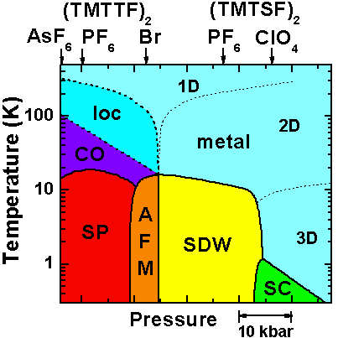
The ever richest phase diagram of electronic phases.
H
CO – Charge Ordering + Ferroelectricity
AFM – Anti-FerroMagnetism
SDW – Spin Density Wave
SP – Spin-Peierls
SC – Superconductivity
H axes – field-induced density waves,
quantum Hall, oscillating cascades

Slide 44
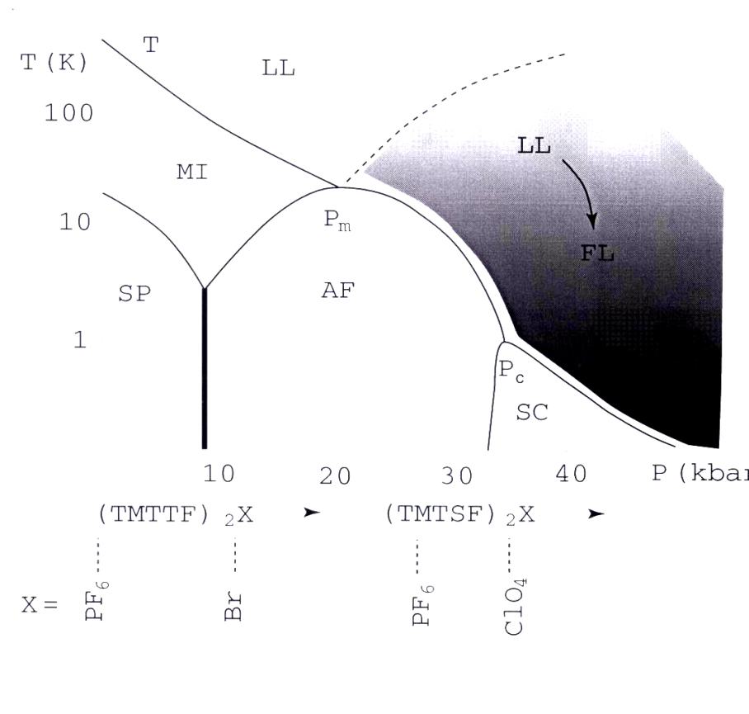
found | guessed
(TMTCF)₂X
SC- superconductivity
AF- AFM = SDW
SP- Spin-Peierls
LL- Luttinger liquid
MI- Mott insulator
Red line T_{CO} ~100-200K – 2000’s revaluation:
Ferroelectricity (Monceau, Nad, SB, et al)
= Charge Ordering (Brown et al); Kanoda 98
spontaneous
Mott insulators
good metals on top of
hidden Mott insulators
Access to switching on/off of the Mott state and to the Zoo of solitons.
Views and interpretations:
FerroElectric Mott-Hubbard state,
mixed site/bond 4K_{F} CDW,
non-symmetrically pinned Wigner crystal,
charge ordering = disproportionation
Facility to see Solitons:
purely 1D regime - T_{CO}≈150K is 10 times above 3D electronic transitions.

Slide 45
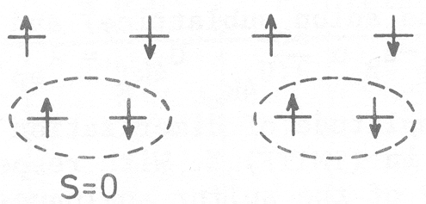
Low T states on top of the Mott insulator.
Spin exchange J_{nm}S_{n}S_{m} with J~t²/U → antiferromagnetic state
Lattice modulation of J – non-magnetic (singlet) spin-Peierls state
AF
2kF SDW
SP
2k_{F} bond « CDW »
(BOW)
Spin-Peierls
ρ=1 (1 electron per site)
Mott-Hubbard localization
case of CuGeO3
ρ=1/2 (1 electron per dimer)
Case of (TMTTF)2X

Slide 46
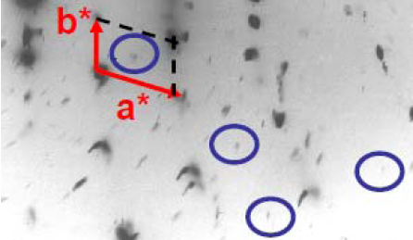
X-ray diffuse scattering pattern from (TMTTF)₂PF₆ at 10K
in its SP ground state:
weak (1/2, 1/2, ?) superlattice spots inside the circles.

Slide 47
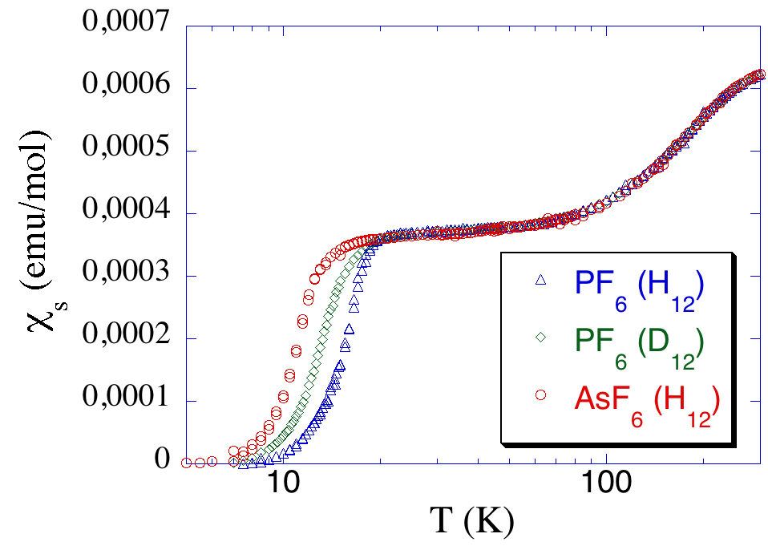
Spin susceptibility measurements: (TMTTF)₂X
TCO
Thermal behavior of a
S=1/2 Heisenberg chain
J~400K
(Dumm et al PRB 62, 6510 (2000))
TSP
no effect at TCO: spin – charge decoupling

Slide 48
Materials on the verge of the Mott transition
P ~ 20 kbar
P ~ 200 bar
anomalous
metal
T*
(V_{1-x}Cr_{x})₂O₃
param.
insulator
(P₀,T₀)
param.
insulator
param.
metal
T (K)
T_{MI}
metal
T_{N}
κ-(ET)₂Cu[N(CN)₂]Cl
AFM
insulator
AFM
insulator
superconductor
superconductor
McWham et al., PRB 7, 1920 (’73)
Limelette et al., Science 302, 89 (‘03)
Georges et al., J. Phys. 114, 165 (’04)
Kino, Fukuyama, JPSJ 65, 2158 (’96)
Kanoda, Hyperfine Int. 104, 235 (’97)
Lefebvre et al., PRL 85, 5420 (’00)
Limelette et al., PRL 91, 016401 (‘03)
Fournier et al., PRL 90, 127002 (‘03)
Kagawa et al., Nature 436, 534 (’05)

Slide 49


New intra-molecular charge transfer:
Kobayashi family et al.
Internal spill-over between overlapping
bands originated by two weakly split
molecular orbitals.
Undoped Four-Layered Two-Gap High-Tc Superconductor. Ba2Ca3Cu4O8F2 Shen group, PRL 07
“Undoped cuprate a60 K superconductor, apical fluorine, inner and outer CuO2 layers, Fermi surface has large n- and p-doped sheets with the superconducting gap on the n sheet twice that on the p sheet.” n,p~15%

Slide 50

Phtalocyanine – a borderline of worlds of π and d electrons.
Its stacks can be both conducting because of π-electrons of the ring,
and magnetically active because of the transition metal core.
These crystals show a metal – insulator transition due to formation
of an electronic crystal – a CDW.
Its breakdown due to the spin polarization in a high magnetic field
gives rise to periodic lattices of solitons.

Slide 51

New attention to ill-conducting organic crystals:
Ferromagnetism and Ferroelectricity
Studied by various approaches:
Electric - Y. Tokura
Optics - S. Koshihara , H. Okamoto
NMR - K. Kanoda

Slide 52

Inorganic world
pi-elctrons – semiconductors, oxygen, chalcogenides
d-electrons – transition metals

Slide 53



Slide 54


P-electrons
The array of Indium chains at Si 111 surface.
Ground state: 2-fold commensurate CDW,
Peierls gap 160meV, Tc~120K.
Han Woong Yeom,
IBS @ PosTech
Conducting and superconducting
inorganic polymer (SN)x

Slide 55






K₂Pt(CN)₄Br_{0.3}H₂O, blue bronze K0.3MoO3
MX3 chain conductors: NbSe3, TaS3, etc
Tanda lab @ Hokkido

Slide 56


Incommensurate, 3D ordered Charge Density Waves - CDW
ARPES gives electrons’ spectral density, hence E(k) with the gap Δ
formed by the CDW
CDW
wave
fronts
Scanning Tunneling
Microscopy STM shows
the CDW modulation in
atomic displacements
and the electronic density.
Brun, Wang, Monceau, SB
chains

Slide 57

Peierls Instability and Charge Density Waves (CDW):
metallic
transition in 1-D
2 electrons in a period
The wave length is not related
to the original cell size → possibility for the incommensurate CDW - ICDW
insulating
Energy profile as function
of the complex order parameter

Slide 58
Collective motion of electronic crystals:
Incommensurate CDWs, SDWs, Wigner crystals:
Frohlich conduction by the collective sliding.
Topological defects: solitons, dislocations (electronic vortices).
Current conversion among normal and condensed electrons.
Phase slips in nano-junctions.

Slide 59



Differential resistance,
universal conductance,
spectrum of the generated
periodic signal

Slide 60
Single model fits of theoretical v(f) to experimental I-V curve (Ogawa, Miyano, S.B.)
a review: S. B. and T. Nattermann
Advances in Physics, 53 (2004)

