Slide 1
Lecture 2.
Excitons, Polarons, Jahn-Teller instability
Literature on a basic theory of excitons:
T. Ziman, a chaper in his book “Principles of solid state physics”
R.S. Knox, “Theory of excitons”
Particularities of excitons in 1D systems with applications to conducting polymers
S. Brazovskii and N. Kirova, “Physical theory of excitons in conducting polymers” Chem. Soc. Rev., 39, 2453–2465 (2010).
N.Kirova, S.Brazovskii, “Conjugated polymers at the verge of strongly correlated systems and 1D semiconductors”, Synthetic Metals, 41 (2004) 139.

Slide 2
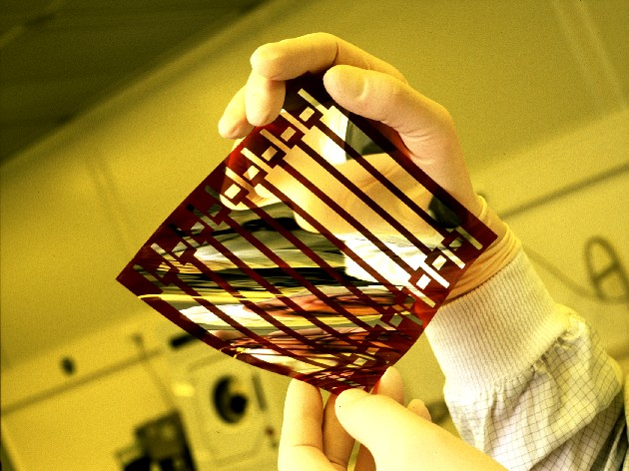
Flexible solar cells
hν
A Flexible, printed plastic solar cell with high efficiency made by SIMENS AG
Physics of various optically active excitations,
their mutual transformations, dynamics and kinetics, constitute the most important fundamental and R&D science.

Slide 3
Optically active polymers
Poly-vinyle-phenylene PPV
Poly-phenylene PPP
Poly-theophene or Poly-pyrolle
Add more examples
From the files??
=S or N

Slide 4
Common studies of electronic properties:
Experimental tools | Access to :
Linear optics : Visible range, far ultraviolet, infra read, Nonlinear optics Time resolved optics | Inter-band excitations & excitons, molecular excitons , molecular vibrations. Nature of the excited states Dynamics and kinetics of excitations
Transport | Conductivity as a function of T: distinction of semiconductors and metals. Magnetoresistance: interchain hybridization
Magnetic measurements ESR, magnetic susceptibility NMR, line shift and relaxation | Localized versus metallic spins Local electronic properties (local magnetic fields, electronic density of states)
X-Ray or electron beam diffraction, neutrons | Crystal structure, degree of disorder
Surface measurements ARPES (+ tr-ARPES) STM, AFM, Tunnel experiments | Spectrum of occupied electronic states Visualization of of electronic density Spectrum of electronic excitations
EELS (electron energy loss spectroscopy) | Spectrum of electronic excited states

Slide 5
Linear and non linear (still at low power) optics
Linear optics (LO):
Observe the absorption spectra, reflectivity
PL
Nonlinear optics (NLO): pump – probe expr.
Photoinduced absorption (PA)
Pump - Light 1 : fixed energy across the gap E>Eg, creation of the excited states
Probe – Light 2: test excitations of the earlier excited states by scanning the probe light energy
Stimulated emission (SE)
Pumpe - Light 1 : fixed energy across the gap E>Eg, creation of the excited states
Probe – Light 2: provokes recombination of the excited states with the emission of the optical photons.
Time resolved NLO:
Measurements as a function of time delay between pump and probe.
Pump
PA
Pump
SE

Slide 6
Which tools do we dispose? What kind of feature can we study?
Linear optics:
Absorption gives the spectrum of virgin excitations.
Emission gives the spectrum of reconstructed excitations (polarons).
Time resolved emission allows to watch the reconstruction in real time.
Nonlinear Optics.
Stimulated emission SE. A small probe illumination provokes emission from earlier pumped excitations at the probe frequency.
Einstein principle (from Bose statistics of photons:)
the SE of even one photon ~ number of photons at this energy.
Photoinduced absorption PA. The basic excitation E1 may possess higher excited states En. Hence optical transitions from E1 to E2, etc.
These allowed transitions help to identify the exciton, also they give access to states which are not accessible directly: by the odd/even symmetry
allowed E0-E1+allowed E1-E2 = not allowed E0-E2
Photoconductivity under (stationary) or after (transient) pumping:
gives access to higher energy E>Eg>Eex unbound excitations –
free e-h pairs. Also to excitons with their subsequent ionization
by thermal activation or applied electric field E.

Slide 7
Combined methods.
High frequency photoconductivity in combination with
optical and teraHerz studies - In this lab.
2. Optical experiments within the setup of the ESR – electron spin resonance.
To distinguish spin-dependent effects.
Solar energy harvesting – needs absorption of light (exciton → e + h)
LED – needs emission of light (e + h → excitons)
Major issues in design, understanding and improving of materials:
free e-h pair versus excitons
Singlet exciton versus triplet ones
On-chain versus interchain binding

Slide 8
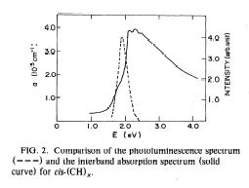
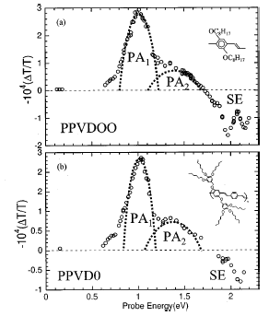
Optical absorption spectra of (CH)x and PPV
2
650 ps
0.1
6
5
4
|
3
d
2
SE (2.43 eV)
|Δα
0.01
6
PA₂ (1.46 eV)
5
4
3
τ
LANL
2
= 630 ps
0.001
0
100
200
300
400
500
600
Utah 1997-2002
Delay time (ps)

Slide 9
Special problem of losses:
1. Recombination of excited states without emitting a photon:
It needs a staircase of levels to descend down loosing the energy
of ~2eV by emitting a sequence of phonons each at <0.2eV.
Impurities or stronger the surface or an interface.
Falling to the lower energy non-radiative excitations:
a. Lowest exciton is indirect one, with the momentum P_{ex}≠0:
Special: Energy minima for the electron and the hole lye at different points of the Brilloin zone: like in Si but unlike GaAs.
b. General and inevitable: Formation of triplet excitons TE which energy is always lower than for singlet ones.
Also for the LED: with electrons and holes meeting randomly, the probability of meeting in a triplet state (3 combinations of the total spin quantum m=1,0,-1) is 3 times higher than for the singlet state – s=0.
TEs live for very long, diffuse distantly, and have a high probability to reach the areas of intensive non-radiative recombination.

Slide 10
Singlet and triplet excitons: creation and annihilation
E
E
Optical pumping
Charge injection
Singlet
Triplet
ps
ms
Luminescence,
primary singlet
µs
Phosphorescence
Fluorescence,
singlets trapped by the impurities
Nonradiative decay channel
Interfaces, lattice vibrations

Slide 11
Electrons, holes and the zoo of excitons
Mystery of triplet excitons
Intra-monomer Coulomb correlations.
Luminescent and non-luminescent polymers
Basis of optical effects:
Presence of excitations which can efficiently absorb/emit the light.
Practical request: energy range of the visible light 1.5-2eV

Slide 12
Geminite (twin) excitation – crerated by one photon
The total momentum is zero: P_{exciton}=P_{light}=E_{exiton}/c→0 -
light velocity c is 100-1000 times higher
than the typical one of electrons.
2. The spin is always zero – the singlet excitation:
the light has an orbital momentum, but it interacts –
except via its weak ~1/c magnetic field –
only with the orbital motion of electrons,
hence cannot change their spin.

Slide 13
Non-geminate excitations
They are formed in light emitting diodes (LED), or under intensive pumping
    Can have any orbital angular momentum
    Can have total spin s=0 or spin s=1
Triplet exciton:

Slide 14
From excitations to free carriers and excitons
Features from ^{k}A_{g}, ^{m}A_{g}, ^{n}B_{u} computed for small systems, as states with
quasi-momenta k (A_{g} ~ sin kx, B_{u} ~ cos kx) they will form continuous bands.
LUMO
Structureles band
Split-off exciton
HOMO
Part of these transitions (non-diagonal in k) will be forbidden by the momentum conservation law, which does not act in small systems.

Slide 15
Excitations or excitons ?
In solid state physics :
Exciton is always an undividable neutral state – a bound state of the electron and the hole in language of the semiconductors science.
Optical excitation is a more general term extended to higher excited states when there is enough energy for the electron and the hole to separate infinitely.
The difference is commonly ignored in language of the molecular science:
No difference in small systems – the objects of the molecular science.
The only distinction: Intra-molecular (Frenkel in SSPh)
or extended
intermolecular Charge Transfer Exciton CTE (Wannier-Mott exciton in SSPh)

Slide 16
EXCITON : electron-hole pair, bound by long range Coulomb forces
Compare – the atom or the positronium
Important question – what kind of particles are created by light and evolve:
band electrons and holes, or excitons?
Excitons give rise to the photolumunescence
Band electrons and holes give rise to the photoconductivity
E

Slide 17
Long range Coulomb interactions and exciton
A picture for molecular crystals
Negligible band width.
Coordinate is an allowed quantum number
Free electron and hole stay at molecular sites at a a distance R
E
LUMO
HOMO
Charge transfer exciton –
Coulomb bound e-h pair
E_{ex} = E_{e}+E_{h} -e²/εR_{ex} <E_{g}

Slide 18
Intramolecular overlaps, Wide bands
Long range Coulomb interactions and exciton
E_{g}=2Δ
Free electron and hole
E_{e}+E_{h}=E_{g}
conduction band
Exciton level
Eg
E_{F}
k
valence band
Optical transitions:
band - to band : E=Eg
Free e, h – photoconductivity
exciton : E=Eex <Eg
photoluminescence
Exciton - Coulomb bound e-h pair

Slide 19
1D excitons in solid state physics
ΔpΔx ∼ 
W - band width
Wannier-Mott exciton: large bands W
small energy E_{b}<< E_{g} large R -
basis of the states near the band edge.
Kohn-Luttinger effective mass approach.
ΔE<<W
E
k
Frenkel exciton:
narrow bands, E_{b} ∼ E_{g}
we need the states from the whole band W,
small R, large p
Ln² – factor : “capacitance”of elongated cigars of charges
electron
hole

Slide 20
Ionization of a shallow Wannier-Mott exciton by the electric field
(field induced exciton dissociation)
High electric field F – exciton is destroyed and particles participate in photoconductivity
small electric field F – exiton is preseved
eFR_{ex}>E_{b}

Slide 21
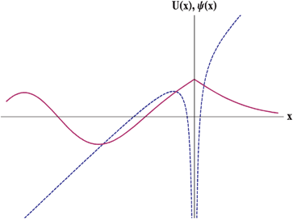
Band edge
Exciton
D. Moses, A.J. Heeger, S.B., N.Kirova., 2000
Problem 1: singlet excton estimated energy is too small, <0.1eV
Problem 2: triplet exciton binding energy ~0.7-0.9 eV is too high
Resolution: electronic correlations

Slide 22
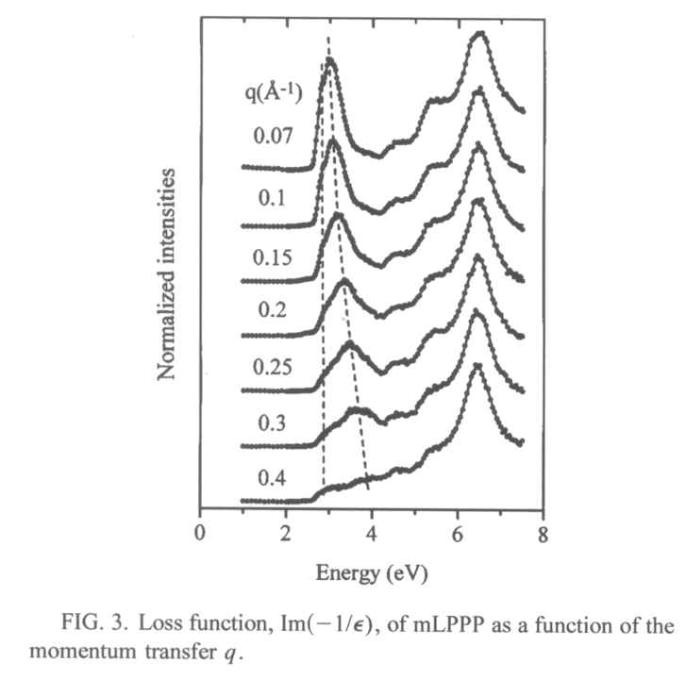
EELS method- electron energy loss spectroscopy.
Access to the exciton’s momentum (unlike P=0 only in optics).
Proof for coexistance of localized and mobile excitons.
High energy electrons passes
through the crystal
The output energy E` and momentum p` determine the losses inside the crystal, hence the energy of emitted elementary excitations (excitons)
E`(p`)-E(p) = E_{ex}(p`-p)
e: E,p
e: E`,p`
exciton
Localized and delocalized singlet excitons
M. Knupfer et al, Germany (1998)

Slide 23
Non-geminate excitons
They are formed in light emitting diodes (LED), or under intensive pumping
E
Electron in conducting band meets a hole in valence band
The two can form a hydrogen-like bound state. Exciton!
    Can have any orbital angular momentum
    Can have total spin s=0 or spin s=1
    Ratio of TE/SE=3/1

Slide 24
Singlet -Triplet
One electron in magnetic field:
Zeeman splitting in two levels s=±1/2
Two electrons in magnetic field:
S=0
Singlet state – no splitting
S=|↓↓>
S=1
Triplet state
S=|↑↑>
Gain of the exchange energy
Gain of the kinetic energy

Slide 25
Compatibility of spins and coordinates for Fermions:
S=0 – only symmetric ψ(x₁,x₂) – kinetic energy gain
S=1 – only antisymmetric ψ(x₁,x₂) – exchange energy energy gain
S-T splitting (exchange energy)
Es
Eg
E_{T}
N.B. Energy decrease of triplet state for repulsive electrons.
This is a background for:
Hund rule in atoms,
ferromagnetism,
some cases of triplet superconductivity in organic metals
For us: the sunk of light emitting singlet excitons to the long leaving triplet ones

Slide 26
Intra-molecular electronic correlations:
Benzene ring, optical transitions
gg*-uu*
gu*+ug*
In reality
6.76 eV
Calculated without
Coulomb correlations
gg*+uu*
5.96 eV
T
0
-T
4.8 eV
gu*-ug*
4.71 eV
Triplets :
4.71 eV
3.59 eV,
T
0
-T

Slide 27
Polymer
Isolated benzene ring
¹E_{1u} gu*+ug*
gg*-uu*
6.76 eV
6eV
LL*
¹B_{1u} gg*+uu*
5.96eV
DD*
DL*±LD*
¹B_{2u} gu*-ug*
4.71eV
2.4 –3eV
Delocalization breaks the intra ring scheme !
The g-states most favoable for the band delocalization contribute to the highest intramolecular states (~4eV difference)
Lowest intamolecular state involves u-states, which do not benefit of delocalization (2-3 eV).

Slide 28
Exciton energy is higher than the energy of free e+h on the molecule,
e-h binding energy is positive
effective on-site e-h repulsion!

Slide 29
Long range Coulomb attraction and intra-monomer repulsion for e-h pair.
h
e
Classical visualization: e-h pair moves towards each other accelerating by Coulomb attraction. Instead of free passing like in a Wannier - Mott exciton, they face a wall of onsite repulsion.
The impact interaction is equivalent to adding the central repulsion peak potential U₀, the particles must tunnel through.

Slide 30
Electronic correlations : role of the impact interaction U₀
U₀ depends on overlap between quantum states of free band particles (e,h) and exact correlated intra-molecular states.
It differs for various excitons.
U_{S}-U_{T} - effective exchange interaction
Bu -singlet
Triplet
x
Interaction potential
a
U_{S}>>U_{T}

Slide 31
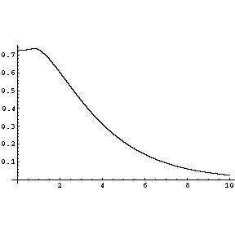
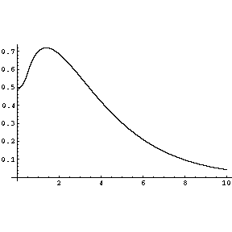
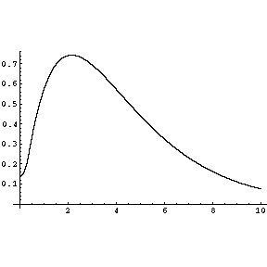
Exciton wave functions for various intra-monomer repulsion potentials
ε=2.5
U=0
U=1eV
U=4eV

Slide 32
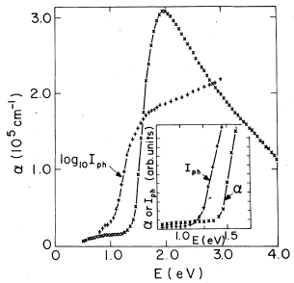
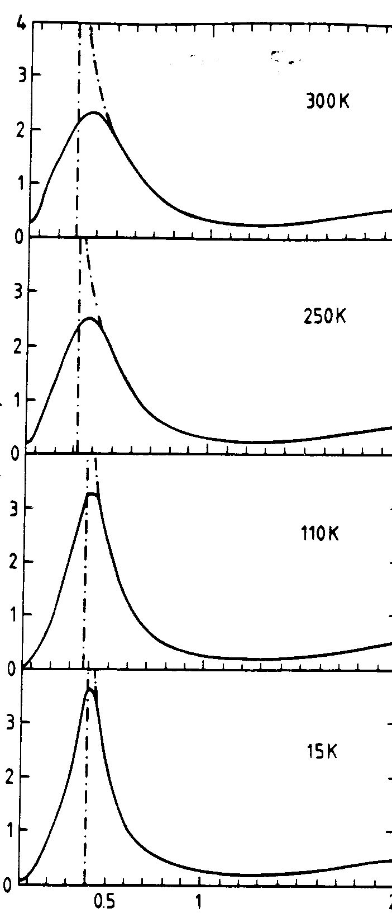
The fundamental edge Eg : free particles, photoconductivity threshols
DOS 1/√(E-E_{g})
(CH)_{x}
CDW

Slide 33
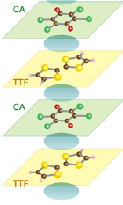
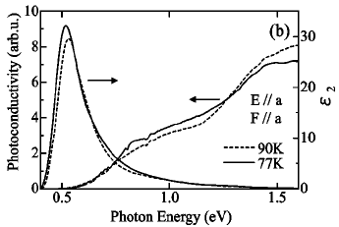
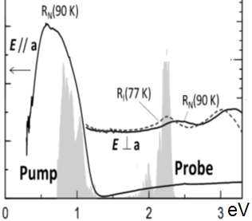
Donor-acceptor chains - workshop for pumping of excitons
Intra-molecular excitons IME (S. Koshihara)
CTE,
0.6 eV
Inter-molecular =
charge-transfer excitons CTE (H. Okamoto).
IME,
2.4 eV
CTE: All signature of the unbound e-h excitation,
Not the exciton

Slide 34
Optical absorption, long rang Coulomb effects
absorption
absorption
E
E
Short range Coulomb interactions
Long range Coulomb interactions

Slide 35
Unbound pairs: suppression of the light emission by the long range Coulomb attraction
Classical intuition:
attraction keeps e and h together, thus enhancing their recombination (emission probability)
But : attraction accelerates the velocities and particles pass by without hand shaking
e
h
e
h
τ/τ_{T}<10⁻¹
T~10-100K, e²/a~10eV

Slide 36
Towards the quantum picture of the final state interaction
Wave function of the relative e-h motion x=x_{e}-x_{h}
even
just like in classics
odd
λ – de Broigle wavw length
|ψ₊(0)|²- probability of recombination
Ψ₋ (0)=0, no recombination, no classical analogy

Slide 37
Jan-Teller instability.
Moleculs, Fullerenes, Conducting polymers.
A Route to the Peierls effect

Slide 38
The Jahn-Teller effect
Jahn-Teller theorem:
“there cannot be unequal occupation of orbitals with identical energy”
Molecules will distort to eliminate the degeneracy
a nonlinear symmetrical molecule with a partially filled set of degenerate orbitals will be unstable with respect to distortion and thus
it will distort to lift a degeneracy to a lower-symmetry geometry and
thereby remove the electronic degeneracy
The case of self trapping – extended version of Jahn-Teller effect.
Lattice deformations create a dip in the potential energy U of the electron.
Common in transition metal complexes, manganites etc, where d or f orbitals are partially filled.
Requested at coming of fullerenes

Slide 39
Cyclobutane C₄H₄
Jahn-Teller effect
4 carbon atoms – 4 π-electrons
Wave functions:
Ψ₁=cos 0•n=cnst
Ψ₂=cos(πn/2)
Ψ₃=sin(πn/2)
Ψ₄=cos πn=(-1)^{n}
Half filled doubly degenerate level
Instability
square --> rectangle

Slide 40
Isolated benzene ring
H H
C C
H C C H
C C
H H
Degenerate level is completely filled – no gain from reducing
the hexagon symmetry. We only loose the deformation energy
N=8 – again the instability, like for N=4, what is next, and at large N ?

Slide 41
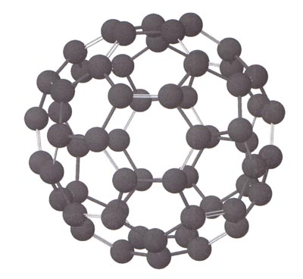
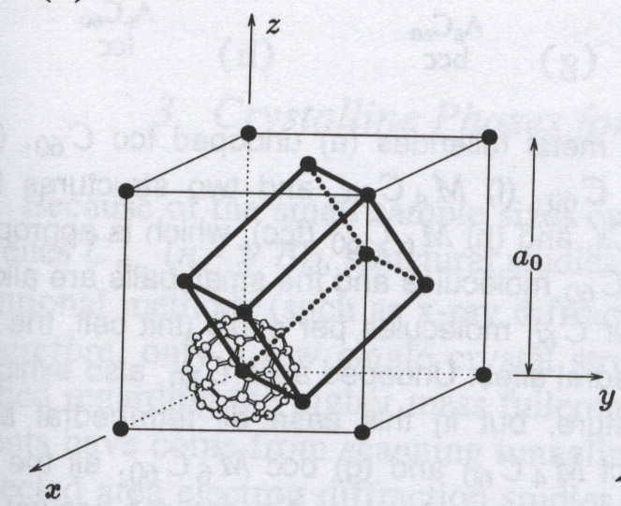
Fullerene Fullerene (C₆₀) Crystal
  Cage diameter - 0.71 nm
  Optical gap – 1.9 eV
Crystalline Fullerene
  fcc structure with lattice
t_{1u} LUMO
can adopt
up to 6
electrons

Slide 42
Charge transfer crystals :
n=0, dielectrics
n=1, metal at high temperature
quasi 1D polymeric chain at room temperature
quenched dimer lattice at low temperature.
n=2 1/3 filled band, should be a metal, but is a semiconductor
n=3 half filled band metal, superconductor
n=4 2/3 filled band, should be a metal; but is a semiconductor, semimetal under pressure, bct
n=5 does not exist ?
n=6 completely filled t_{1u}, dielectric
1D polymeric phase under illumination,
2D polymeric phase under pressure

Slide 43
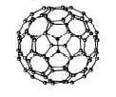
The Jahn-Teller effect on the isolated molecule
Uniaxial cage distortion: Splitting of the t_{1u} level
Two-fold degenerate (x,y) level E₁=-Δ/3
Non degenerate z-level E₂= 2Δ/3
Rem.: Center of gravity of the levels does not change
E₂,n₂
2Δ/3
-Δ/3
E₁,n₁

Slide 44
Excited states of the molecule, anti Jahn-Teller effect
Δ
Δ/4
Δ/2
Triplet excited state 1
Triplet excited state 2
Ground state
Excited state

Slide 45
Electrons on deformable lattice - instabilities
Interaction between two different single-electron centers
1
2
If there were no overlap t : E₁=E₀; E₂=-E₀
E₀
-E₀
Hamiltonian for the eigenstates:
Ground state -attraction
→ larger t
First excited state:
E+(-E)=0, no interaction
Anti-bonding totally excited state - repulsion

Slide 46
Add the potential energy:
If E₀<<t - nearly identical atoms:
Always non trivial minimum at t≈2/K – an equilibrium
If E₀>>t
Instability threshold at E₀K=2

Slide 47
Electrons and excitons on a deformable background
Self-trapping of electrons and excitons
Polarons

Slide 48
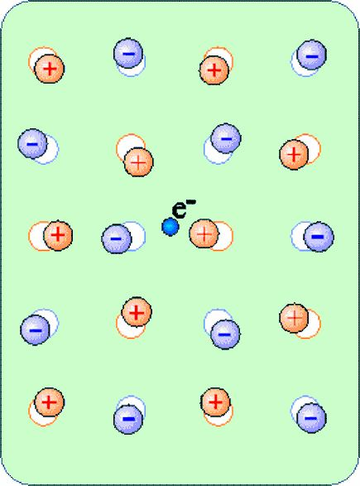
What’s a polaron?
www.britannica.com: Polaron…. An electron accompanied by an electrical displacement of neighboring charges constitutes a polaron.
www.wikipedia.com : A polaron is a quasiparticle composed of an electron and its accompanying polarization field.
Formation of polarons:
A conduction electron in an ionic crystal or a polar semiconductor repels the negative ions and attracts the positive ions
A self - induced potential arises
which acts back on the electron
Energy gain must exceed the cost of deformation + kinetic energy of confined electron
Origin of word “polaron” – selpftrapping in polar crystals (NaCl, LiF, etc)
Today used of all types of selftrapping or autolocalization
Polaron effect is strong in ionic, but weak in covalent crystals – except 1D systems !

Slide 49
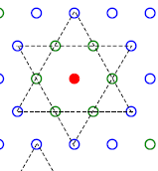
1T-TaS2 – polaronic Wigner crystal view (ours, disputable).
Background: narrow-gap (E_{g} =Δ_{e}+Δ_{h}≈0.6-0.8 eV) insulator formed from parent metal (with 1e per Ta site) by a high-T (>500K) CDW.
Incomplete nesting leaves each 13-th electron ungaped which
in a typical CDWs would give rise to a pocket of carriers.
Here, each excess carrier is self-trapped by inwards displacements of the surrounding atomic hexagon (forming the “David star” unit)
which gives rise to the intragap local level accommodating this electron.
These charged heavy polarons inevitably arrange into the Wigner crystal
which is always a hexagonal super-lattice –
by Nature chance upon the underlying hexagonal lattice
This ideal locked form is the C phase.

Slide 50
Exciting the self-trapped electron from the intragap level
deprives the deformations from reasons of existence,
the David star levels out in favor of a void in the WC while the electron is sent to a higher delocalized band or recombines with a band hole.
Adding an electron to the UHB may lead to a stable bipolaron,
but the energy cost most probably will not allow for its stability.
Mitosis into two polarons will proceed thus creating an interstitial in the WC – both voids and interstitials have been seen by STM.

Slide 51
l
1D polaron: self-consistent problem
U
Spontaneous deformation forms the potential well U for an electron
Energy functional:
K- elasticity contant
Ψ – electron wave function
m*- electron effective mass
~²/m*l²
~ U
~KU²l/2
E
Min over U at
1/l
l=∞ - a free electron,
is always unstable
Minimum at
At D>1 the long range Coulomb interactions are necessary
polaron = e + strain field – a heavy particle

Slide 52
Polaronic effects - lattice relaxation
π electron interaction (flat arrangement of phenyl rings) competes with Van der Waals hydrogene repulsion (perpendicular arrangement of phenyl rings)
Lattice relaxation: phenyl ring libration
Torsion angle
20º for PPV and
30º for PPP

Slide 53
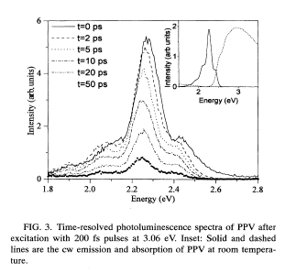
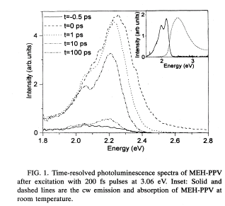
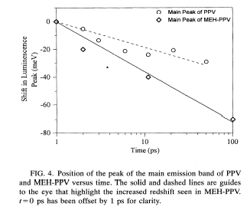
Polaronic effects: SE and PL
Stimulated Emission
red-shift
Lanzanni et al, 2002
Hayes et al, (1995)

