Slide 1
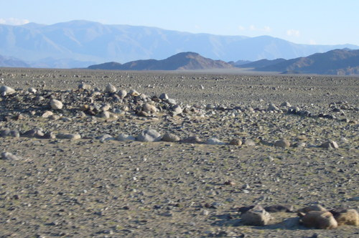
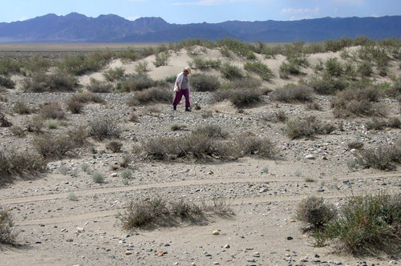
A time to cast away stones, and a time to gather stones;
A time to search and a time to give up,
A time to keep and a time to throw away
Ecclesiastes 3:4-3:6
“impractical things endure and retain their vitality
for thousands of years,
whereas necessary, practical things survive only briefly”
Kasimir Malevich, manifesto of Suprematism

Slide 2
S. Brazovskii
CNRS-Orsay, France & PCS-IBS, Korea
Sources for original items of these lectures and beyond:
Joint work with experimental groups from
France (P. Monceau – all on CDWs and more,
C. Brun & Z.Z. Wang - STM).
Russia (Yu. Latyshev - tunneling, F. Nad – ferroelectrics,
A. Sinchenko – CDWs in HMF).
Slovenia & Japan (D. Mihailovic & H. Okamoto – femto-optics),
Korea (Yung Woo Park – polyacetylene, high E and H).
On theory:
N. Kirova – excitons and solitons in polymers,
electronic vortices in junctions, electronic ferroelectricity.
Earlier collaborations: I. Dzyaloshinskii, I. Krichever, S. Matveenko

Slide 3
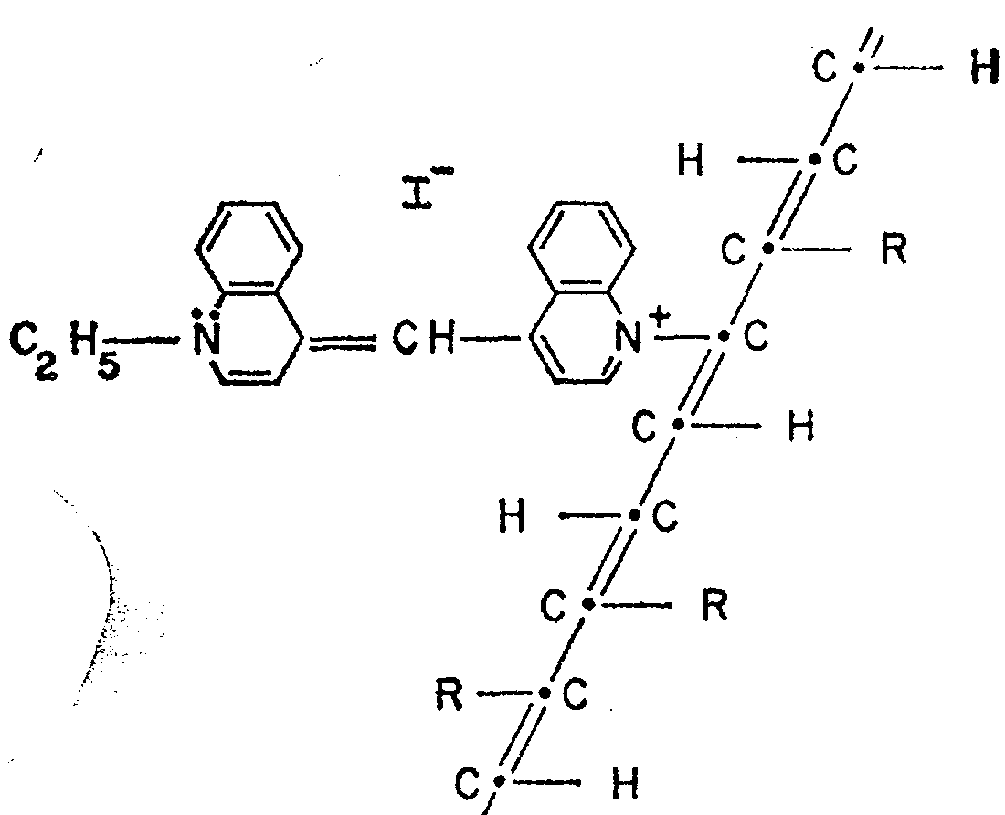
« In the beginning was the Word, …
and without him was not anything made that was made »
Physical Review 1964 & Scientific American 1965
W.A. Little , Stanford University
Possibility of a synthesizing an organic superconductor.
Superconductivity at room temperature.
It has not yet been achieved, but … it is possible to synthesize organic materials that … conduct electricity without resistance.
Little drawing: conjugated polymer -
the polyene backbone with ligands R
Superconductivity: Tc ~ ħω_{ph} exp(-1/λ)
λ –coupling of electrons to vibrations
with a frequency ω_{ph}~1/ M^{1/2}

Slide 4
Initiated paths of material science:
Inorganic world of d-electrons
Inorganic chains/planes like MX3/MX2
(M=Nb, Ta, Ti, Mo; X=S, Se, Te),
Pt chain compounds, surface structures like for In here at CALDES
The carbon world of pi-conjugated systems:
Organic conducting crystals
Molecular crystals with a charge transfer
Conjugated polymers
Graphite (intercolated)
Fullerenes (Sun born), nano-tubes, graphene
Looking for high Tc superconductivity scientists found:
Materials with curious electronic phases:
conductors, superconductors, magnetics, ferroelectrics,
charge ordered states, charge/spin density waves,
optically and electronically active polymers

Slide 5
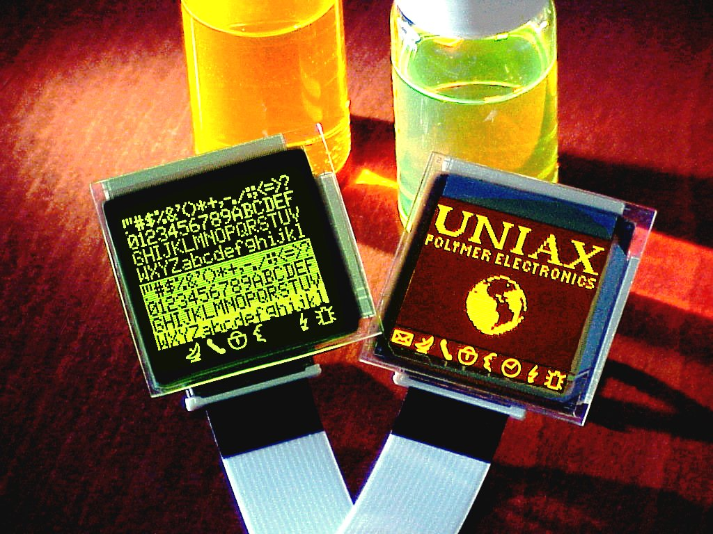
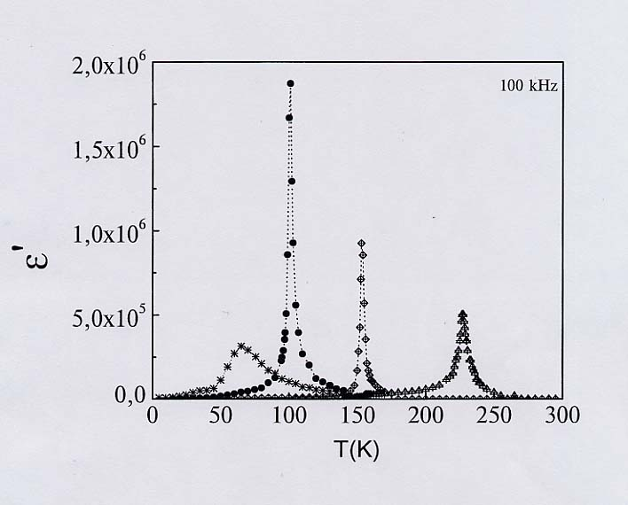
Ready or promising for applications:
Polymers for Light Emitting
or Harvesting & Organic Ferroelectrics
AsF₆
SbF₆
ReO₄
PF₆
New targets: Optical, Voltage, and STM switching I
n layered electronic crystals (TaS2)
Ljubljana-Slovenia , CALDES - POSTECH

Slide 6
Electronic structures of conjugated carbon-based systems
Core electrons lying deeply in energy.
σ electrons from the valent sp3 shell of the carbon, their orbitals are directed in the backbone plane and localized between two adjacent atoms.
π electrons, from the top sp3 shell , their orbitals are directed perpendicularly to the backbone plane, hence delocalized over an array of atoms, hence the term “π− conjugation”.

Slide 7
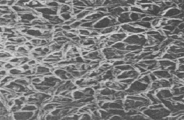
Heeger, MacDiarmid and Shirakawa
Nobel Prize in chemistry 2000
« for the discovery and development of electrically conducting polymers ».
Inside these noodles: poly-crystals of trans-(CH)_{x}
Made conducting under a heavy doping (Y.W. Park)

Slide 8
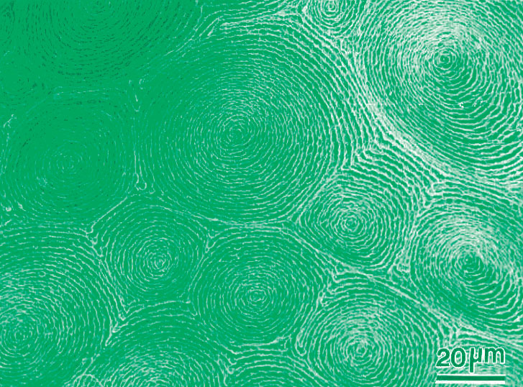
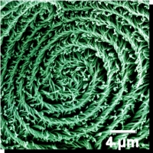
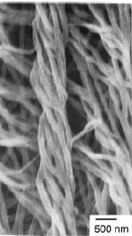
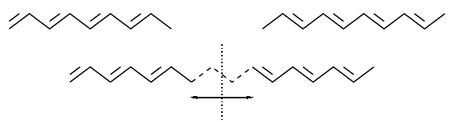
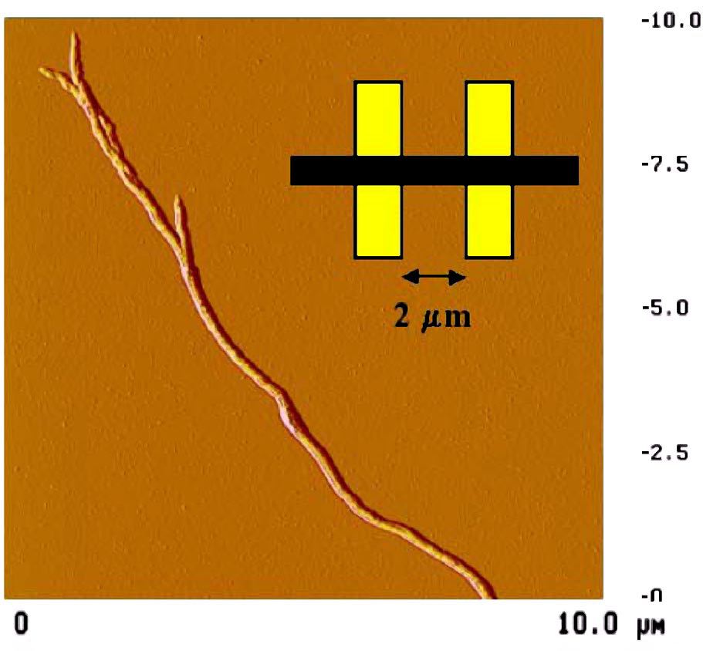
Helicoidal polyacethelene (K.Akagi, Kyoto) - multi-scale material:
cells -> spirals -> threads -> crystalline fibers -> polymer chains
-> π-electrons -> Peierls-dimerization -> solitons -> confinement
Realization of the Gross-Neveu
model from QFT and the KdV eqs.

Slide 9
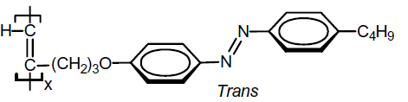
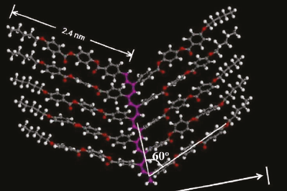
Substituted polyacetylenes - Today’s great variety:
chemistry is centered in Hong Kong, Beijing, Kyoto
Semiconductor, excitons,
light emission, even Lasing !

Slide 10
Unique conjugated polymes: polyacetylene
Polyacethylene (CH)x – recall carotines, vitamin A
H
H
H
H
H
H
C
C
C
C
C
C
C
C
C
C
C
C
H
H
H
H
H
H
should be a metal but is a small-gap dielectric (1.5eV)

Slide 11
Cyclobutane C₄H₄
4 carbon atoms – 4 π-electrons
Instability
square --> rectangle
Jahn-Teller --> Peierls
Wave functions:
Ψ₁=cos 0•n=cnst
Ψ₂=cos(πn/2)
Ψ₃=sin(πn/2)
Ψ₄=cos πn=(-1)^{n}
Half filled doubly degenerate level 2,3
gain electronic energy -2Δ
loose deformation energy
Similar story in doped Fullerenes

Slide 12
Unique conjugated polymes: polyacetylene
Dream: the metal
Reality: narrow gap insulator
H
H
H
C
C
C
C
C
H
H
Peierls effect - one dimentional chain of equidistant atoms is unstable with respect to the dimerisation: Spontaneus symmetry braking results in the dielectric state, the gap is open
E
E
Δ∝Wexp(-1/λ)
ε_{F}
-k_{F}
k_{F}
-k_{F}
k_{F}

Slide 13
Peierls model - deformable lattice
Main interactions : electron – phonon coupling (electron-electron repulsions are small)
Ground state: W = W_{el} + W_{lat}
W
-Δ₀
Δ₀
symmetry Δ→-Δ
Δ

Slide 14
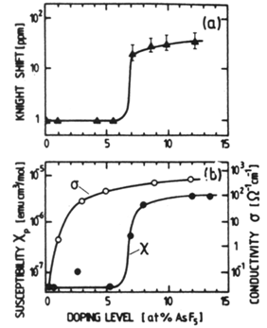
Doped polyacetylene (Y.W. Park):
Two steps to become a metal,
First hint to existence of solitons
conductivity σ and magnetic susceptibility χ
The major puzzle:
spins appear at much higher doping than the metallic conductivity:
the whole interval of conduction by spinless – unlike electrons – particles.
That and many other propertiese showing up in NMR, ESR, optics
have brought the solitons to the sight of experiments

Slide 16
The organic conductor TTF-TCNQ
k_{F}
F. Zwick et al, PRL (1998)
ARPES result: conventional Quasi-1D material with two open
Fermi surfaces originated by two stacks.
But other data: TTF at least is the strongest correlated conductor
of the whole family.

Slide 17
S. Kagoshima
et al. (1976)
T>T_{c} – "Diffuse X-ray scattering" measures local
structural correlation without the long range order,
T<T_{c} – bright Bragg spots will appear only below T_{c}.
Lines are in the inter-chain direction:
no dependence on K - no correlation among chains.
2K_{f} appear at lower T but condense into true Braggs.
4K_{f} lines exist since the RT but never condense,
4K_{f} CDW = Wigner crystal ever coexists
with both metallic and CDW phases.
J. P. Pouget et al. (1976)

Slide 18
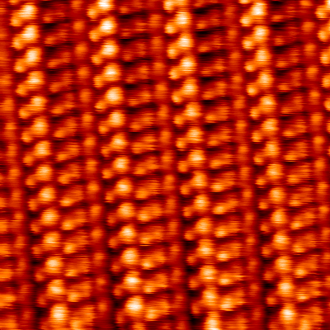
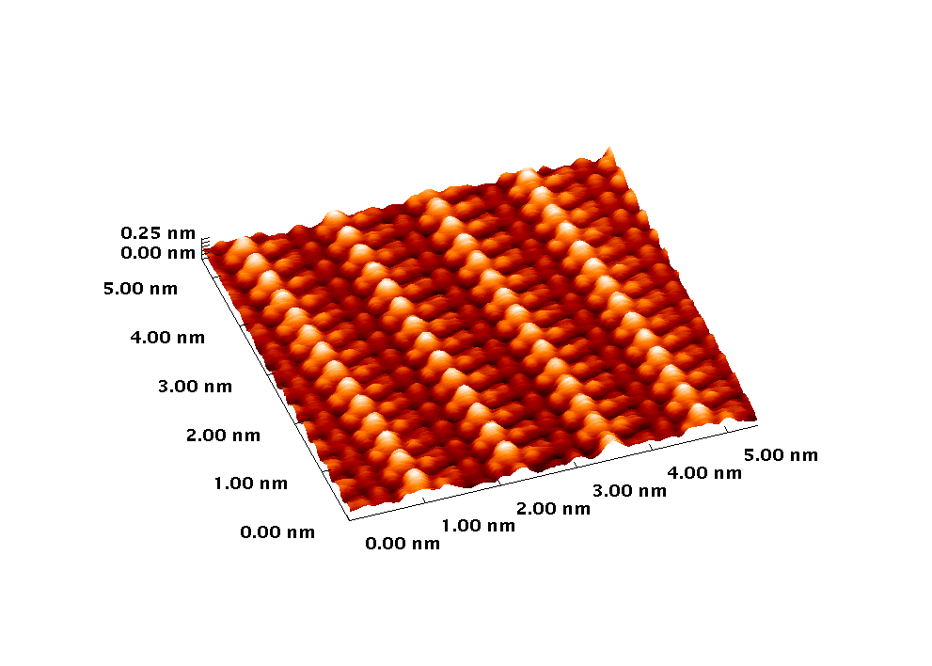
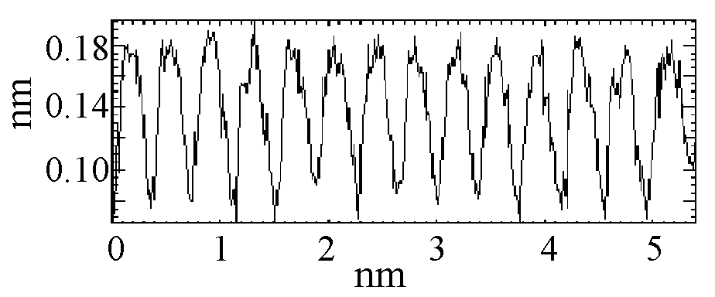
Molecular Resolution at T = 63K on TTF-TCNQ (001) surface
TTF⁺
TCNQ⁻
TCNQ⁻
Corrugation:
TCNQ : 2 x 0.6 Å
TTF : 2 x 0.2 Å
h_{TCNQ}-h_{TTF} = 1 Å
I_{t}= 1nA , V_{bias}= 50mV
Acquisition time : 210 s

Slide 19
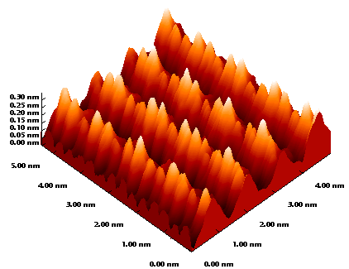
CDW at 35.6K
Z.-Z. Wang, France

Slide 20
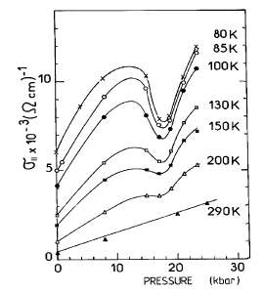
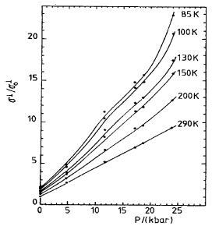
Charge Transfer Change at High Pressure D. Jerome
1:3 commensurability locking and its consequences.
Collective nature of
on-chain transport
versus
single-particle nature
of inter-chain transport
On-chain conductivity
drops at the 3:1 lock-in
Inter-chain conductivity
does not feel the lock-in

Slide 21
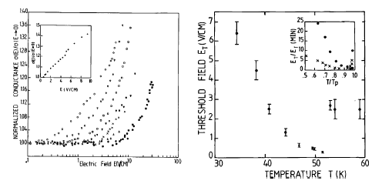
Message from/to another world: incommensurate CDWs.
Key word - sliding vs pinning.
Recall indications for sliding of stripes (LANL 2008)
Collective nature of the on-chain conduction in TTF-TCNQ is seen from
the nonlinear I-V which are setup below T_{c} for the 2K_{f} CDW

Slide 22
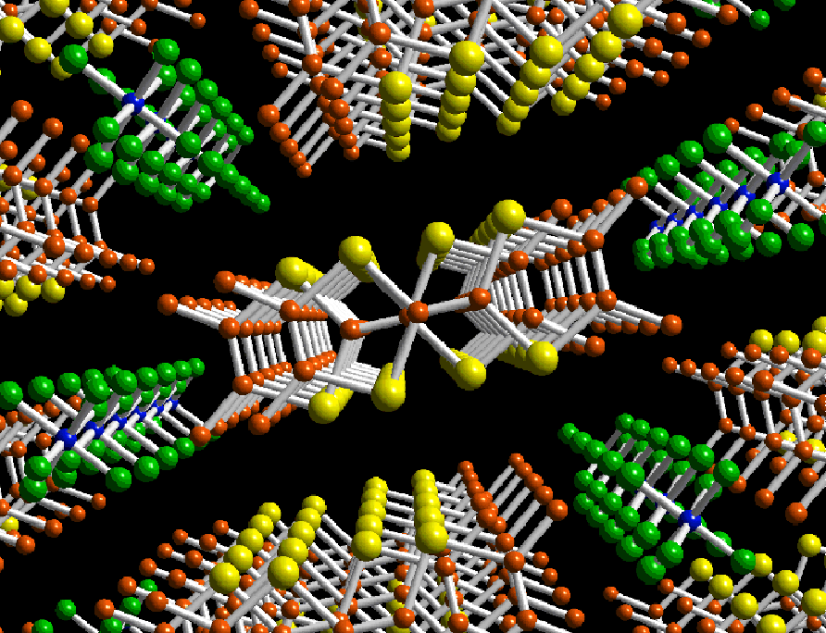
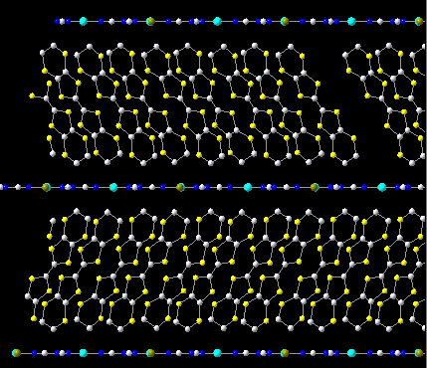
The world of π-electrons: conducting organic crystals.
Interplay of common structural instabilities (Peierls insulator)
with effects of strong Coulomb interactions (Mott insulator)
and nevertheless the superconductivity.
(TMTSF)₂PF₆
κ-(BEDT-TTF)₂Cu[N(CN)₂]Br

Slide 23
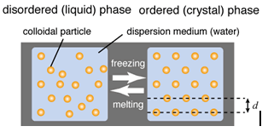
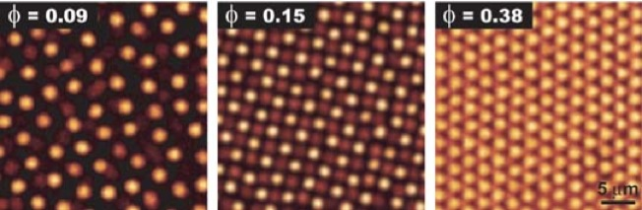

Schematic illustration of liquid and crystal states of charged colloidal dispersion.
particle charge of typically 100e to 1000e.
As the particle concentration increases, the fluid changes into a body-centered cubic crystal and eventually a face-centered cubic crystal
Microscopic realizations:
Electrons trapped near the liquid He surface,
Charge ordering in organic crystals

Slide 24
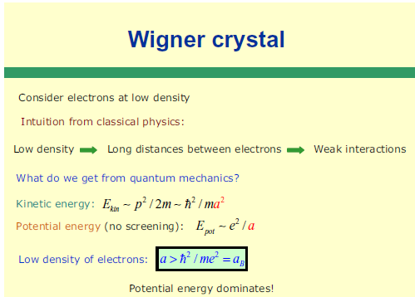

Slide 25
Coulomb Interaction to cause 4k_{F} CDW = Wigner crystal
2 electrons in a period
Coulomb, on-site or long-range
2k_{F} CDW
2π/4k_{F}
4k_{F} CDW
The electrons have a strong correlation in their motion
because of the repulsive Coulomb interaction.
4k_{F} CDW is the introduction to physics of strongly correlated electrons.

Slide 26
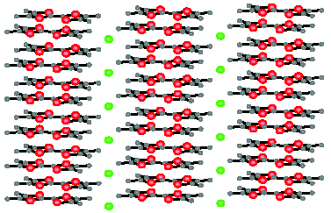
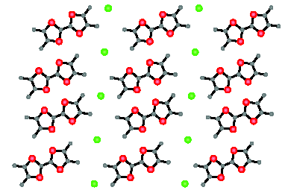
The world of organic conductors is dominated by e-e repulsion
with lattice deformations upon them
conterion
= dopant X
Molecule
TMTTF
or TMTSF
(TMTCF)2X , C=T,Se ; X=ClO4, BF4, PF6, etc
Origin of conducting Fermi-sea:
Complete charge transfer between the chain X
and the molecular stack; one fermion per two moleculas,
¼ filled band – prone to a commensurability effects

Slide 27
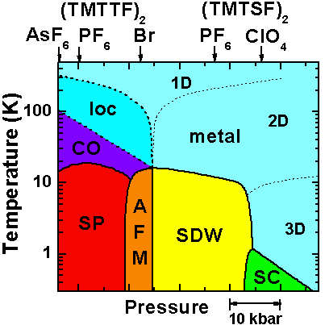
The ever richest phase diagram of electronic phases.
H
CO – Charge Ordering + Ferroelectricity
AFM – Anti-FerroMagnetism
SDW – Spin Density Wave
SP – Spin-Peierls
SC – Superconductivity
H axes – field-induced density waves,
quantum Hall, oscillating cascades

Slide 28
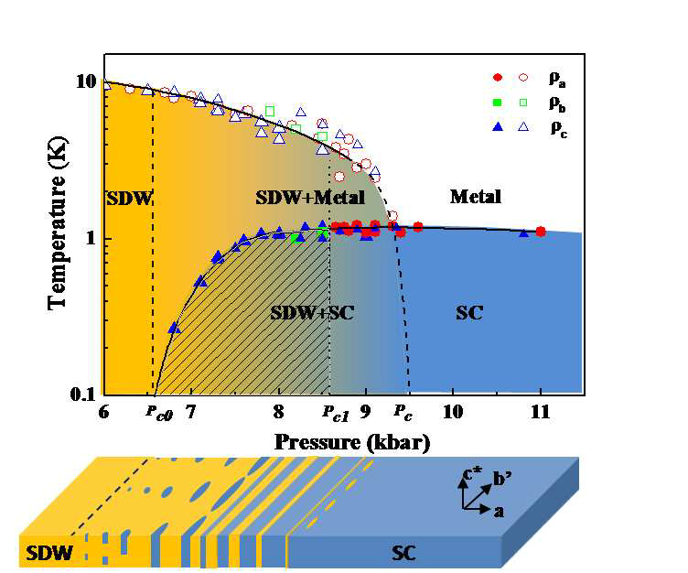
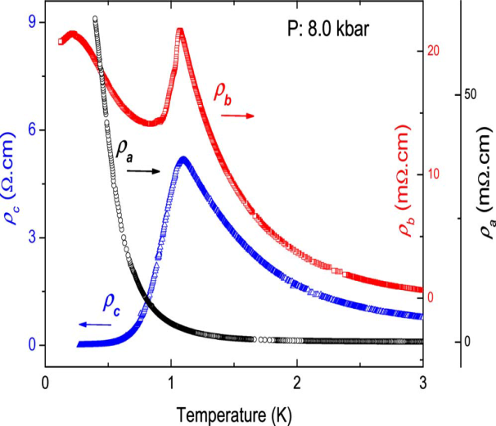
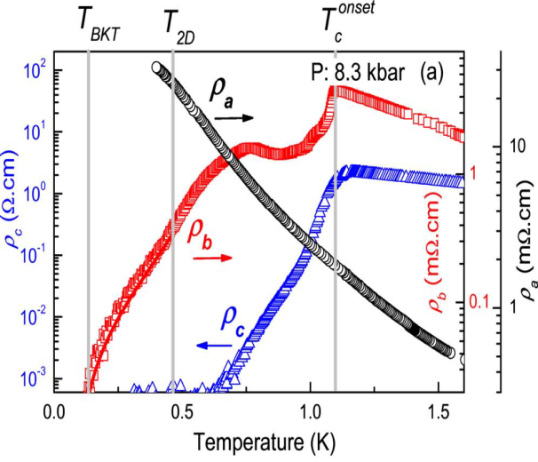
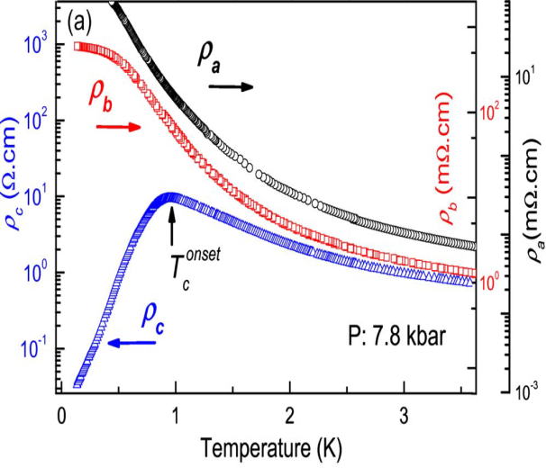
Domain walls at the spin-density-wave endpoint of the organic superconductor (TMTSF)2PF6 under pressure PRB 2010
N. Kang, B. Salameh, P. Auban-Senzier, D. Jérome, C. R. Pasquier, and S.B.
The (super)conducting state starts along the worst conducting (c) direction,
Evollves to the medium conduction (b) direction,
Sets the last along the best, on-chain, (a) direcion.

Slide 29
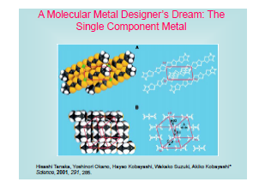
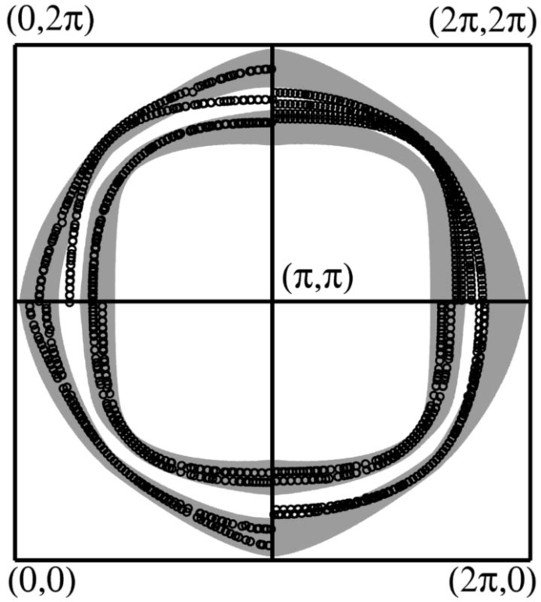
New intra-molecular charge transfer:
Kobayashi family et al.
Internal spill-over between overlapping
bands originated by two weakly split
molecular orbitals.
Undoped Four-Layered Two-Gap High-Tc Superconductor. Ba2Ca3Cu4O8F2 Shen group, PRL 07
“Undoped cuprate a60 K superconductor, apical fluorine, inner and outer CuO2 layers, Fermi surface has large n- and p-doped sheets with the superconducting gap on the n sheet twice that on the p sheet.” n,p~15%

Slide 30
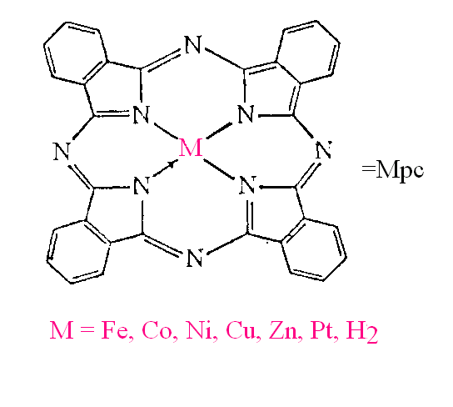
Phtalocyanine – a borderline of worlds of π and d electrons.
Its stacks can be both conducting because of π-electrons of the ring,
and magnetically active because of the transition metal core.
These crystals show a metal – insulator transition due to formation
of an electronic crystal – a CDW.
Its breakdown due to the spin polarization in a high magnetic field
gives rise to periodic lattices of solitons.

Slide 31
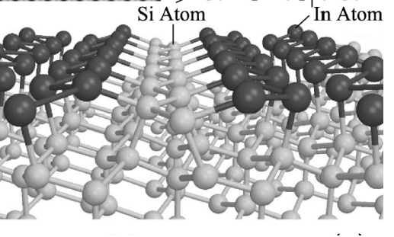
The array of Indium chains at Si 111 surface.
Ground state: 2-fold commensurate CDW,
Peierls gap 160meV, Tc~120K.
Han Woong Yeom, IBS @ PosTech

Slide 32
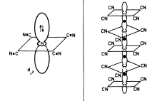
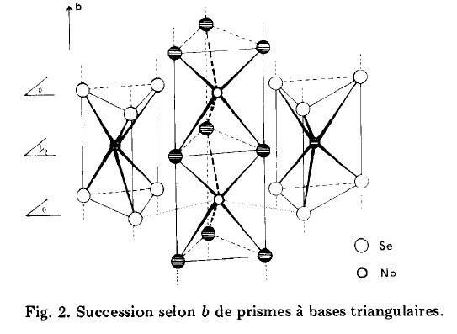
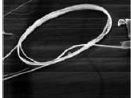
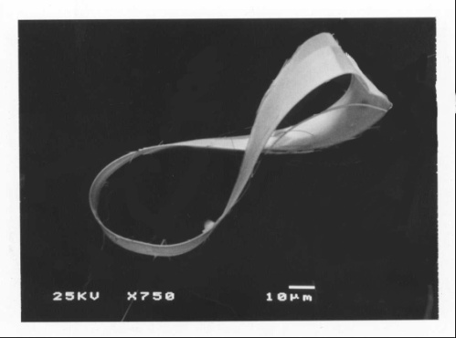

Inorganic world of d-electrons:
K₂Pt(CN)₄Br_{0.3}H₂O , NbSe3 , and
superconducting ! polymer (SN)x
Tanda lab @ Hokkido

Slide 33
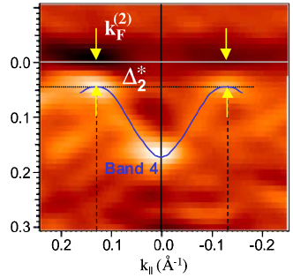
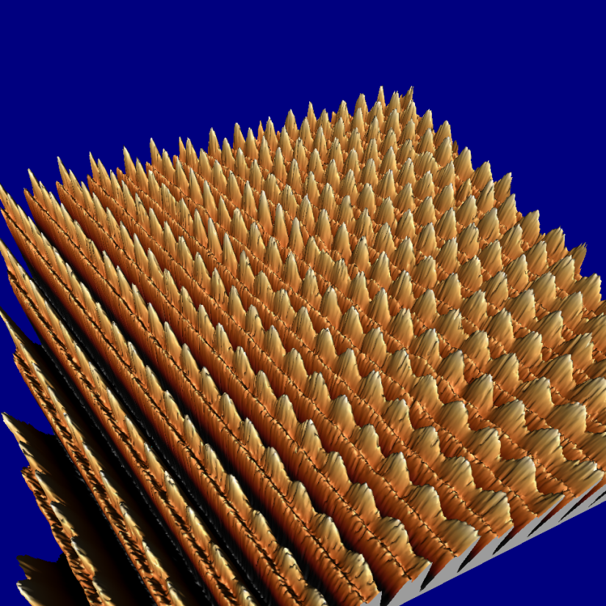
Incommensurate, 3D ordered Charge Density Waves - CDW
ARPES gives electrons’ spectral density, hence E(k) with the gap Δ
formed by the CDW
CDW
wave
fronts
Scanning Tunneling
Microscopy STM shows
the CDW modulation in
atomic displacements
and the electronic density.
Brun, Wang, Monceau, SB
chains

Slide 34
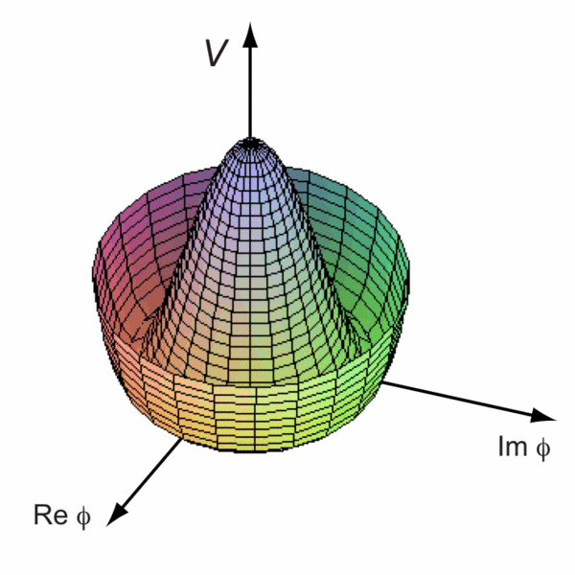
Peierls Instability and Charge Density Waves (CDW):
metallic
transition in 1-D
2 electrons in a period
The wave length is not related
to the original cell size → possibility for the incommensurate CDW - ICDW
insulating
Energy profile as function
of the complex order parameter

Slide 35
Collective motion of electronic crystals:
Incommensurate CDWs, SDWs, Wigner crystals:
Frohlich conduction by the collective sliding.
Topological defects: solitons, dislocations.
Current conversion among .
Phase slips as instanons.
Attend the talk by Natasha Kirova at the APCTP

Slide 36
Incommensurate Charge (Spin) Density Wave – CDW, SDW
-- simplest sliding crystal
CDW specific versus universal notations:
currnt I – velocity v= ∂φ/∂t
electric field E – driving force f
phase φ -- displacement u
susceptibility ε ~δ φ /δE response δ u /δf
Energy: elastic from strains ∇φ, pinning, driving :
Deep relation to the common friction phenomenon +
particularities from the periodicity mapping φ= φ+2π

Slide 37
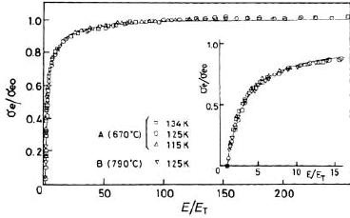
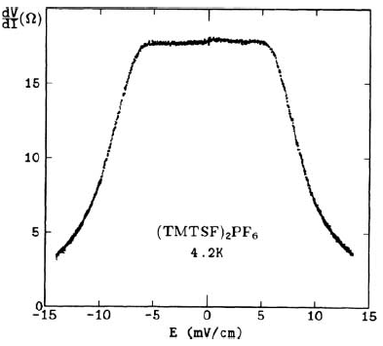
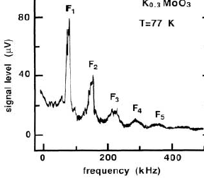
Differential resistance,
universal conductance,
spectrum of the generated
periodic signal

Slide 38
Single model fits of theoretical v(f) to experimental I-V curve (Ogawa, Miyano, S.B.)
Works through three regimes.
1. Middle part : regime f~logv.
2. Left part, if plotted in the normal scale, - linear law f~v.
3. Right part: sharp upturn discriminates in favor of the high strengths – unrestricted bistability f=f_{max}-cnst/v.
Curvature sign changing at low v is an artifact of logarithmic rescaling of the current axis.
a review: S. B. and T. Nattermann
Advances in Physics, 53 (2004)

Slide 39



The models
Universal symmetry defined models.
Lattice models.

Slide 40
E
-2k_{F}
E
2k_{F}
-2k_{F}
2k_{F}
ε_{F}
-π/2a
π/2a
-k_{F}
k_{F}
Charge Density Waves - three models in one:
Half-filled band - 1 e per unit cell, ±2k_{F}= ± π/a –
the same point – only one degree of freedom in Δ;
Incommensurate 2k_{F} : complex field Δ= Δ₁+i Δ₂
3. Small 2k_{F} : quadratic dispersion near the band bottom –
Shroedinger rather than Dirac H.

Slide 41
Origins of multi-periodicities and of solitons at their branching.
Doping from half filling (KdV to NLSE)
Zeeman splitting (FFLO)
From bottom (strong coupling to BCS)
Charge Density Waves – 3x2 models in one:
Half-filled band - 1 e per unit cell, ±2k_{F}= ± π/a – the same point – only one degree of freedom in Δ , Z₂;
Incommensurate 2k_{F} : complex field Δ= Δ₁+i Δ₂
3. Small 2k_{F} : quadratic dispersion near the band bottom –
Shroedinger rather than Dirac Hamiltonian.
4. Unlocking of each of above modulations by Zeeman splitting.
All that is unified by the Todda lattice model
(S.B., I.Dzyaloshinskii, I.Krichever; S. Matveenko)

Slide 42
Bridge between theories of the real and complex ((one and two components ) .
Peiels or Mott effect from combination of bonds- and sites-dimerizations
R`
R`
R
R
∆_{s} - from dimerization of sites
∆_{b} - from dimerization of bonds

Slide 43
Microscopics of local and instantaneous electronic states in CDWs .
BCS-like Peierls-Fröhlich model for the CDW.
Exact static solutions – solitons- of multi-electronic models.
Adiabatic generalization to dynamic processes – instantons.
Incommensurate CDW : Acos(Qx+φ) Q=2K_{f}
Order parameter : Δ(x,t)~ Aexp(iφ)
Electronic states Ψ= Ψ₊exp(iK_{f}x) + Ψ₋exp(-iK_{f}x)
Justification of the mean-field BCS, and for co-observation of electrons and solitons: Small phonon frequency: experimentally ω_{ph} <0.1Δ

Slide 44
A simple-minded way to get a luck of exact solution
for the minimum of the energy (here for the real field Δ)
Variational eqs. of W over Ψ and ∆:
A self-consistent set of Bogolubov – DeGennes eqs.
These functional eqs. become algebraic at the risky suggestion
Ansatz: any term has the same structure is satisfied provided

Slide 45
Two infinite sets of integrals of motion:
Each term is an integral of motion of the mKdV equation
hence the total energy is invariant. Expecting physically only the translational degeneracy, we insist the traveling solution Δ(x,t) = Δ(x-ct)
We know the answer before obtaining it.
This “natural” Anzats applies only to a single periodicity
A deeper view: may be a hidden, even multiple, degeneracy

Slide 46
Quasi-1D Mott state = 4K_{F} CDW = commensurate Wigner crystal
Charge degrees of freedom: phase ϕ=ϕ(x,t)
2K_{F} CDW/SDW ~cos (ϕ+xπ/2a) 4K_{F} CDW~ cos (2ϕ+xπ/a)
H= /(4πγ) [v (∂_{x}ϕ )² + (∂_{t}ϕ )² /v] - Ucos (nϕ )
n=integer (n=2,3,4 are known)
commensurability ratio between the DW and the underlying crystal
v~v_{F} – velocity γ= K_{ρ} - in notations of “Luttinger liquid”
γ (all interactions) , γ(0)=1 - major monitoring parameter :
γ<4/n² : any repulsion for n=2,
build-in U is not renormalized to zero, generic Mott state case,
Threshold in U if n>2
γ<2/n²: strong repulsion, then U can be spontaneously generated
– Charge Ordering = 4K_{F} condensation,
always a threshold effect, no bridge to weak coupling theories

Slide 47
-
+
-
+
Uexp[i2ϕ] : amplitude of the Umklapp scattering
(-K_{F,}- K_{F}) → (+K_{F},+K_{F}) is allowed here.
Momentum deficit 4K_{F} is absorbed by reciprocal lattice period.
Continuous chiral symmetry is lifted.
Umklapp scattering amplitude, leading to the Mott state
Dzyaloshinskii & Larkin, Luther & Emery.
U from 4K_{F} commensurability
Notes:
47

Slide 48
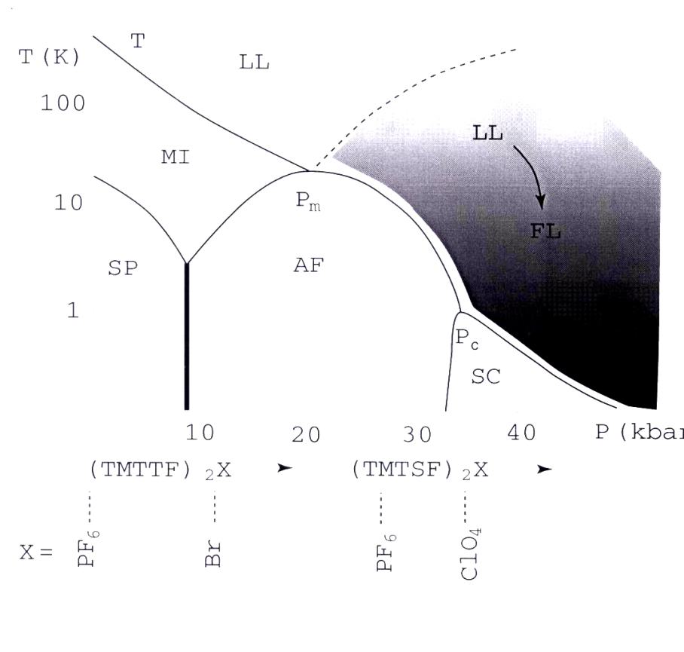
found | guessed
(TMTCF)₂X
SC- superconductivity
AF- AFM = SDW
SP- Spin-Peierls
LL- Luttinger liquid
MI- Mott insulator
Red line T_{CO} ~100-200K – 2000’s revaluation:
Ferroelectricity (Monceau, Nad, SB, et al)
= Charge Ordering (Brown et al); Kanoda 98
spontaneous
Mott insulators
good metals on top of
hidden Mott insulators
Access to switching on/off of the Mott state and to the Zoo of solitons.
Views and interpretations:
FerroElectric Mott-Hubbard state,
mixed site/bond 4K_{F} CDW,
non-symmetrically pinned Wigner crystal,
charge ordering = disproportionation
Facility to see Solitons:
purely 1D regime - T_{CO}≈150K is 10 times above 3D electronic transitions.

Slide 49
Combined Mott insulator as an electronic ferroelectric.
COMBINED MOTT - HUBBARD STATE: 2 types of dimerization ⇒
Site dimerization : H_{U}^{s}=-U_{s} cos 2ϕ (spontaneous)
Bond dimerization : H_{U}^{b}=-U_{b} sin 2ϕ (built-in)
H_{U}= -U_{s}cos 2ϕ -U_{b}sin 2ϕ = -Ucos (2ϕ-2α)
U_{s}≠0 → α ≠0 → shifts from ϕ =0 to ϕ = α - FE polarization.

