Slide 1
Microscopic solitons/instantons in quasi-1D
electronic systems with symmetry breakings:
Born in theories of late 70’s, Guessed in experiments of early 80’s,
Persuading observations in 2000’s, Visualization in 2010’s
Why the resent explosion of interest ?
New optically and electronically active polymers,
New ferroelectric Mott state in organic conductors.
New STM and tunneling observations in Charge Density Waves.
New high magnetic field access to spin polarized FFLO-like states
of CDW, superconductor, and the spin-Peiels state.
further new area:
Transformations of symmetry broken electronic states by
impacts of optical pumping and electrostatic field effect doping.

Slide 2



Tidal wave in a
“small river”
of Brazil
Tsunami coming
Solitons in general : propagating isolated profiles –
from the tsunami wave (Russel 1834) to
magnetic domain walls and to hypothetic
holons and spinons in strongly correlated systems

Slide 3
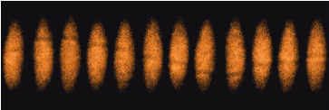
A most opposite exemple:
Heavy solitons in a fermionic superfluid. M.W. Zwierlein, MIT
“We create long-lived solitons in a strongly interacting superfluid of fermionic atoms and directly observe their motion.”

Slide 4
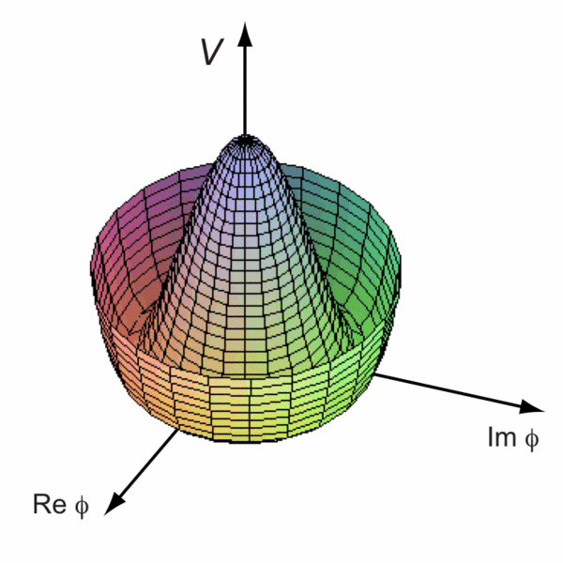
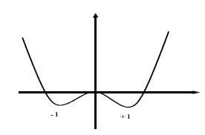
Solitons in perspective of quasi-1D electronic systems
Self-localized excitations exploring degeneracies of ground states
with a spontaneously broken symmetry:
superconductor, CDW, SDW, charge-order Mott insulator, electronic ferroelectric.
Solitons carry spin and/or charge – separately, even in fractions.
They bring associated spectral features
(electronic mid-gap states, vibrational modes)
They can take over normal electrons as charge or spin carriers.
They give definitions of holons and spinons in correlated systems.
Instantons : related transient processes for creations of solitons or their pairs, for conversion of electrons or excitons into solitons
Symmetry breaking :
degenerate equivalent
ground states.
simplest soliton=
kink between them

Slide 5
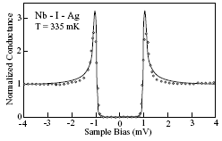
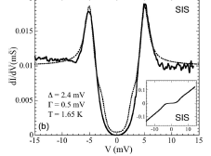

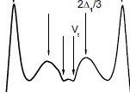
Singlet ground state gapful systems:
SuperConductors SCs and
Charge Density Waves CDWs.
Standard BCS-Bogolubov view:
Spectra : E(k)= ±(∆²+(v_{f}k)²)^{1/2}
States = linear combinations of :
electrons and holes at ±p for SC
electrons at –p and p+2p_{f} for CDW
CaC₆
pair-breaking gaps from
tunneling experiments.
Is it always true?
Proved “yes” for typical SCs.
Questionable for strong coupling : High-T_{c},
real space pairs, cold atoms, bi-polarons.
Certainly incomplete for CDWs
as proved by many modern experiments.
Certainly inconsistent for 1D and even
quasi 1D systems as proved theoretically.
NbSe₃
Guilty and Most Wanted : solitons and their arrays.

Slide 6
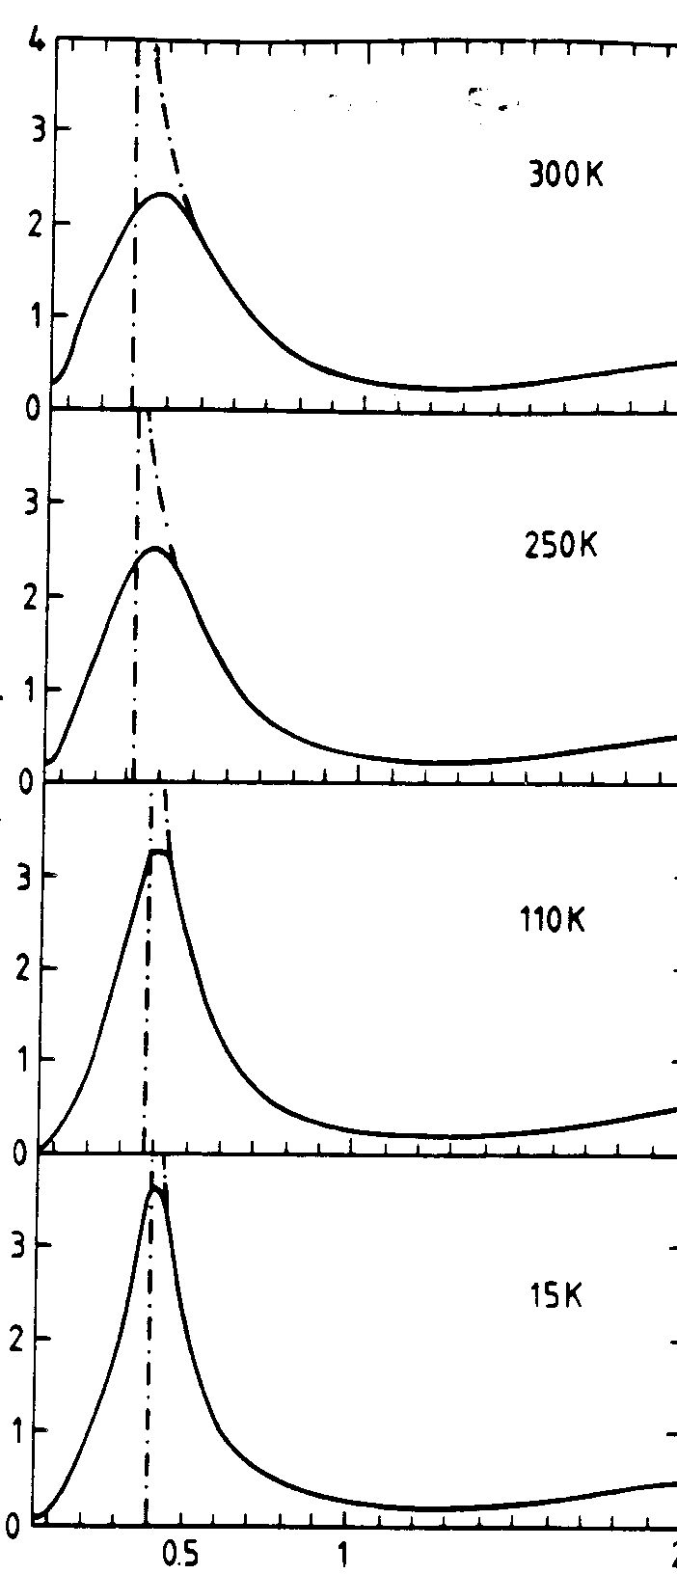
The gap interval (-Δ, Δ) may become partly filled by:
Absence of the true long range order
(the pseudogap),
Anomalous lower energy excitations
- solitons
Pseudogaps in tunneling and optics

Slide 7
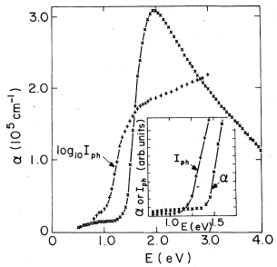
Photo-current, hence the photo-conductivity,
comes only from excited unbound pairs at E>E_{g}
Absorption – also from bound excitons, hence expect a
lower threshold at E_{ex}<E_{g} as it is normally observed.
The photocurrent I_{ph} offset
starts below the absorption !
I_{ph} is much more sensitive, it recovers
adiabatically forbidden creation
of relaxed configurations –
here pares of solitons.
Their threshold is, theoretically, 30% lower.
In favor of that: exponential growth of I_{ph}.

Slide 8
Topological defects on the polyacethylene chains
W
Ideal chain
Δ
Δ₀
0
-Δ₀
Q=+e
Charge solitons
q=±e, s=0
Δ₀
0
Q=-e
-Δ₀
Δ₀
Spin soliton,
q=0, s=1/2
0
-Δ₀
Δ=Δ₀ tanh [x/ξ₀], W_{tot} = (2/π)Δ₀ E_{el} =0

Slide 9
Self-trapping in 1D - polaron
Spontaneous deformation forms the
potential well U for an electron
l
U₀
Energy functional:
Min over U₀ : U₀~1/Kl
~1/2m*l²
~ -U₀
~KU₀²l/2
E=1/2m*l² -U₀+KU₀²l/2
W
1/l
Minimum W₀ at l₀~K/m* , W₀< E₀ <0
l=∞ - always unstable
At D>1 long range Coulomb interactions (ionic crystals) are necessary
to get self-trapping without the barfrier, hence the name “polaron”

Slide 10
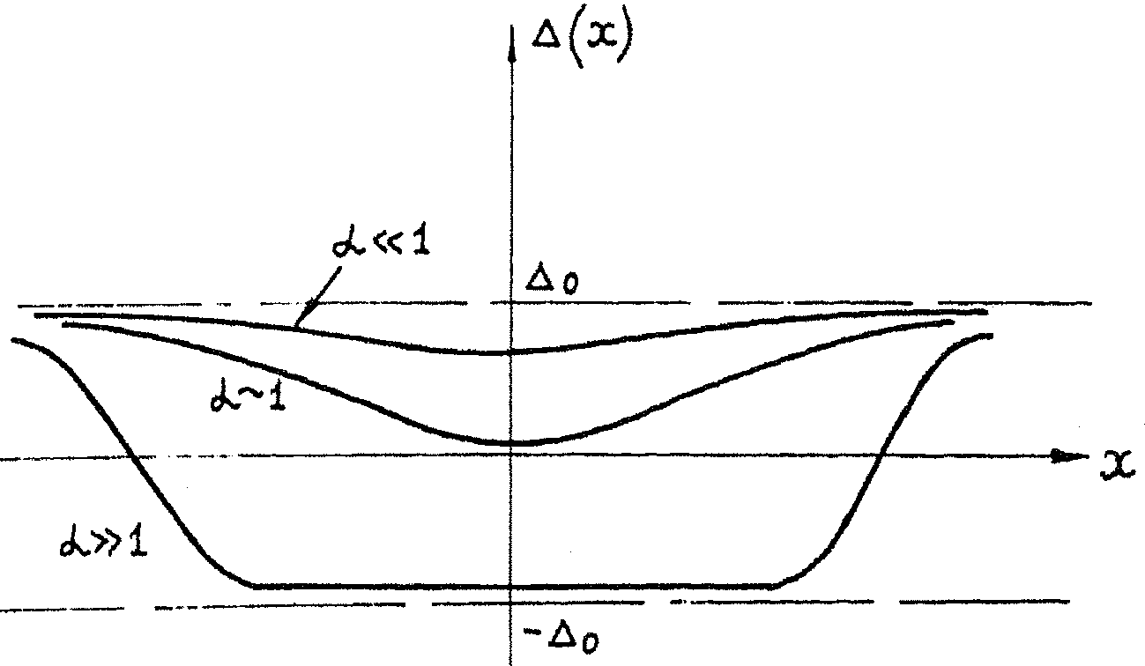
One way to build the family of solutions – diverging kinks
Intragap levels of
developing bound state
Δ
E_{b}
0
-E_{b}
−Δ
One trapped electron –
stable intermediate position
Two trapped electrons –
diverging pair of kinks

Slide 11
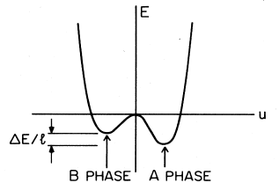
Effect upon kinks: global lifting of symmetry - confinement.
Nature present -- cis-isomer of (CH)_{x} :
build-in slight inequivalence of bonds
hence lifting of ground state degeneracy,
hence confinement of solitons
Cis-(CH)_{x} :
Nonsymmetric dependence
of GS energy on dimerisation
Confinement – the linear growth of the attraction energy while the particle diverge.
Ideal chain
Energy difference per unit length
is a constant confinement force F.

Slide 12
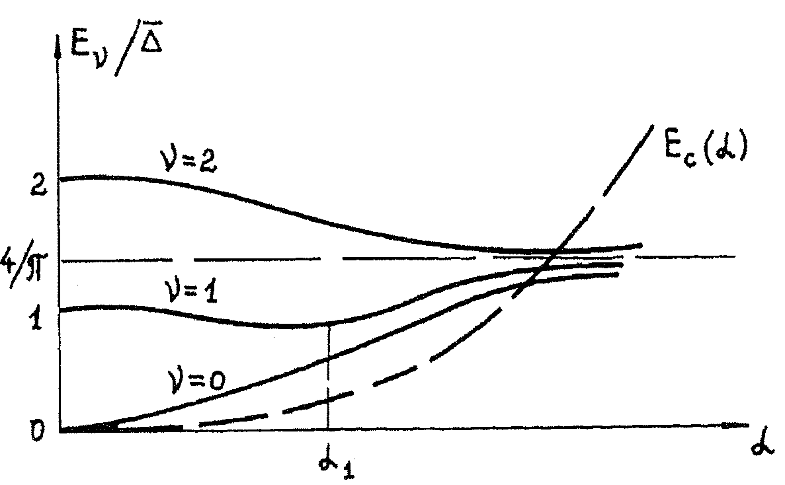
2 kinks cannot diverge far away anymore.
They form a loose bound state – a particle with the charge 2e - the bipolaron
New ingredient –
confinement energy

Slide 13
Confinement of kinks pair into 2e charged (bipolaron)
or neutral (exciton) compex.
Symmetry determined picture of optical differences for trans- and cis- isomers S. B. and N. K.
Photoconductivity trans-(CH)_{x} vs photoluminescence cis-(CH)_{x}
also new optical features due to hybridization of mid-gap states

Slide 14
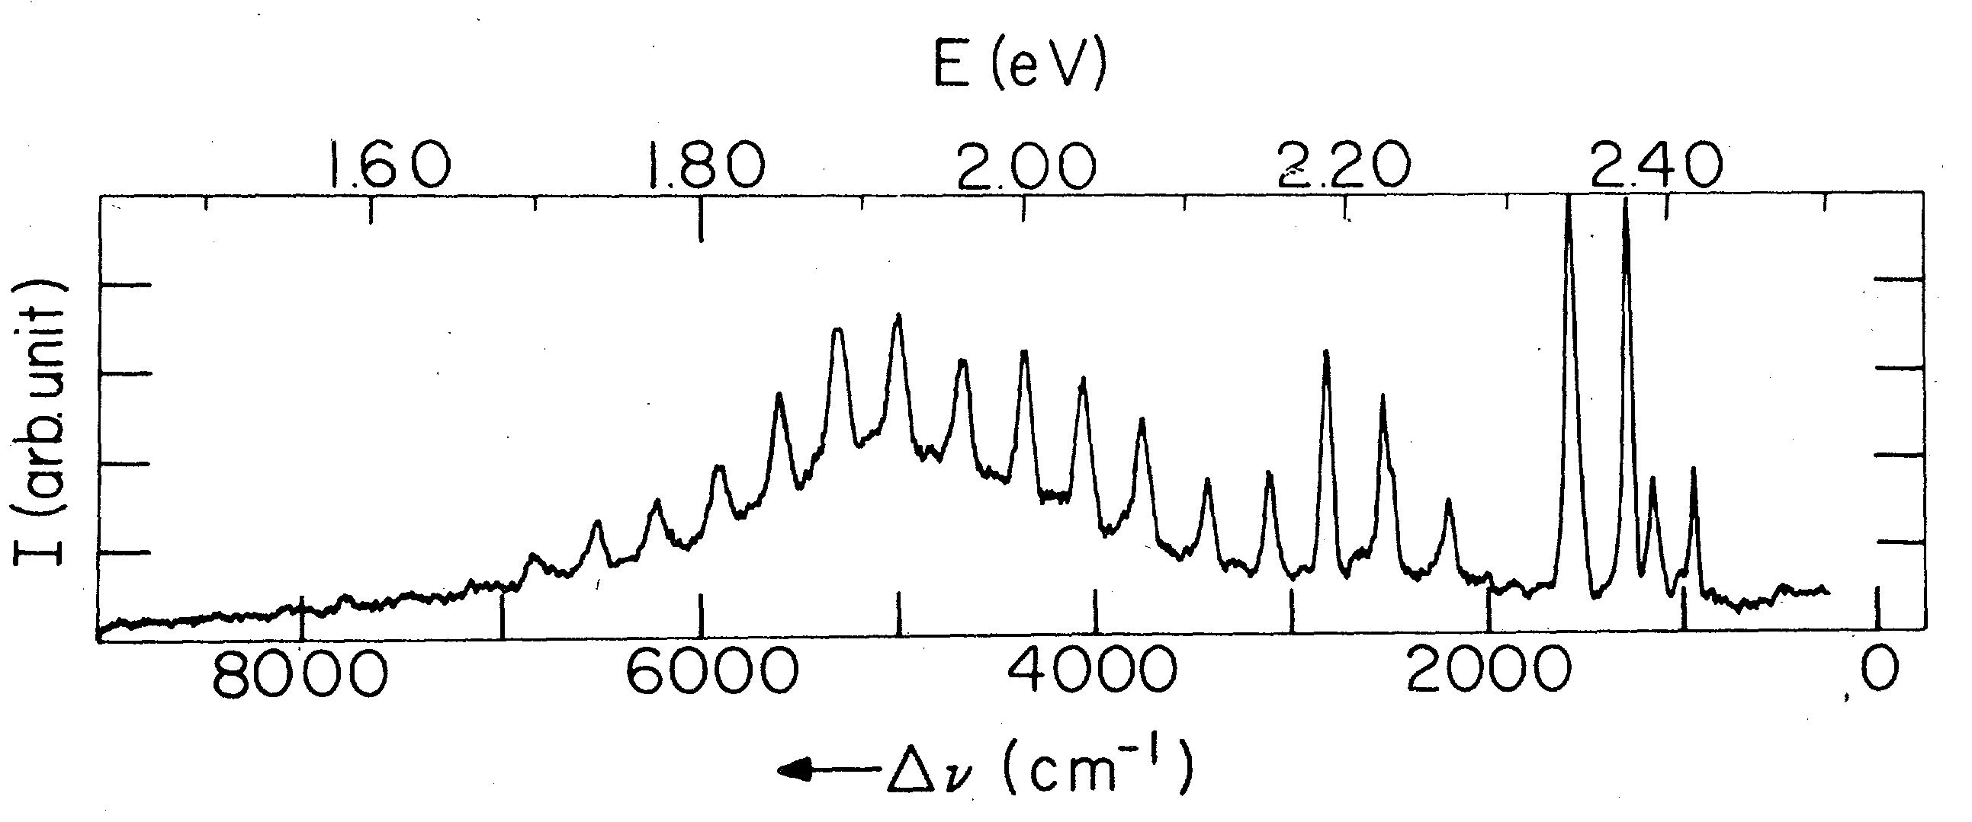
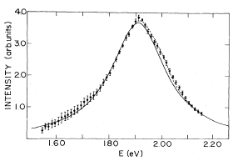
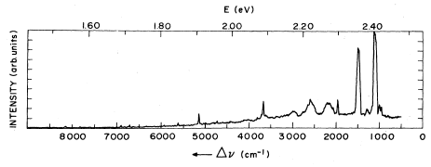
Only luminescence of cis-(CH)x vs only photoconductivity
In trans- (CH)x
Same data, just
cleaned from phonons
Broad line covered by multiple phonons
repetitions - vibrations of the lattice dressing
of the selft-traped state
- additional proof of the selftrapping.
trans-PA, T=7K, pump at 2.54eV
Remnant luminescence is
50 times less then that of cis-PA

Slide 15
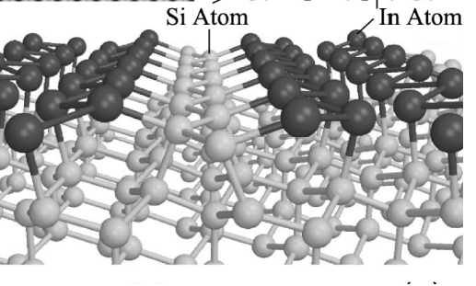
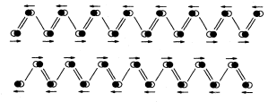
Observation of a soliton in a truly 1D physics, Han Woong Yeom, Pohang
The array of Indium chains at Si 111 surface.
Ground state: 2-fold commensurate CDW, discrete Z₂ symmetry of dimerization. Realization of the Gross-Neveu model and KdV.
E
E
E_{F}
-k_{F}
k_{F}
-k_{F}
k_{F}

Slide 16
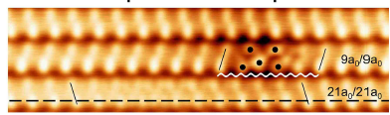
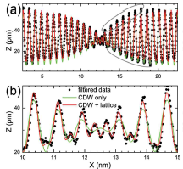
Strong defect immobilizes
the soliton at a below chain
Excellent fitting similar to NbSe3
with ξ= 3.4 nm=9a
Amplified central view
Hopping of solitons’ was noticed – mobile intrinsic defect !

Slide 18
Arrays of amplitude solitons (Fulde, Ferrel, Lakin, Ovchinnikov) unit for spin-polarized superconductors
Unit of CDW superstructure in HMF (new experiments on organics).
Soliton lattice unit in spin-Peierls systems in magnetic field
(NMR, neutrons – C. Berthier et al, Grenoble; J.P. Pouget et al).
Very new (Orsay – Jerome, Pasquier, S.B., et al):
Solitonic lattice as a support for superconductivity near
SDW insulator-metal transition
CDW or SC under slightly supercritical Zeeman splitting. plotted:
Solitonic lattice of the order parameter,
Unpaired spins = mid-gap states density distributed near the gap zeros.
If melted, each element becomes a particle - Amplitude Soliton = Spinon
1
0
-1
Equivalent picture in Peierls systems:
charged spinless solitons introduced by dopping or field effect
SB, Gordunin, Kirova

Slide 19
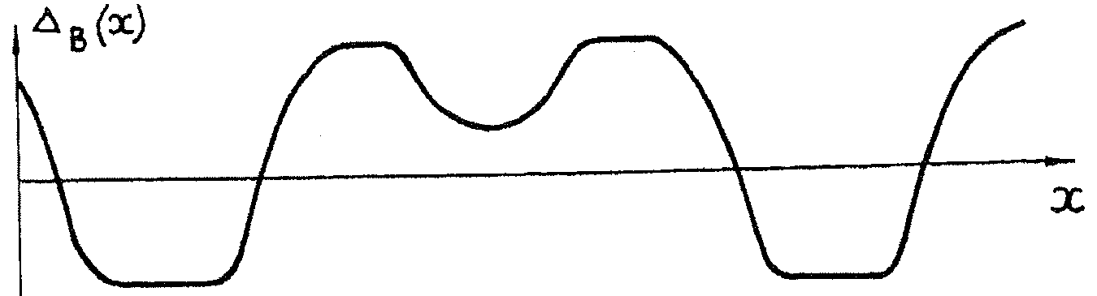
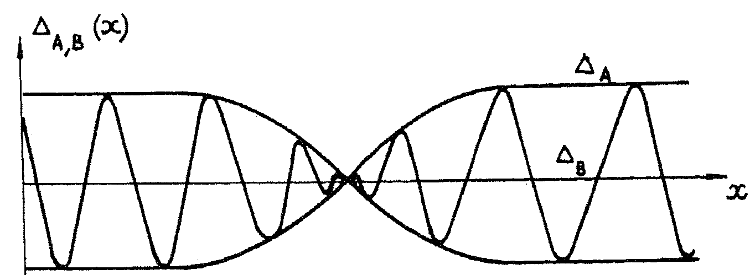
Combination of charge doping and spin injection:
Soliton upon a periodic structure: two limiting regimes.
Soliton embedded into a rare array of waves
Surfers’ hunt: Overlapping soliton modulates sequence of waves.
Whatever regime or soliton’s position, the array shift across
the soliton is always half of the period . The soliton is topologically nontrivial but is not topologically stable. It is stable energetically accommodating the unpaired spin ½ at the split off level.
The charge is variable: evolves from e to zero.
SB, Dzyaloshinskii, Kirova

Slide 20
CASES OF CONTINUOUS DEGENERACY
Limitation of the above cases of discrete symmetry breaking :
Solitons can be created only in pairs, even in 1D.
In D>1 they are either permanently confined in pairs
or aggregated into macroscopic domain walls.
A higher continuous degeneracy -
superconductors, SDWs, incommensurate CDWs -
allows for existence and creation of isolated solitons,
of direct conversion of a single electron into a single soliton.
In 1D, a single electron becomes unstable with respect to its selftrapping - transformation into a soliton.
In D>1 an undressed electron is metastable,
hence both particles may be observed simultaneously

Slide 21
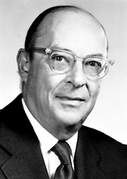
John Bardeen’s Grand Unification:
……
1940’s - transistor
1950’s - Superconductivity
1976 – 30/01/1991- - Charge Density Waves
Common features of incommensurate CDWs and the superconductors:
O_{cdw} =Acos(2K_{F}x+ φ) → complex order parameters
O_{cdw,sc} ~ A exp[iϕ]
hence vortices ←→ dislocations, phase slips ←→ phase solitons
Similar microscopic theories: Peierls-Frohlich vs BSC
Pair-breaking gaps 2Δ , hence tunneling, FFLO ←→ solitonic lattices
Tighter links at D=1:
The phases ϕ_{cdw} , ϕ_{sc} are in conjugation: [ϕ_{i}, ∂_{x}ϕ_{j}]~δ(x)
2Δ becomes the common spin gap; broken pair becomes 2 free spinons.
Spinons as amplitude solitons

Slide 22
Continuous symmetries. The Instanton.
Solitons are stable energetically but not topologically.
Special significance: allowance for a direct transformation of one
electron into one soliton. (Only 2→2 allowed for dimerization kinks)
Δ
2
V₁
2π
SOLITON
θ
E
V₂
2θ
E
-
Sequence of chordus solitons develops from bare θ=0 through
the amplitude soliton at 2θ=π to the full phase slip 2θ=2π.
Intra-gap split-off state E evolves from Δ₀ to -Δ₀ providing spectral flow across the gap together with the electrons’ conversion.
V_{n}(θ) - selftrapping branches of the total energy for chordus solitons with
the intragap state fillings n =1 and n=2.

Slide 23
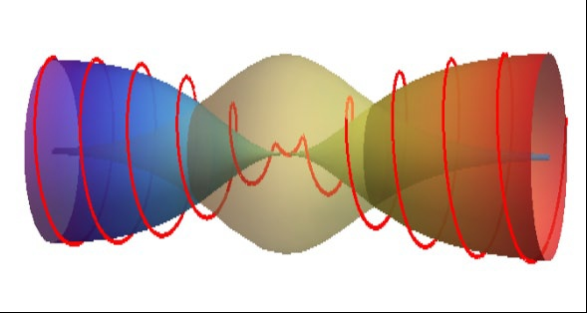

Complex order parameter , Incommensurate CDWs.
Noninteger variable charges.
Modeling for the amplitude π-soliton = spinon in the CDW
Localisation of the
self-trapped electron
(A,ϕ) trajectory of the CDW order parameter Acos(Qx+ϕ)
This is the state of a 1D CDW or 1D superconductor
with one added unpaired electron.
SB for CDW; SSH,
Takayama-LinLiu-Maki for polyacetylene

Slide 24
Probabilities to create combined topological defects:
AS creates the π- discontinuity δφ=π along its world line: (0<t<T, x=0)
compensating for the sign change of the amplitude :
To be topologically allowed = to have a finite action S, the line must terminate with half integer space-time vortices located at (0,0) , (0,T) : their circulation provides the jump A→-A combined with φ→φ+π
which leaves invariant the order parameter Aexp(iφ).
The phase action as a function of time T:
x
+
+/-
-/+
Contrary to usual 2π- vortices, the connecting line
is the physical singularity which string tension gives
t
+
Total action S=S_{core}+S_{phase} , min{S}~ln(T)
hence the power law for I(Ω)~exp(-S)

Slide 25
Ground state continuous degeneracy allows for topologically unstable solitons if they are stabilized energetically.
Such is the amplitude soliton at the above figure.
Major properties of amplitude solitons:
Energy < Δ: self-trapping of electrons into the soliton
They bear mid-gap states = zero fermionic mode
3. They carry spin but no charge.

Slide 26
Add a single electron or hole near the gap rims, ±Δ₀, allow for deformations of the gap: amplitude Δ=Δ₀+δ and phase  d /dx= ’ if applicable.
Check for stability:
Topological soliton !
Charge of trapped electron
is exactly compensated

Slide 27
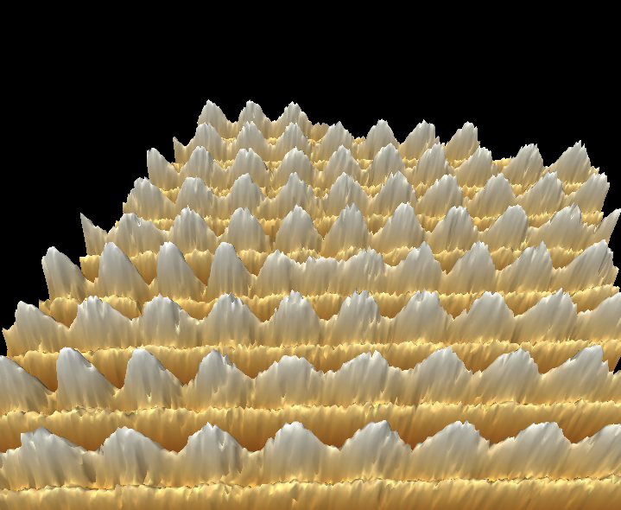
STM view of the CDW1 in NbSe3
STM is tuned to see only the CDW
The chain
bearing
the soliton
S. B., C. Brun, Z.-Z. Wang, and P. Monceau, Phys Rev Let (2012)

Slide 28
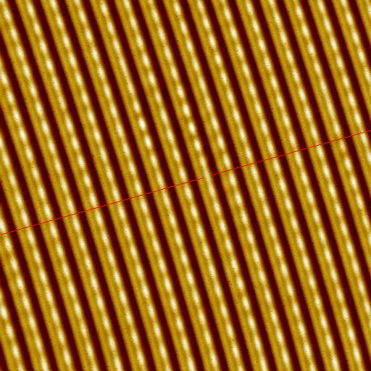
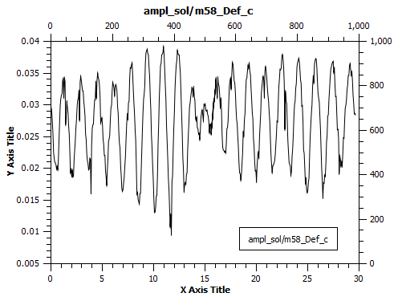
Another presentation of same scan
At the (red) front line, the defected chain
is displaced by half of the period.
Along this chain, the whole period 2π
is missed (or may be gained).
A particle with the charge 2e ? No,
1e - might be created by one electron.
Go to the raw data:
Soliton profile along the defected chain.
The CDW adopts itself by half a period shift and its amplitude vanishes,
presumably to accommodate electron or hole to the mid-gap state.

Slide 29
Soliton is a light particle, M_{s}~m_{b}.
To be seen by STM, it needs to be
Immobilized - trapped by a host lattice defect.
Could it be that we saw an impurity effect rather than the soliton?
No, the impurity gives an opposite effect – the Friedel oscillation
which was identifed also in the same set of experiments.
FO~Cos(2K_{F}x)|x|⁻¹ Exp(-|x|/ξ) cf. Ishioka et al, 2011
Low T
High T
High T

Slide 30

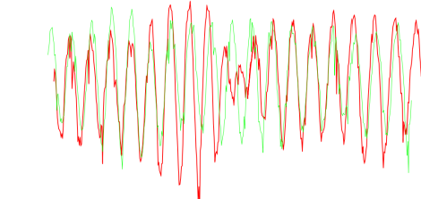
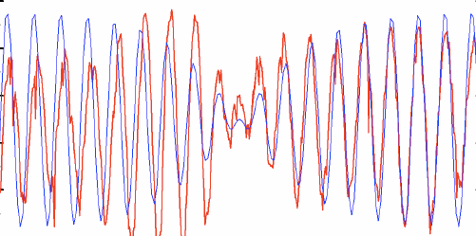
The CDW is perforated here and there by nodes of amplitude
Profile along the defected chain
vs its nearest neighbor
Defected chain vs theory
Phase stretching by π over long tails allows the amplitude kink to adapt to a long range 3D order. General concept: topologically
bound complex of the kink core and the half-integer vortex.

Slide 31
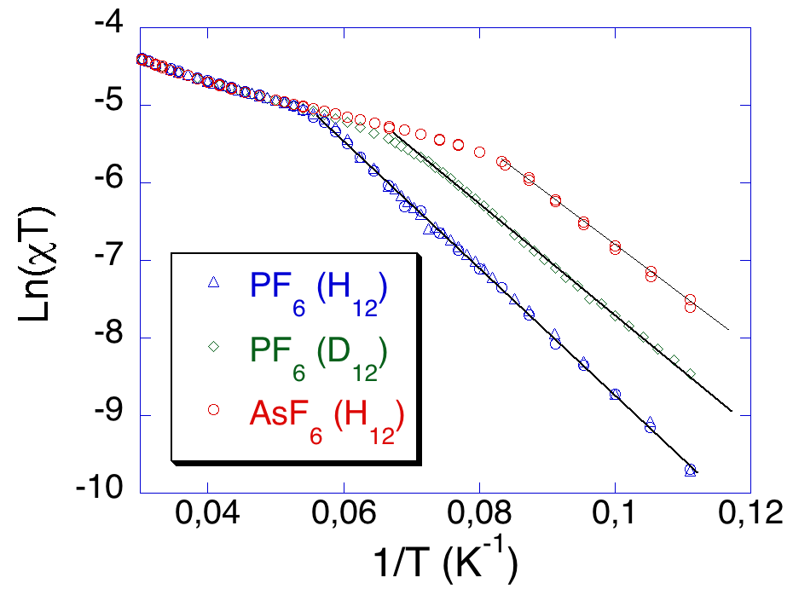
Organic conductors: low scales of gaps allow for their determination
from thermal activation and comparison with optical features.
What does conduct in these “narrow gap semiconductors” ? NOT the electrons, even in the polaronic version !
PF6
AsF6
SbF6
Conductance , normalized to RT
- Ahrenius plot LogG(1/T).
Gaps Δ_{c} for thermal activation of
conductance within 500-2000K.
χ∼exp(-Δ_{s} /T) , Δ_{s} ∼75Κ
Contrarily to normal semiconductors –
NO GAP, or a very small gap Δ_{s},
in spin susceptibility χ(T).
Clearlest example for conduction by
charged spinless solitons - holons.

Slide 32
Collective description for the 1D Mott state on the dimerized lattice.
Spin degrees of freedom are gapless, split-off and not important for a while.
Charge degrees of freedom: phase ϕ=ϕ(x,t)
2K_{F} CDW/SDW ~cos (ϕ+ πx/2a) 4K_{F} CDW~ cos (2ϕ+ πx/a)
-
+
4K_{F} →1 – Umklapp scattering (Dzyaloshinskii + Larkin)
Bosonization language (Luther + Emery)
-
+
H~ (/4πγ) [v_{ρ} (∂_{x}ϕ )² + (∂_{t}ϕ )2 /v_{ρ} ] - Ucos (2ϕ-2α)
without interactions γ=1 and v_{ρ}=v_{F}
The energy H_{U}= -Ucos (2ϕ) is doubly degenerate between ϕ= 0 and ϕ= π.
It allows for phase π solitons = holons with charge e vacancy defects.
φ=0
φ =π

Slide 33
Collective description for the 1D Mott state on the dimerized lattice.
Spin degrees of freedom are gapless, split-off and not important for a while.
Charge degrees of freedom: phase ϕ=ϕ(x,t)
2K_{F} CDW/SDW ~cos (ϕ+ πx/2a) 4K_{F} CDW~ cos (2ϕ+ πx/a)
Two fold commensurability: pinning potential potential and its degeneracy.
Wave function Ψ distriburtion at E_{F} (for the site dimerisation):
+ o - o + o - o

ϕ=0,π: Ψ=±1 at good sites  and Ψ=0 at bad sites 
ϕ=π/2: Ψ=0 at good sites  and Ψ= =±1 at bad sites 
-
+
-
+
H~ (/4πγ) [v_{ρ} (∂_{x}ϕ )² + (∂_{t}ϕ )2 /v_{ρ} ] - Ucos (2ϕ) + Wcos (4ϕ)
without interactions γ=1 and v_{ρ}=v_{F}
The energy H_{U}= -Ucos (2ϕ) is doubly degenerate between ϕ= 0 and ϕ= π.
It allows for phase π solitons = holons with charge e = CO vacancy defects.
φ=0
φ =π

Slide 34
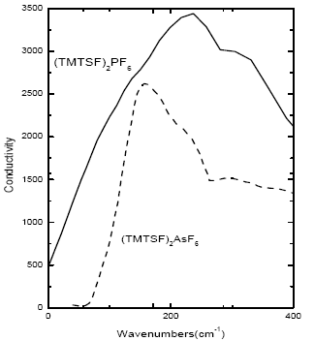
First evidence for solitons = holons:
the activated conductivity with gapless spin susceptibility
Second evidence – optical gaps, even in case of remnant metals.
E_{g}=2Δ - unbound
pair of kinks
Exciton = two-kinks bound state
Peierls
spin gap
Drude
peaks
Optical conductivity (absorption): M. Dressel, L. Degiorgi et al

Slide 35
Effects of subsequent symmetry lifting.
Topologically confined solitons. Spin-Charge reconfinement.
Another present from the Nature:
second symmetry lowing transition of tetramerization
SCN
Ahrenius plots for the cobductivity.
Inclination gives the activation energy
for charge carriers
ReO4
Spin-charge reconfinement below T_{AO} of tetramerisation. Enhanced gap Δ comes from topologically coupled π- solitons in both sectors of the charge and the spin. The last is weakly localized. What does it mean ?
Spin degrees of freedom enter the game:
θ - spin chiral phase, θ′/ π = smooth spin density

Slide 36
Schematic illustrations for effects of the tetramerization
Inequivalence of bonds = , -- between good sites 
endorses ordering of spin singlets.
Also it prohibits translations by one    distance
which were explored by the δϕ=π soliton.
But its combination with the defected unpaired spin
(δθ=π soliton which shifts the sequence of singlets)
is still allowed as the selfmapping –
connction of equivalent ground states

Slide 37
Further symmetry lifting of lattice tetramerization or of spin-Peierls order
mixes charge and spin: additional energy
Vcos (ϕ-β)cos θ - on top of ~Ucos (2ϕ-2α)
ϕ and θ -- chiral phases counting the charge and the spin
ϕ ′/ π and θ′/ π = smooth charge and spin densities
cos θ sign instructs the CDW to make spin singlets over sorter bonds
Major effects of the small V - term :
Opens spin gap 2Δ_{σ} :
triplet pair of δθ=π solitons at ϕ=cnst
Prohibits δϕ =π solitons –
now bound in pairs by spin strings
Allows for combined spin-charge
topologically bound solitons:
{δϕ =π , δθ=π} – leaves the V term invariant
Quantum numbers of the compound particle --
charge e , spin ½ but differently localized:
charge e , δϕ =π sharply within ħv_{F}/Δ_{ρ}
spin ½ , δθ =π loosely within ħv_{F}/Δ_{σ}
s
p
I
n
c
h
a
r
g
e
s
p
I
n

Slide 38
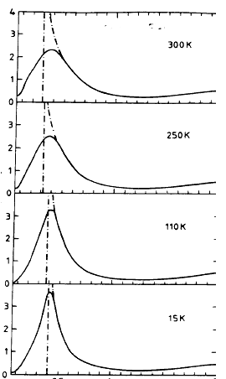
Incommensurate CDWs in quasi 1D conductors.
Subgap transitions due to non-adiabatic quantum fluctuations;
Related pseudogap (cf. cuprates).
Already a long standing problem in optics :
Figure – DiGiorgi group, ETH
Optical absorption in Blue Bronze
Expected edge singularity:
Subgap tail persistent at low T.
Quantum processes -
presence of excitations below 2∆

Slide 39
Can the solitons cross the boarder to the higher D world ?
Are they allowed to bring their anomalies like
spin-charge separation or mid-gap states?
Password : confinement.
As topological objects connecting degenerate vacuums,
solitons acquire an infinite energy unless they
reduce or compensate their topological charges.
Various scenarios :
Compensation by the gapless mode S.B. 1980, 2000's
Aggregation into domain walls versus their melting by thermal deconfinement or long rage Coulomb forces
S.B. & T.Bohr 1983, S. Teber 2001
Coupling to structural defects in polymers.
Binding to kink-antikink pairs, origin of bipolarons.
S.B. & N.Kirova, 1981- 90’s
Topological binding to gapless degrees of freedom

Slide 40
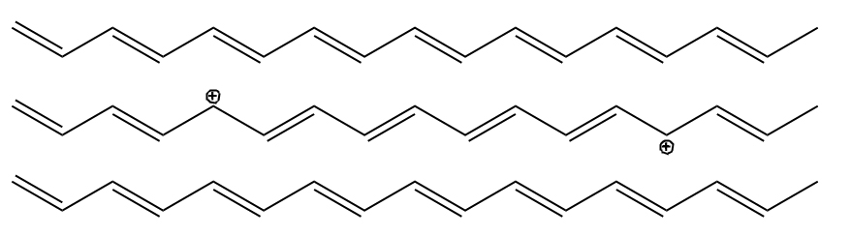
(CH)x – 3D phase
In-phase
Out of phase
In-phase
Interaction of chains brings confinement of solitons into pairs.
In-between the kinks, the interchain correlation is broken,
hence the confinement energy W_{cnf} = F|x|;
The confinement force F>0 is additive to the electric field E, hence erasable : W_{cnf} + W_{E} = F|x|-Ex,F → G=F-E
Notes:
Mismatch between the phase

Slide 41

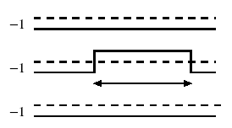
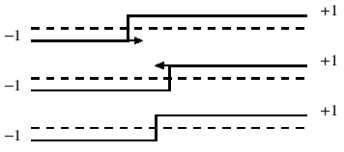
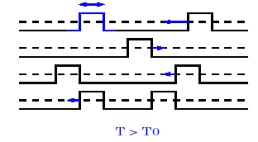
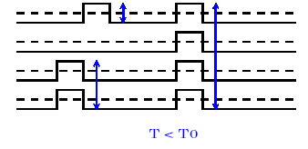
FINITE TEMPERATURE, ENSEMBLES OF SOLITONS,
PHASE TRANSITIONS OF CONFINEMENT AND AGGREGATION.
DISCRETE SYMMETRY only.
Fatal effect upon kinks: global lifting of degeneracy, hence confinement.
Nontrivial but still spectacular:
local lifting in the state with long range order.
Interchain coupling of the order parameter.
Two competing effects:
Binding of kinks into pairs at T<T_{c};
Aggregation into macroscopic domain walls at T<T₀<T_{c}.
Solution for a statistical model T.Bohr and S.B. 1983, S.Teber et al 2000’s

Slide 42
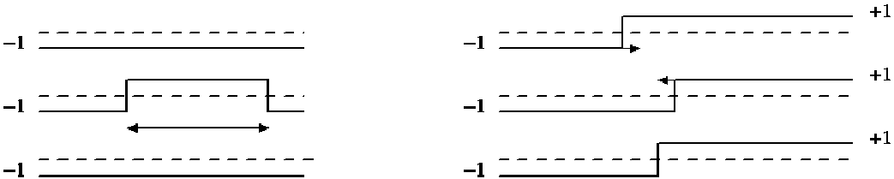

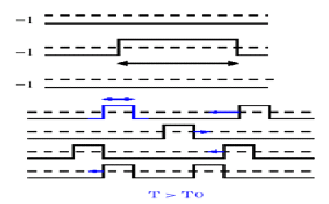

High temperature T > T1: Solitons exist as individual entities.
They already experience long range attractions towards binding them into pair at the same chain (left panel)
or to walls at neighboring chains (right panel).
Intermediate temperatures T1 >T > T2. No more individual solitons, but a gas of their conned pairs. Pairs’ lengths are loose and fluctuate at T1 > T > J; they are tight at J > T > T2.

Slide 43
Lower temperature below T2:
Another transition (D=3) or a crossover (D=2) for formation of
macroscopic domain walls made from
transversely aggregated kinks.
At T<T2 they are embedded to the gas of bikinks;
At T→0 they absorb all particles.

Slide 44
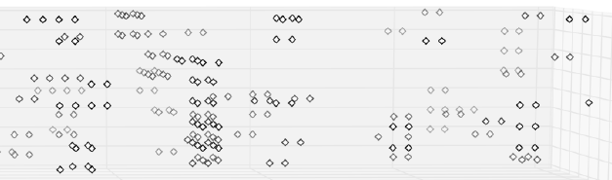
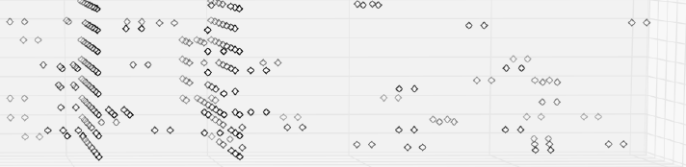
T=2.1J⊥
T=2.0J⊥

Slide 45
Major puzzle and inspiration in CDWs: amplitude solitons
within the long range ordered phase at T<T_{c}
Obstacle : confinement.
Changing the minima on one chain would lead to
a loss of interchain ordering energy ~ total length.
Need to activate other modes to cure the defect !
Unifying observation :
combination of a discrete and continuous symmetries
Complex Order Parameter O= A exp[iϕ] ; A - amplitude , ϕ - phase
Ground State with an odd number of particles:
In 1D - Amplitude Soliton O(x=-∞) ⇔ - O(x=∞)
performed via A ⇔-A at arbitrary ϕ=cnst
Favorable in energy in comparison with an electron, but: Prohibited to be created dynamically even in 1D
Prohibited to exist even stationary at D>1
RESOLUTION – Combined Symmetry :
A ⇔-A combined with ϕ→φ+π – semi-vortex of phase rotation compensates for the amplitude sign change

Slide 46
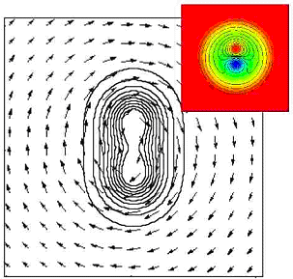
core : kink –
spin carrier
flux lines
of ½ -vortices
kink – roton combination, exemple of the superconductor or the CDW.

Slide 47
SPIN-GAP cases - superconductivity or incommensurate CDW.
Bosonisation language :
Η_{1D}~(∂θ)² -Vcos(2θ)} +(∂ϕ)²
V - from the backward exchange scattering of electrons
In 1D : Spinon as a soliton θ→ θ+π hence s=1/2
+ Gapless charge sound in ϕ.
CDW order parameter ~ ψ†_{+↑} ψ_{-↑} + ψ †_{+↓} ψ_{-↓} ~ exp [iϕ] cosθ
Its amplitude cosθ changes the sign along the allowed π soliton
Same for the superconductivity with another (gauge) phase ϕ
At higher D : allowed mixed configuration
θ → θ+π , s=1/2 ϕ → ϕ+π , e=1
↑spin soliton ↑ ↑charged wings↑
Spinon as a soliton +
semi-integer π-vortex of ϕ
confined
spin

Slide 48
Singlet Superconductivity
O_{SC}~ ψ_{+↑} ψ_{- ↓}+ ψ_{+↓} ψ_{-↑} ~ exp [iχ] cosθ H=…-g₁cos2θ
θ → θ+π s=1/2 χ→ χ+π
↑spin soliton ↑ ↑wings of supercurents↑
spin carrying
core
half
flux
lines
Quasi 1d view : spinon as a π- Josephson junction in the superconducting wire (applications: Yakovenko et al).
2D view : pair of π- vortices shares the common core
bearing unpaired spin.
3D view : half-flux vortex stabilized by the confined spin.
Updown view: nucleus of melted FFLO phase in spin-polarized SC

Slide 49
At presence of unpaired spins, the vortex created by rotation (magnetic field) splits into two semi-vortices.
Spatial Line Nodes and Fractional Vortex Pairs in the FFLO Vortex State of Superconductors
D. F. Agterberg, Z. Zheng, and S. Mukherjee 2008
Vortex molecules in coherently coupled two-component Bose-Einstein condensates
K. Kasamatsu, M.Tsubota, and M. Ueda 2004
Last step: reformulate these results inversely –
unpaired spin creates the vortex pair
at NO rotation/MF.

Slide 50
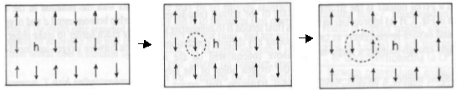
Propagating hole as an amplitude soliton.
Its motion permutes AFM sublattices ↑,↓
creating a string of the reversed order parameter:
staggered magnetization. It blocks the direct propagation.
Bulaevskii, Khomskii, Nagaev.
Brinkman and Rice.
Adding the semi-vorticity to the string end heals the permutation
thus allowing for propagation of the combined particle.
spin flipping
spin rotations
by hole motion
Alternative view:
Nucleus of the stripe phase or the minimal element of its melt.

Slide 51
Half filled band with repulsion.
SDW rout to the doped Mott-Hubbard insulator.
Η_{1D}~(∂ϕ)² -Ucos(2ϕ)+(∂θ)²
U - Umklapp amplitude
(Dzyaloshinskii & Larkin ; Luther & Emery).
ϕ - chiral phase of charge displacements
θ - chiral phase of spin rotations.
Degeneracy of the ground state:
ϕ →ϕ+π = translation by one site
Staggered magnetization ≡ AFM=SDW order parameter:
O_{SDW} ~ cos(ϕ) exp{±i(Qx+θ)} , amplitude A= cos(ϕ) changes the sign
To survive in D>1 : The π soliton in ϕ : cos ϕ → - cos ϕ
enforces a π rotation in θ to preserve O_{SDW}
spin flipping
spin rotations
by hole motion

Slide 52
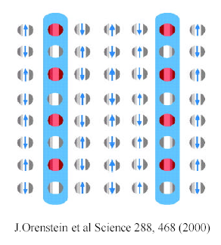
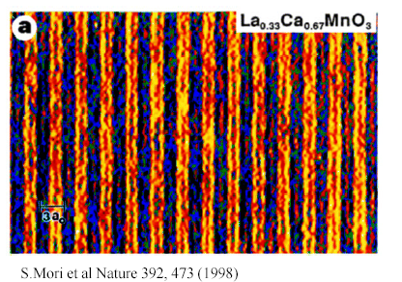
Inverse rout: from stripes to solitons
1D → quasi 1D → 2D,3D route to dopping of AFM insulator.
Aggregation of holes (extracted electrons) into stripes.
Left: scheme derived from neutron scattering experiments.
Right: direct visualization via electron diffraction microscope.
Equivalence for spin-gap cases:
Fulde-Ferell-Larkin-Ovchinnikov FFLO phase in superconductors
Solitonic lattices in CDWs above the magnetic breakdown
Solitonic lattices in spin-Peierls GeCuO in HMF - Grenoble

Slide 53
+
Kink-roton complexes as
nucleuses of melted lattices:
FFLO phase for superconductors
or strips for doped AFMs.
+
-
+/-
-/+
-
+
+
Defect is embedded into the regular stripe structure (black lines).
+/- are the alternating signs of the order parameter amplitude.
Termination points of a finite segment L (red color) of the zero line must be encircled by semi-vortices of the π rotation (blue circles)
to resolve the signs conflict.
The minimal segment would correspond to the spin carrying kink.
Vortices cost ~E_{phase}logL is less than the gain ~-ΔL
for the string formation at long L. Can we shrink to the atomic scale?
For smallest L~"unit cell", it is still valid in quasi 1D : E_{phase}~T_{c}<Δ
For isotropic SCs, E_{phase}~E_{f} – strong coupling is necessary.

Slide 54
OUTLOOK
Existence of electronic solitons is proved experimentally for CDWs in several classes of quasi-1D conductors.
Solitons feature self-traping of electrons into mid-gap states and separation of spin and charge into either spinons or holons, sometimes with their reconfinement.
Continuously broken symmetries allow for solitons to enter
D>1 world of long range ordered states: SC, ICDW, SDW.
Solitons take forms of amplitude kinks, topologically bound to
semi-vortices of gapless modes – half integer rotons.
These combined particles substitute for electrons: certainly in quasi-1D systems – for both charge- and spin- gaped cases.
The description is extrapolatable to strongly correlated isotropic cases: from dopped AFM insulators to FFLO in superconductors.
Here it meets the picture of fragmented stripe phases.

