Slide 1
Electronic Ferroelectricity
From realities of organic conductors to
perspectives of conjugated polymers and the graphene
Requests: Light-weight, plastic, processible ferroelectric materials.
Working example: Structural ferroelectricity in a saturated polymer.
R&D: Neutral-to-Ionic transitions in insulating organic crystals
Electronic ferroelectrics: Mott-Hubbard phase and
the polar charge ordering in organic conductors.
Predictions: ferroelectricity in electronically and optically active conjugated polymers.
Hypothesis: Spontaneous polarization of zigzag edges in graphene nanoribbons.

Slide 2
Ferroelectricity is a rising demand in
fundamental and applied solid state physics.
R&D include:
Active gate materials and electric RAM in microelectronics,
Capacitors in portable WiFi communicators,
Electro-Optical-Acoustic modulators,
Electro-Mechanical actuators
Transducers and Sensors in medical imaging.
Difficulties with conventional ferroelectric oxides:
Process compatibility and contamination.
Request for plasticity – polymer-ceramic composites
but weakening responses – effective ε~10.
Plastic ferrroelectrics are necessary in medical imaging – low weight :
compatibility of acoustic impedances with biological tissues.

Slide 3
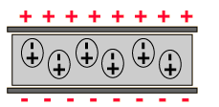
Polarization in Insulators
Positively charged species in insulators shift/rotate/align toward the negative electrode and negatively charged species shift/rotate/align towards the positive electrode; creating dipoles.
The dipole moment density is called the Polarization (P) .
E
E
Electron Cloud
Electron Cloud
-
-
+
+
-
-
+
+
+
+
Electronic polarization, occurs in all insulators
Molecular polarization, occurs in all insulating molecules; oils, polymers, H₂O…
E
-
+
-
-
+
-
+
-
+
+
-
+
Polarization jump equals
to interface charge density
Ionic polarization occurs in all ionic solids: NaCl, MgO…

Slide 4
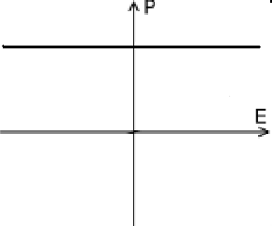
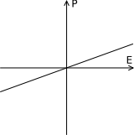
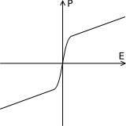
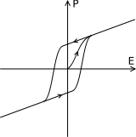
Basic types of polarizeable media :
Polarization P in applied field E
Dielectric Paraelectric Ferroelectric Pyroelectric
Strain response to the applied
electrical field ⇨ piezoelectricity
Spontaneous polarization in the absence applied electrical field.
Strong variation in polarization with temperature
Traditional Ferroelectrics:
Insulating, ionic crystals, which exhibit spontaneous polarization
switchable by external electric fields
Spontaneous polarization sets on below a material-specific
transition temperature

Slide 5
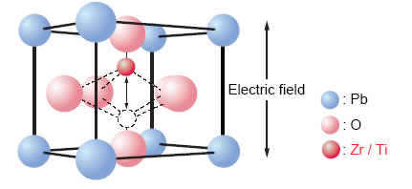
Important Ferroelectric Materials
PZT - Pb(Zr_{x}Ti_{1-x})O₃
  large spontaneous polarization, high piezoelectric coefficients,
  high transition temperature (~370°C)
SBT – SrBi₂Ta₂O₉
  low remnant polarization but
  very high transition temperature (~570°C)
Symmetry breaking from
centro-symmetric cubic structure
to non-centro-symmetric tetragonal – ferroelectric state
Notes:
to come slowly to fefets: two important ferroelectric materials used in fefets
PZT: Lead Zirconate Titanate
a particular phase transition appears at a certain mixture ratio – the so-called morphotropic phase boundary marks this transition.
leads to 14 different polarization directions -> highly polarizable state, which is often exploited for certain applications
SBT: Strontium Bismuth Tantalate

Slide 6
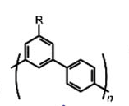

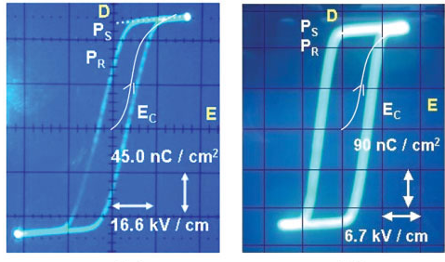
Liquid crystalline conjugated polymers (K. Akagi, Kyoto)
Compare:
BiFeO₃ (BFO)
P∼100μC/cm²
Ferroelectric hysteresis loops of PPP and PMP liquid crystals
The polarization comes from a ligand R:
it is not yet an electronic FE of pi-electrons

Slide 7
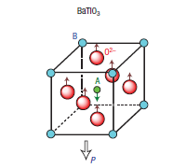
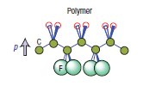
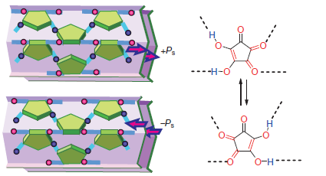
Typical origin of FE: particular, generally unpredictable ways to gain the energy from homogeneous ions’ displacements
Displacement transitions – generally unknown reasons
Traditional inorganic ferroelectrics,
BaTiO3, Pb(Zr_{x}Ti_{1-x})O₃ et al
Global conformations in polymers : PVDF
Cis versus trans (preferable angles for molecular bonds)
Local conformations
of big molecules :
organic ferroelectrics
(S. Horiuchi@AIST)

Slide 8
More secured way of the design:
symmetry defined effects, driven by electronic correlations.
Following examples of organic conductors:
from TTF-CA,BA (H.Okamoto, Y.Tokura, N.Nagaosa, et al, 1990-2012)
to (TMTTF)₂X, etc (Monceau,Nad, Brazovskii; Brown) since 2001

Slide 9
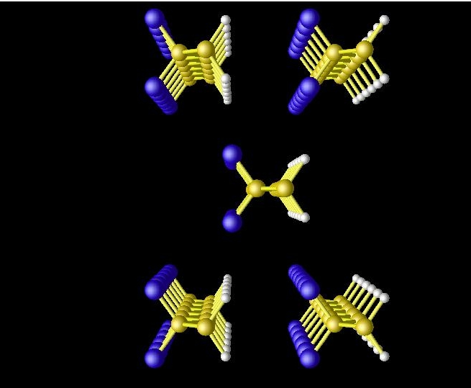
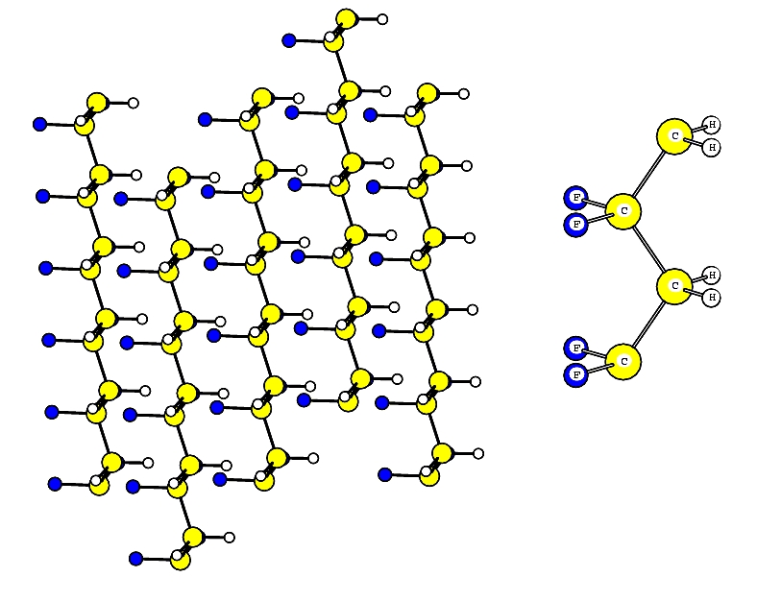
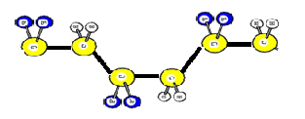
Can we have organic-only, particularly polymer-only ferroelectric ?
One ferroelectric saturated polymer does exist - Poly(vinylidene flouride) PVDF :
ferroelectric and pyroelectric,
efficient piezoelectric if poled –
quenched under a high voltage.
Light, flexible, non-toxic, cheap
Helps in very costly applications :
ultrasonic transducers, sonar equipment
unique as long stretching actuator.
PVDF structural unit
Trans FE phase
Driving force behind the FE ordering:
preference of trance- (versus cis-) conformation
But: ε~10 – modest efficiency (compare to ε~500 for inorganic FE)

Slide 10
Can we go wider, diversely, and may be better with conjugated polymers?
Can we mobilize their fast π-electrons to make a better job than common ions?
Is there a predicatable, symmetry defined way to reach FE states?

Slide 11
More secure : symmetry defined approach,
particularly when driven by electronic correlations
Instructions for the deterministic the FE design:
Combined symmetry breaking.
Lift the inversion symmetry, remove the mirror symmetry,
Do not leave a glide plane.
Keep the double degeneracy to get a ferroelectric rather than an unflexible piroelectric state.
A chain with the double dimerization of sites and bonds.
Alternation of bonds removes the mirror symmetry,
Alternation of sites removes the glide plane
Local view: Bonds are polar because of site dimerization.
Their dipoles are not compensated since the lengths alternate.

Slide 12
Both dimerizations are built in: alternating stacks TMTTF_{0.5}TMTST_{0.5} (Pouget et al) - must be pyroelectric: the polarization is frozen
Any one of two dimerization is spontaneous. Direction of polarization can be changed – the ferroelectric state. Its 4 versions:
Dimerization of bonds is built in; dimerization of sites is spontaneous: organic conductors (TMTTF)₂X. Charge ordering is endorsed by the energy gain from falling to the Mott insulator state: band filling goes from ¼ to ½) (S.Brazovskii & Monceauin 2000’s)
2. Dimerization of sites is built in; dimerization of bonds is spontaneous – Peierls dimerization: proposal for conjugated polymers of the (AB)_{x} type, expected to be seen in substituted polyacetylene (CRCR’)_{x}
(S.Brazovskii & N.K. – 2008)
3. Both sites’ and bonds’ dimerizations are spontaneous
-1st order neutral-ionic transition in charge transfer salts like TTF-CA (Y.Tokura et al)
Spin- Peierls dimerization:
organic quantum magnets (F. Kagawa et al, 2010)

Slide 13
(AB)_{x} Conducting Polymers | Organic Crystals
built-in extrinsic (∆_{e})
nonequivalence of sites | nonequivalence of bonds
Spontaneous intrinsic (∆_{i})
Peierls bonds alternation | Wigner-Mott-Hubbard charge localization
Threshold effect ∆_{in} WILL NOT be spontaneously generated – it is a threshold effect - if ∆_{ex} already exceeds the wanted optimal Peierls gap.
Lifting of the inversion symmetry, leading to electric polarization, hence the ferroelectricity.

Slide 14
. Dimerization of sites is built in;
dimerization of bonds is spontaneous
Peierls insulator – conjugated polymers of the (AB)x type like di-substituted polyacetylene

Slide 15
Combined Peiels effect in diatomic linear chain polymer (C₂RR`)x
(Theories: S.B. & N.K. 1981, M.Rice&E.Mele 1982)
∆_{e} comes from the build-in site dimerization – non-equivalence of sites.
∆_{i} comes from the spontaneous dimerization of bonds, the Peierls effect.
R`
R`
R
R
E
ε_{F}
} E_{g}=2Δ
-k_{F}
k_{F}
This is a threshold effect !
∆_{in} WILL NOT be spontaneously generated
if ∆_{ex} already exceeds the wanted optimal Peierls gap ∆₀ .
Chemistry precaution: make a small difference of ligands R and R’

Slide 16
“Accidental” origin of the success to get the Peierls effect of bonds dimerization:
weak difference of radicals –
only by a distant side group.
Small site dimerization gap leaves a space
to add the bond dimerization gap.
Still a missing link : no attempts to check for the Ferroelectricity:
To be tried ? and discovered ! By whom, in which country?
How do we know that polarization is present (X-rays are no good, q=0)?
From identification of physics of solitons.

Slide 17
Solitons with non integer variable charge (S.B.& N.K., M.Rice&J.Mele)
Breaking of the charge-conjugation symmetry
Δ₀
0
-Δ_{e}
-Δ₀
S=0
Δ₀
Δ_{e}
0
-Δ₀
Δ₀
S=1/2
0
-Δ_{e}
-Δ₀
All solitons play multiple roles. They are:
Defects of dimerization
Supporters of one intra-gap split-off state – at Δ_{e} ≠0,
The walls separating domains with opposite FE polarizations
have spin-carrying and charge-only forms.
Even spin solitons carry the charge – small as eΔ_{e}/Δ.

Slide 18
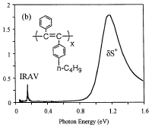
Proof for spontaneous dimerization via existence of solitons.
Optical results by Vardeny group, Utah. Solitons’ identification:
Absorption, Luminescence, Dynamics
Features in IR and visible
Combined ESR - optics experiments and IRAV infra-red-active vibrations:
The spin carrying solitons which still carry some charge
- surprising from experience of the conventional polyacetylene

Slide 19
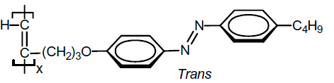
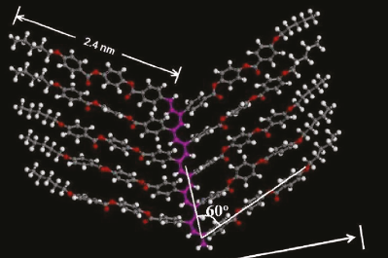
What else is promising today?
A great variety of synthesis is already demonstrated.
(the strongest activity in chemistry has moved to Hong Kong,
with physical characterizations in Beijing.
An existing compound which may be at least the pyro-electric.
The carbon backbone has a
cis isomerization –
the degeneracy of bonds’ dimerization is already lifted,
the polarization is weakly frozen.

Slide 20
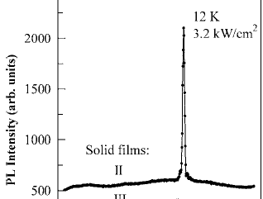
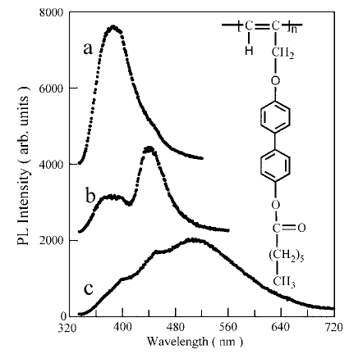
Another example of the monosubstituted polyacetylene tells that
there may be a ferroelectrically tunable visible-light laser. Shantou, Guangdong, China
Photo-luminescence spectra at room temperature for low pumping:
a) and b) - dilute and concentrated solutions, c) - solid film c.
Green laser at T <200K for photo pumping ~4 kW/cm2.

Slide 21
Particular interest in developing ferroelectric
π-conjugated systems “electronic ferroelectrics”:
Manipulations of charged solitons by electric field.
Their spectral features arrive in optics
Gigantic ε, easy repolarization – fast response
Conductivity and/or optical activity of π-conjugated systems will add more functionality to their ferroelectric states.
Polarizability of chains can allow to manipulate morphology (existing hybrids of polymers and liquid crystals. K. Akagi - Kyoto).
High and fast nonlinearity :
χ₂ for the optical mixing , second harmonic generation

Slide 22
Hypothesis on the spontaneous polarization
at edges of the Graphene – think of nanoribons.
Analogy to the (AB)x polymer
The sites are alternating by their position.
Will the bond alternation be added at a reasonable temperature?
It depends on the coupling λ of the edge state with lattice deformations.
Theoreticlal estimations for λ strongly diverge: from λ~10⁻² to λ~0.3.
Need a stronger localization L of the edge state: λ~1/L.
Waiting for experiments.

Slide 23
Dimerization of bonds is built in; dimerization of sites is spontaneous after a phase transition to the Mott insulator state: organic conductors (TMTTF)₂X

Slide 24
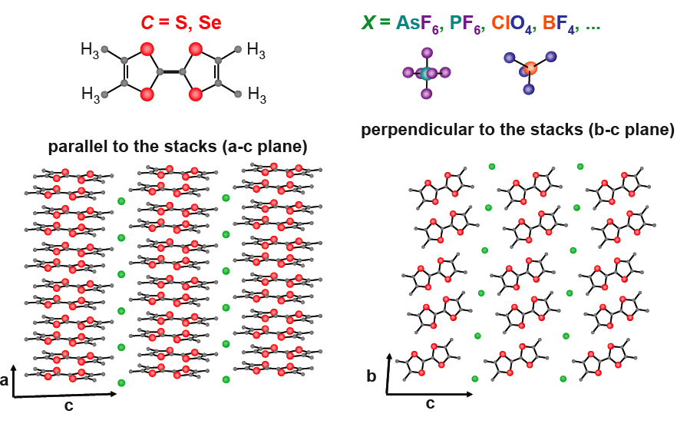
Organic crystals: Bechgaard-Fabre salts
Built-in dimerization of bonds in a-direction
(the counterions X are placed against each second pair of molecules )

Slide 25
Spontaneous symmetry breaking seen by
displacements of counter-ions,
nonequivalence of sites
Displacements of ions X.
ferroelectricity.
Redistribution of electronic density, amplification of polarizability ε by (ω_{p}/∆)²~10² ε ~10³

Slide 26
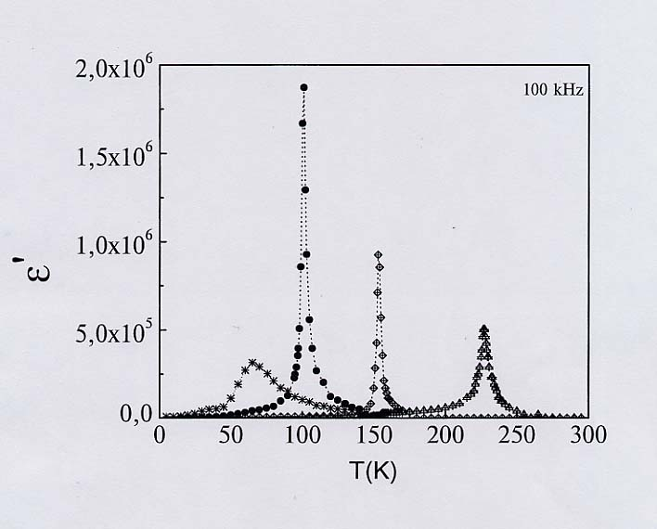
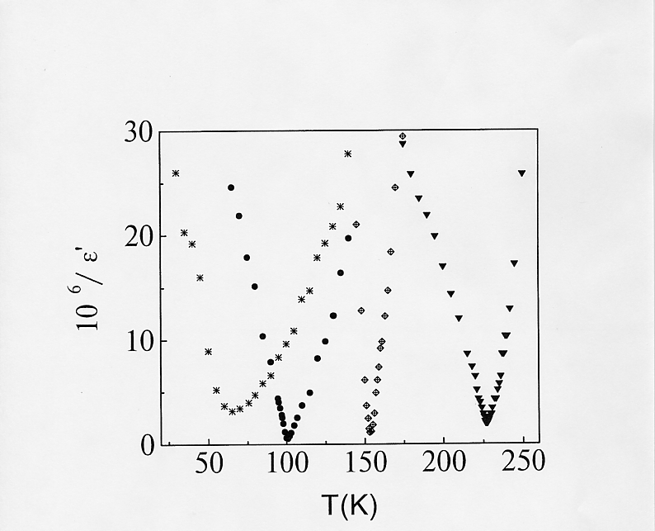
Real part of dielectric constant of (TMTTF)₂X salts
P.Monceau et al. Phys. Rev. Lett. 86 (2001) 4081
AsF₆
SbF₆
ReO₄
PF₆
Real part of the permittivity (the dielectric constant ε’ )
- the second order phase transition described by the perfect Curie law

Slide 27
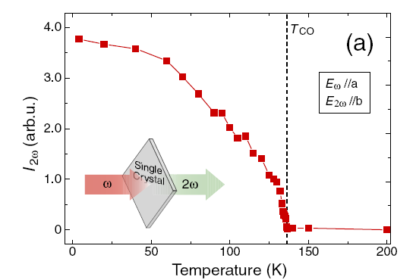
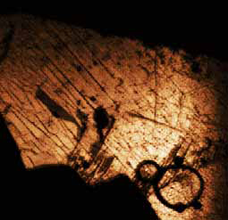
Direct proof for the FE state in a syster compound:
local measuraments of the second harmonic generation in α-(ET)₂I₃ K. Yamamoto et al. (2008-11)
Second harmonic generation
Identification of the frozen polarization:
through anomalous optical activity
- lack of inversion symmetry
E² is allowed only
if the inversion symmetry is lifted.

Slide 28
* T. Nakamura, et al (2007)
** S. Fujiyama, et al (2006)
***W. Yu et al., (2004)
What is so special about ferroelectricity in organic conductors?
Charge carriers screen the electric field at the sample boundaries,
eliminating the usual separation into domains of opposite polarization.
Hence no hysteresis, easy ac repolarization and
the astonishingly high permittivity ε∝10⁶.
That allows us to test the dynamical scaling from critical fluctuations.

Slide 29
Both sites’ and bonds’ dimerizations are spontaneous
- 1st order neutral-ionic transition in
charge-transfer salts like TTF-CA

Slide 30
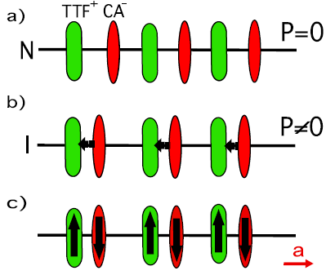
Both types of dimerisations are (quasi) spontaneous:
Neutral-Ionic Transition
TTF-CA: stacks of alternating donors D=TTF and acceptors A=CA.
T>Tc=81 K: molecules are weakly charged.
T=Tc: quasi-neutral to ionic transition.
Charge transfer ρ_{n} jumps from 0.3 to 0.7
Charged molecules shift relative to each other – interpretations as
either Coulomb or spin-Peierls instabilities,
creating alternating long and short bonds.
With all inversion and mirror symmetries lifted, this might be the ferroelectric.
Thermodynamic CT.
Primary effect: redistribution of the charge density ρ with no symmetry breaking, hence an isomorphic (liquid-gas class) transition described
by the single real field q=ρ- ρ_{n}.
Actually – symmetry breaking because of complementary dimerization.

Slide 31
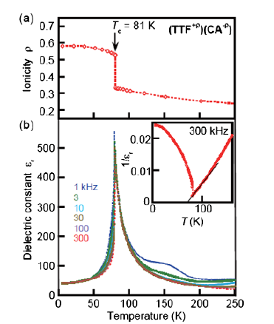
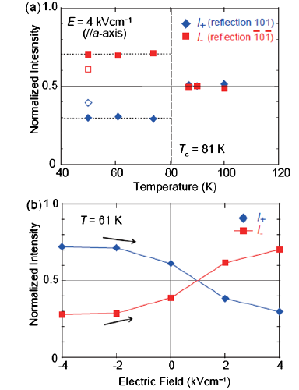
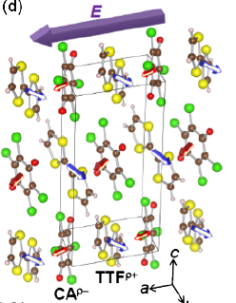
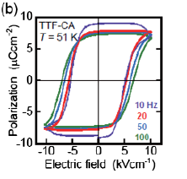
Electronic Ferroelectricity in a Molecular Crystal with Large Polarization Directing Antiparallel to Ionic Displacement
K. Kobayashi, S. Horiuchi, R. Kumai, F. Kagawa, Y. Murakami, and Y. Tokura
Phys. Rev. Lett. 108, 237601 (2012)
Electronic polarizaion is 20 times of the ionic polarization
and the two point in opposite directions.

Slide 32
Game of principle variables.
h – dimerizational displacement of molecules
ρ - charge transfer, in neutral phase ρ = ρ_{n},
ρ_{c} − monitoring parameter ρ_{c} = ρ_{c}(T)
The energy density:
ρ_{c} > ρ_{n}– critical value of ρ for instability in h:

Slide 33
Changing the energy landscape by pumping excitations
ρ-ρ_{n}
Trivial minimum at ρ=ρ_{n} , h=0
n=0.04
Double minima at ρ>ρ_{n} , h=±h₀
appear and evolve to the ionic state
h

Slide 34
LESSONS and PERSPECTIVES
π-conjugated systems can support the electronic ferroelectricity.
Effect is registered and interpreted in two families of
organic crystalline conductors (quasi 1D and quasi 2D).
Mechanism is well understood as combined collective effects of
Mott or Peierls types.
An example of a must_be_ferroelectric polyene has been already studied .
The design is symmetrically defined and can be previewed.
Solitons will serve duties of re-polarization walls.

Slide 35
« In the beginning was the Word, …
and without him was not anything made that was made »
Physical Review 1964
W.A. Little
Possibility of a synthesizing an organic superconductor.
“Little” mystification: did he actually mean ferroelectricity?

Slide 36
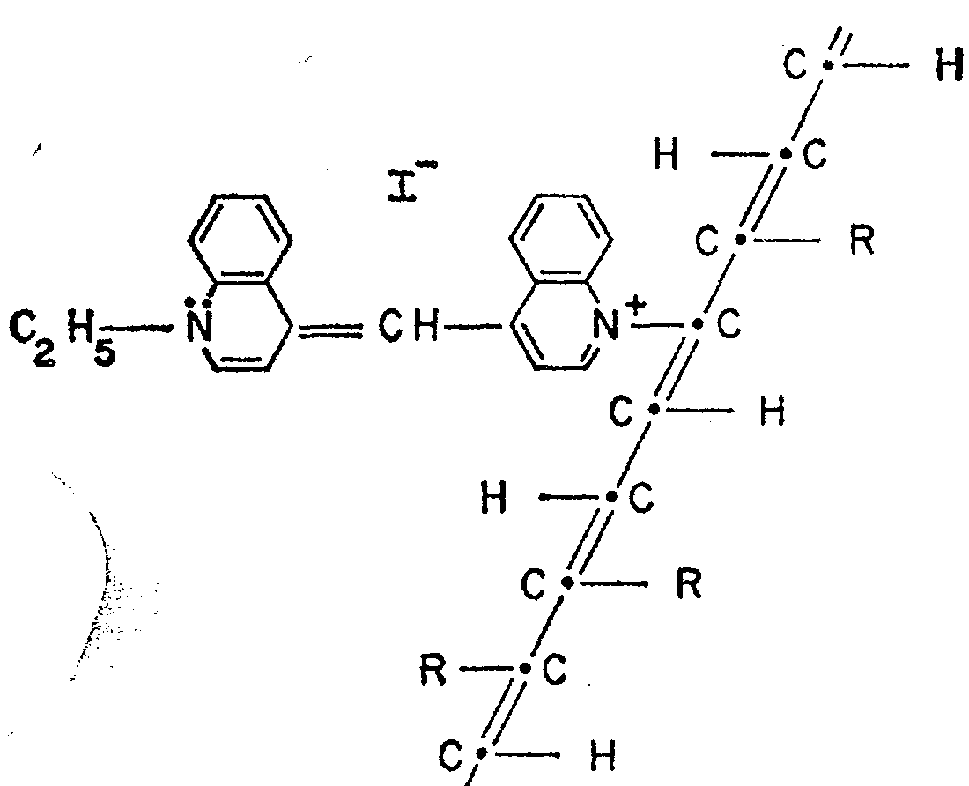
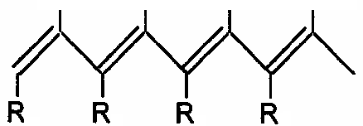
Was “organic superconductivity” the only promised land?
Not quite : some of the prophet's visions actually
imply a spontaneous electric polarization,
hence they are Pyro/Ferro-Electics.
Drawing - PRB 1964 - pyroelectric
His later popular drawing (Sci. Am.)
Questionably a superconductor,
It must be a ferroelectric.

Slide 37
Supplementary:
Relaxation in the electronic ferroelectric.

Slide 38
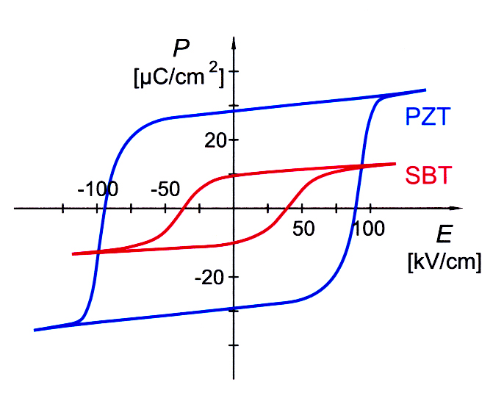
The hysteresis loop
in traditional FEs: PZT, SBT
Why the hysteresis loop:
P is retarded with respect to E.
Finite backward E_{t} is necessary to switch the sign of E.
Pinning of domain walls by lattice defects!
Notes:
to come slowly to fefets: two important ferroelectric materials used in fefets
PZT: Lead Zirconate Titanate
a particular phase transition appears at a certain mixture ratio – the so-called morphotropic phase boundary marks this transition.
leads to 14 different polarization directions -> highly polarizable state, which is often exploited for certain applications
SBT: Strontium Bismuth Tantalate

Slide 39
HYSTERESIS ?
Go to low T, introduce the defects
Δ~300 K
Polarizations inclined → normal component of electric field E
→ surface charge. Unusually, it is screened by current carriers, no field goes out of the sample → no need for a domain structure.
Mono-domain state → gigantic ε’ and χ₂ (global symmetry breaking)
ac current
Domain walls sweep in the course of re-polarization by ac current.
Jump of the longitudinal polarization  makes the wall charged.
Hence the accompanying cloud of normal carriers
which resistance gives rise to the observed activated damping at low T.
v. v. : domain wall concentrates carriers, effecting || & ┴ conduction

Slide 40
Do we see the motion of FE solitons - walls ? Yes at T<T_{c}
Frequency dependence of imaginary part of ε= ε′+iε′′
Comparison of frequency f dependence of ε′′(f) at two temperatures near T_{c}:
above - 105K and below - 97K.
Low frequency shoulder - only at T<Tc :
pinning of FE domain walls, hidden hystresis ?
Relaxation time τ(T) in a wide temperature range.
Main peak: Activation energy Δ_{τ}=322K well correlates with the conductivity activation Δ_{σ}≈350K
Low T – friction of FE domain walls by charge carriers, ferroelectric polarization dissipates via charge carrier - spinlesss solitons (holons).
Critical slowing down near T_{c}, Landau-Khalatnikov critical relaxation

Slide 42
frequency f dependence of imaginary part ε"
ε′′(f) curves at two temperatures
around T_{c}=102K,
above - 105K and below - 97K.
Low frequency shoulder –
only at T<Tc :
pinning of FE domain walls
i.e. hidden hysteresis ?
τ(T) =1/f_{m}

Slide 43
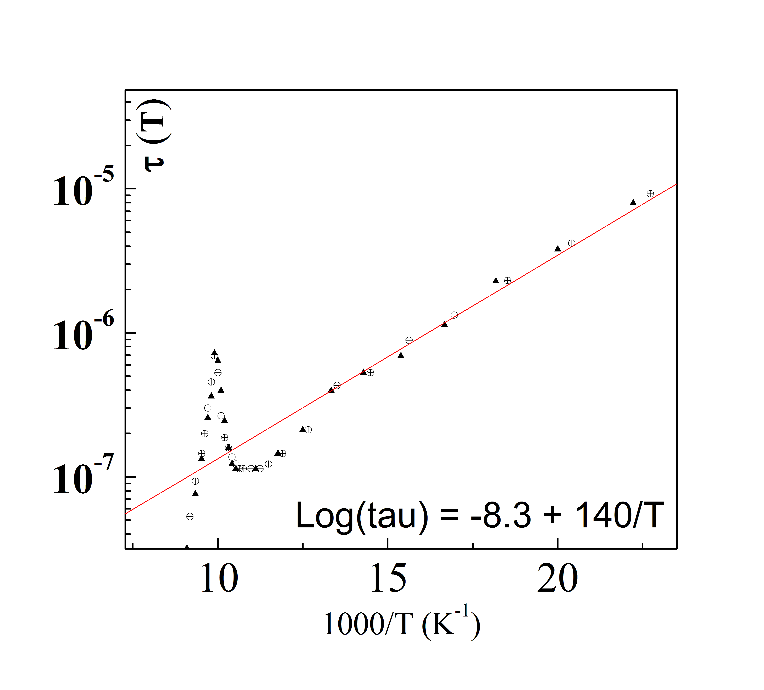
Relaxation time τ(T) in a wide temperature range.
τ(T) =1/f_{m} is given by
the maximum position
f_{m} of ε"(f)
Perfect low T activation law.
Activation energy Δ_{τ}=322K
well correlates with the conductivity activation Δ_{σ}≈350K ➔ ferroelectric polarization
dissipates via charge carriers
spinlesss solitons (holons).
Proof for the FE and I-V interference
critical
relaxation

Slide 44
Advantage of using the inverse complex function: ε=ε'+iε" → 1/ε=μ= μ'+iμ"
5.5x10
5
5.0x10
5
ε"
μ'
4.5x10
5
10⁻⁶
4.0x10
5
μ"~f^{n}
n=0.86
3.5x10
5
3.0x10
5
μ"
2.5x10
5
2.0x10
5
1.5x10
5
f
f
5
6
7
1.0x10
5
10
10
10
100000
1000000
1E7
Log-Log plots of ε" and μ',μ'' above Tc : T=105K
Hump in ε" → straight line for μ" over the whole interval of f.
The power law μ" ~f^{n} with n=0.86±0.01.
The exponent 0.86 is not 1 as in mean field theory of critical relaxation
- unexpected access to the profound dynamical scaling at the criticality.

Slide 45
Below Tc : T=97K
10⁻⁵
μ"~f^{n} , n=0.78
Log-Log
scales
10⁻⁶
μ'
μ"
f
10⁻⁷
10kHz
100kHz
10MHz
Log-Log plot still recovers a good straight line
but only at sufficiently high f.
The power law is μ"~f^{n} with n=0.78
– not far from n=0.86 for T=105K but beyond our accuracy 0.02.
This fit covers symmetrically both slopes of the maximum of ε".
Now we extrapolate and subtract the straight line, to single out the contribution of the low f shoulder in μ" and ε".

Slide 46
Separation of the low f feature - now it shows up sharply
and can be plotted in Lin-Lin scales. FINAL RESULT :
μ"
Isolated low frequency contribution
to the imaginary part μ"
of the inverse permittivity.
1x10⁻⁷
2x10⁻⁸
f
4
5
5
5
5
5
50kHz
1.0x10
1.5x10
200kHz
300kHz
Presumably: pinning of sweeping domain walls, weak hysteresis.

Slide 47
CONCLUSIONS on dynamics of the FE conductors
Simultaneous analysis of real and imaginary parts of the
inverse permittivity allows to separate several dynamic regimes.
critical slowing down characterized by anomalous powers
0.86 and 0.78 - above and below the phase transition.
b. low frequency response of the re-polarization, associated to
sweeping of domain walls below Tc.
c. low T viscosity of the FE polarization follows the concentration of normal conducting carriers – the spinless solitons.

